Slide 1
NLM Value Set Authority Center
eMeasures Issues Group (eMIG)
May 24, 2012
NLM
Curation and delivery of value sets for eMeasures

Slide 2
Overview
Motivation for a Value Set Authority Center at NLM
NLM Terminology services
In support of value set curation
In support of value set development
Value set repository
Value set delivery

Slide 3
Between eMeasures and Code Systems
Value Sets
eMeasures
eMeasure
development
Code Systems
Value set curation

Slide 4
Motivation Value set development
Value set development requires integration with terminology services
Find codes using synonyms, approximate matches, …
Exploit the structure of code systems
All procedures requiring fluoroscopy
All drugs containing “Macrolides” as an ingredient

Slide 5
Motivation Value set curation
Value set curation
Ensure referential integrity
All codes in a VS are valid codes in the corresponding code system
2474318017 (urine screen for chlamydia) – code for the term (wrong)
412761009 (urine screen for chlamydia) – code for the concept (OK)
Update VSs when the code systems are updated (no “stale” codes)
346892 (Amoxicillin 25 MG/ML Oral Suspension) – obsolete code
313797 (Amoxicillin 25 MG/ML Oral Suspension) – active code
Avoid duplication
Find value sets having similar members
In the same code system
Across code systems (using UMLS concept mappings)
Between intensional and extensional definitions

Slide 6
Motivation Value set delivery
Value set delivery
Authoritative
Curated value sets
Latest version
Previous versions archived & available for reference
Format
Human-readable format
Web site, HTML-based
Machine-readable format
Web service, XML-based

Slide 7
Between developers and consumers of VSs
Phase 2
Phase 1
Authorship
Curation Delivery
Consumption
Integration with Authoring Tool(s) to support value set authorship
Web page population for human consumption
Controlled Value Set Repository & Validation Engine
API
Free-standing, web-based value set authoring tool(s)
Web download / web services for machine consumption
API
Value Set / Measure Authors
Consensus Organization(s)
NLM
ONC
Consensus Org(s)
NLM
Vendors
Providers
Public Health Orgs
Courtesy of J. Reider (ONC)

Slide 8
Terminology at NLM
NLM has a long tradition of integrating terminologies
Unified Medical Language System (UMLS)
RxNorm
NLM provides terminology services
UMLS Terminology Services (UTS) API
RxNorm API
NLM is involved in terminology development
In house development
Medical Subject Headings (MeSH)
U.S. extension of SNOMED CT
Funding support
SNOMED CT, LOINC, …

Slide 9
Terminology services UMLS
Unified Medical Language System (UMLS)
Contains all major terminologies required for MU2 (SNOMED CT, RxNorm, LOINC, …)
Updated twice a year (May and November)
Provides terminology services (UTS = UMLS Terminology Services)
Search by name, by code
Exact, normalized, approximate matches
Within or across code systems
Access to the structure of a code system
Hierarchical and other relations

Slide 10
Terminology services UMLS (cont.)
Unified Medical Language System (UMLS)
Multiple interfaces
Graphical – UTS browser
Application Programming Interface (API)
Ensures protection of intellectual property
UMLS license agreement
UTS authentication

Slide 11
Terminology services RxNorm
RxNorm
Integrates names and codes from multiple drug information sources (First DataBank, Multum, SNOMED CT, NDF-RT, Structured Product Labels,…)
Updated monthly (with weekly additions)
Provides terminology services (similar to UTS)
Multiple interfaces
Graphical – RxNav browser
Application Programming Interface (API)

Slide 12
Terminology services and value set curation
Terminology services are useful for value set curation
Referential integrity
Identify if a code exists in a code system
Including specific versions
Map obsolete codes to current codes
Identify if a term corresponds to a code
Similarity
Identify similar value sets
Across code systems through UMLS mappings
Between intensional and extensional definitions
Value set curation also involves
Informing VS developers of changes to the code systems
Coordinating with VS developers for validating changes

Slide 13
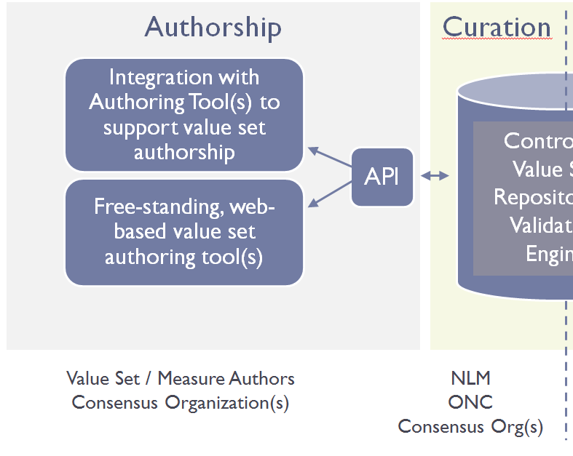
Terminology services and value set development
Interface between terminology services and value set authoring tools
Integration through APIs (Phase 2)
Ensure referential integrity
Access to the latest version of code systems
VS authoring tools can focus on VS, not terminology

Slide 14
Value set repository Charateristics
One-stop shop for all value sets for MU
Authoritative source
Curated value sets
Latest version (& archived previous versions)
Publicly available
But does not mean value sets are in the public domain; copyrights and, in some cases licensing restrictions, apply
Used by
eMeasure developers (check existing value sets)
Value set developers (get terminology, validate value sets)
eMeasure implementers (get curated value sets)

Slide 15
Metadata for value sets
Several metadata schemata
CTS2 (Common Terminology Services)
IHE SVS (Sharing Value Sets)
…
Major metadata elements
Value set identification (OID) + version
Code system + version
Author
Creation date
Purpose
eMeasures associated with
…

Slide 16
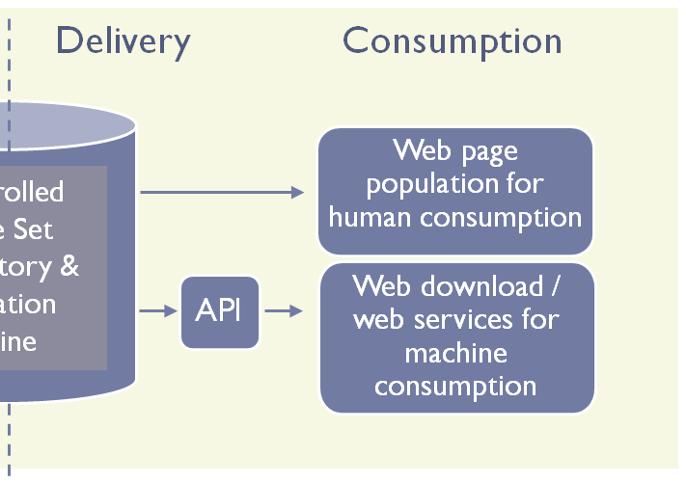
Value set delivery
Search for published value sets
By name, identifier (OID), members (codes)
Additional metadata (author, date, measure(s), message segment(s), etc.)
Retrieve value sets and their metadata
Human consumption
Web display
HTML-based
Machine consumption
Download + Access through an API
XML-based

