Slide 1
Appendix B – Checklist for
Review of Adherence to General Standards
Peer Review Training – National Science Foundation
August 16, 2012
Kieu Rubb, Treasury OIG ~ rubbk@oig.treas.gov ~ 202-927-5904

Slide 2

What I’ll Cover Today
Purpose of Appendix B
Details of GAS:
  Independence
  Competence
  Quality Control and Assurance
  Professional Judgment
Questions

Slide 3
Purpose
Test Audit Organization’s Compliance with General Standards
  How much testing?
General Standards | 2011 GAS | 2007 GAS
Independence | 3.01-3.59 | 3.02-3.30
Professional Judgment | 3.60-3.68 | 3.31-3.39
Competence | 3.69-3.81 | 3.40-3.49
Quality Control & Assurance | 3.82-3.95 | 3.50-3.69

Slide 4
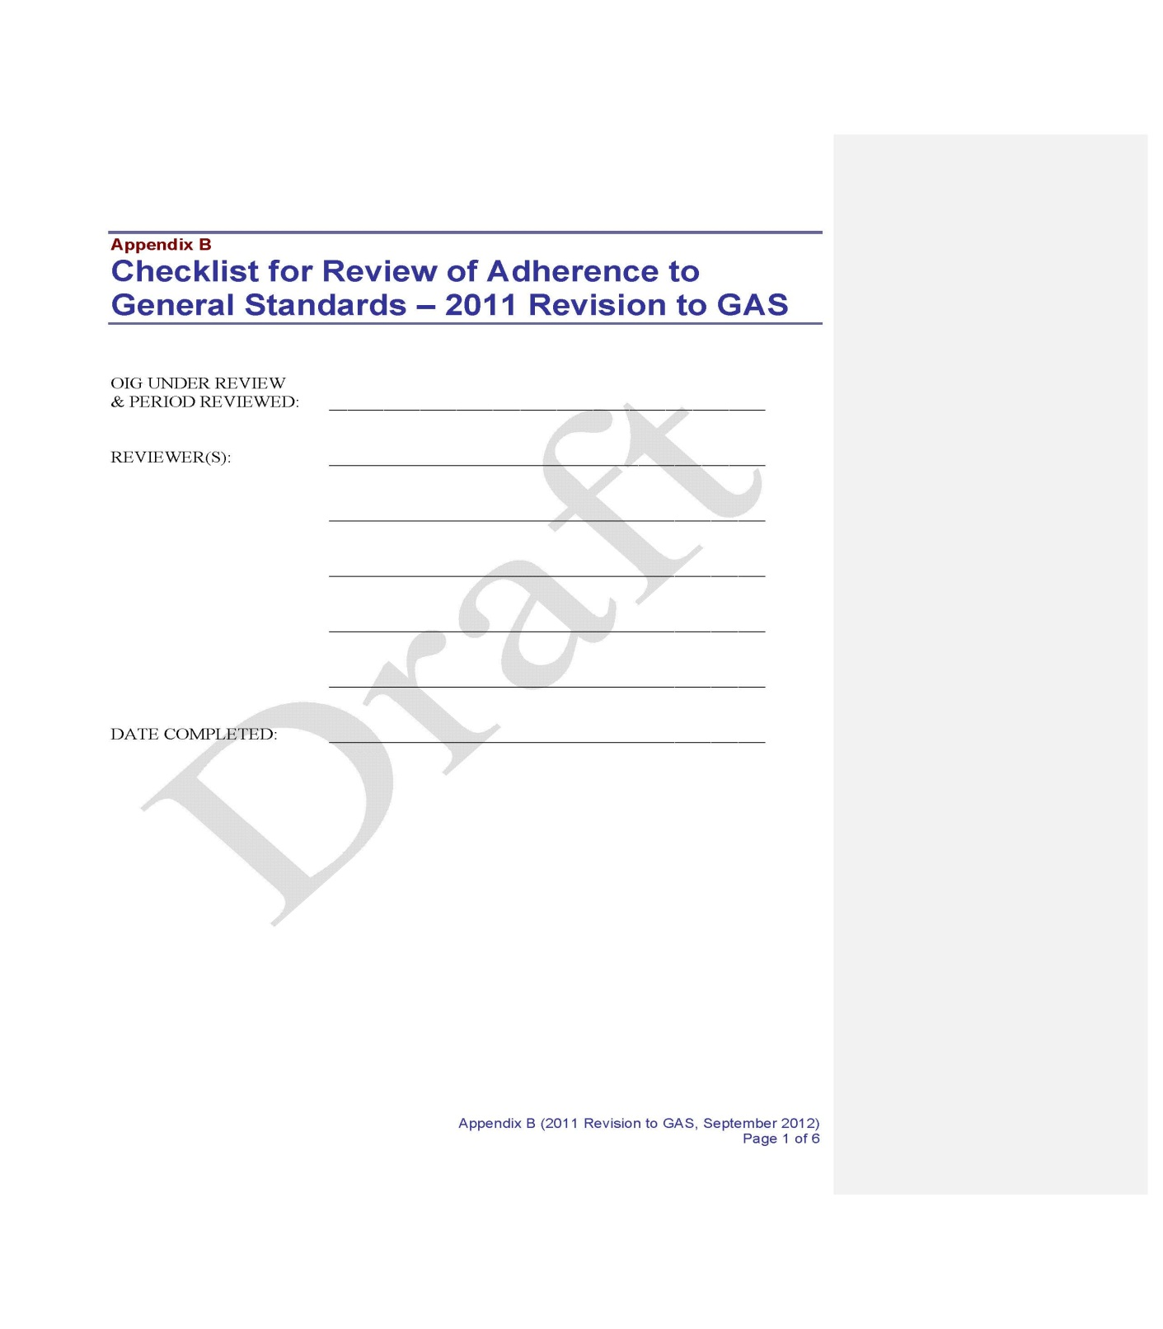
Appendix B

Slide 5
Independence
2011 GAS | 2007 GAS
In all matters relating to the audit work, the organization and auditor:
Must be independent of mind and in appearance | Must be free from personal, external, organization impairments
Identify/evaluate threats to independence and reduce/eliminate them by adopting safeguards | Avoid appearance of impairments with policies/procedures, communications, monitoring, disciplinary, stress importance
Types of threats include self-interest, self-review, bias, familiarity, undue influence, and management participation | Personal and professional relationships, beliefs and biases, employment interests, and financial interests
Structural - organization placement and reporting level within entity | External forces and organizational placement
Nonaudit services may create threats to independence | Nonaudit and other services provided to the auditee may create impairment.
Decline the engagement or terminate an in-progress engagement if safeguards do not reduce or eliminate threats | If impairments can effect or appear to affect independence, decline to perform work or disclose the impairments and modify the GAGAS compliance statement

Slide 6

Independence of Mind
  GAS 3.03.a – The state of mind that permits the performance of an audit without being affected by influences that compromise professional judgments, thereby allowing an individual to act with integrity and exercise objectivity and professional skepticism.

Slide 7

Independence in Appearance
  GAS 3.03.b. – The absence of circumstances that would cause a reasonable and informed third party, having knowledge of relevant information, to reasonably conclude that the integrity, objectivity, or professional skepticism of an audit organization or member of the audit team had been compromised.

Slide 8
Independence Framework
  Conceptual framework to help auditors identify, evaluate, and apply threats to independence based on facts and circumstances unique to the audits
    Prohibited activities
    Identifying and removing threats
    Implementing safeguards

Slide 9

Independence
Things to Consider
  Auditors/audit organizations’ opinions, findings, conclusions, judgments, recommendations are impartial
  Threats to individual auditors and safeguards
  Structural threats and safeguards
  Agency organizational chart, nonaudit services provided, SAR, policies and procedures, audit and related documentation, and other documents
  Interviews and observations
  Documentation of independence considerations (2011 GAS 3.59)
  Independence certification or financial disclosure
  Independence checklists
  Other documents or procedures

Slide 10
Independence
More Things to Consider
2011 | 2007
Document consideration of management’s ability to oversee nonaudit services | Establish policies/procedures whether to accept nonaudit services
Evaluate whether to accept nonaudit services | Evaluate whether to accept nonaudit services
Obtain management assurance for performing management functions | Documentation independence considerations specific to nonaudit services when no impairment (GAS 3.30)
Establish and document the auditors’ understanding with management for nonaudit services and requirements | Obtain written understanding with auditee, exclude audit personnel from team, no scope reduction

Slide 11

Independence
Examples
  I worked in CFO before moving to OIG and was in charge of Accounts Payable in FY 2012. Can I perform the audit of the FY 2012 statements?
  I was assigned to audit the manufacturing process at the Philadelphia Mint facility and my uncle is the deputy plant manager, can I perform the audit?
  I am seeking employment with the Office of the Comptroller of the Currency, can I perform an audit of one of their failed banks?

Slide 12
Competence
Staff assigned to perform audit must collectively possess adequate professional competence needed to address objectives and perform work
  Recruitment, hiring, continuous development, assignment, and evaluation
  Blending of education and experience
  Access to audit standards and reference materials
  New hires have adequate education and experience
  Technical skills
  CPE requirements

Slide 13
Competence
Things to Consider
  Interviews/observations
  Review HR and training records and audit documentation
  GAGAS, environment/subject matter, statistical sampling, IT, engineering, actuary, general skills, communication skills
  GAAP or applicable financial framework (2011 GAS), AICPA, SAS, SSAE, CPAs or working for CPAs
  Nature, extent, formality of programs, policies, procedures depend on organization’s size, structure, work

Slide 14
Competence
  External Specialists
    2007 – auditors should assess qualifications and competency and document such conclusions
    2011 – no documentation required but make sure qualified and competent
  Internal Specialists
    2007 – part of the audit organization and perform as a member of the audit team should comply with GAGAS CPE requirements
    2011 – do not need to meet GAGAS CPE requirements when do not direct, perform, report as part of the audit team

Slide 15

Quality Control and Assurance
System Encompasses:
  Policies and procedures
  Leadership
  Communication
  Independence, legal, ethical
  Assignments
  People and competencies
  Audit work and documentation
  Monitoring

Slide 16
Quality Control and Assurance
What?
  Establish as system of quality control designed to provide reasonable assurance of compliance with professional standards and applicable legal and regulatory requirements
  Have external peer review every 3 years

Slide 17

Quality Control Monitoring
Things to Consider
  Policies and procedures, monitoring program, SAR
  Interviews and observations
  Audit assignments
  Other procedures

Slide 18
OIG’s Monitoring Program
  What to look for:
      Are there policies and procedures
      Is monitoring done
      Is it done annually
      Does the team collectively have sufficient expertise and authority
      Are results analyzed and summarized
      Are systemic issues reported
      Are corrective actions taken

Slide 19

OIG’s Monitoring Program
Does OIG perform monitoring to assess compliance with standards and policies/procedures?
Things to Consider
    Sample monitoring reports and documentation
    Include in peer review sample engagements also reviewed by monitoring team
    Interviews and observations
    Other procedures

Slide 20

Monitoring Reports
Determine whether monitoring reports:
  Described work performed
  Were recent enough to be of value
  Scope of work sufficiently comprehensive

Slide 21
Monitoring Documentation
Determine whether documentation are adequate and …
  Indicated team performed all work necessary to satisfy review objectives
  Indicated proper supervision
  Supported findings and recommendations

Slide 22
Monitoring Recommendations
Determine whether recommendations:
  Supported by adequate documentation
  Included written comments from responsible OIG official with corrective actions taken or proposed (and adequately assessed)
  Tracked and monitored to ensure corrective action taken

Slide 23
Monitoring and Peer Reviews
GAS says to include monitoring in peer review
  Quality control policies and procedures
  Adequacy/results internal monitoring
  Risk assessment
2011 GAS – Peer review team uses professional judgment in deciding type of peer review report to issue

Slide 24

External Peer Reviews
Did the OIG:
  Receive external peer review performed by independent reviewers within the last 3 years?
  Communicate peer review results and made reports available to appropriate oversight bodies?
  Include peer review report results and mention of review conducted in SAR?

Slide 25
Professional Judgment
What?
  Must use professional judgment in planning and performing audits and reporting results
  Exercising reasonable care and professional skepticism
  Acting diligently, complying with applicable professional standards and ethical principles
  Comments:
    Difficult to test
    Not generally tested in Appendix B
    Tested as part of sampled engagement covered in Appendices C, D, E, F

Slide 26

Professional Judgment
How? Did audit show that Auditors had:
  Questioning mind
  Critically assessed evidence
  Performed work in good faith
    and with integrity
  Objectively evaluated information
  Collective knowledge, skills, and
    experience of all personnel involved with audit
  Documented significant decisions affecting the objectives, scope, methodology, findings, conclusions, and recommendations
  Reasonable documentation

Slide 27

Professional Judgment
Things to Consider
  Subjective
  Professional Judgment
  Observations
  Interviews
  Records and audit
  documentation
  Other procedures

Slide 28
How Much Testing?
Nature and extent should be sufficiently comprehensive to provide a reasonable basis for conclusion and depends on:
  Adequacy policies and procedures
  Compliance with policies and procedures
  Prior peer review results
  Organization’s structure and size
  Monitoring results
  Other factors

Slide 29

Something to think about
Audit organizations and their system of quality control are set up differently – informal, formal, big, small, centralized, decentralized, geographically dispersed. Different is ok as long as the controls are in place and functioning as intended.

Slide 30


Appendix B
Contact Information: Kieu Rubb, Treasury OIG 202-927-5904, rubbk@oig.treas.gov
APRG@oig.treas.gov - For questions or comments on the guide or peer reviews

