Slide 1
Improving Preventive Care for Older Americans Oregon Evidence-Based Practice Center/ Kaiser Permanente Center for Health Research
1
Principal Investigator: Evelyn P. Whitlock, MD, MPH
Elizabeth Eckstrom, MD, MPH
David Feeny, PhD
Jennifer Lin, MD, MCR
Rongwei Fu, PhD
Leslie A. Perdue, MPH
Tracy L. Beil, MS

Slide 2
What are the most important challenges in synthesizing the evidence on prevention in older adults?

Slide 3
Which outcomes do you measure when lengthening life is no longer the primary goal?
Focus shifts to Health Related Quality of Life and Function
More reliance on self-reported measures: but are they reliable?
Test-retest reliability
Inter-observer reliability
Do these measures have evidence for validity in older people?
Criterion validity
Cross-sectional construct validity
Longitudinal construct validity (responsiveness)

Slide 4
The Pitfalls of “Effect Size”
Distribution based scales may be difficult to translate to clinically important change
COPE trial- caregiver training for dementia subjects showed “.24” change in ADL/IADLs. This was statistically significant. But does it mean subjects got modest improvement in one ADL? Or a small improvement in multiple ADLs? Was the change enough to make the subjects more independent (ie, less work for the caregiver)?
Anchor based criteria might be easier to translate

Slide 5
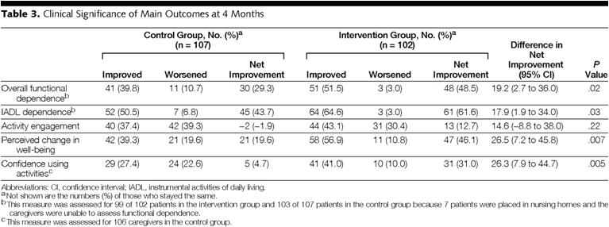
Better Yet: Translate numbers to “Percent Improved”
Clinical Significance of Main Outcomes at 4 Months
Gitlin, L. N. et al. JAMA 2010;304:983-991

Slide 6
More Methodologic Challenges in Outcomes
Large inter-study variation in outcome reporting (domains measured, domain-specific measures chosen and reported) within a body of evidence
Floor and ceiling effect issues for measures
How much time is needed for change to occur?
What is the minimum clinically important difference?

Slide 7
Challenges in Synthesizing Results: Considering a Constellation of Outcomes Example from Multifactorial Intervention and Management to prevent Functional Decline
7
ADL k=12
Total Trials k=63
IADL k=10
Meta-Analysis k=51
Hospitalization
k=13
Mortality k=44
Institutionalization
k=15
Notes:
Outcomes varied widely in whether reported, what reported, how reported, and timing of outcome measurement
GIVEN THAT MANY INTERVENTIONS SPECIFIC TO OLDER ADULTS ARE COMPLEX , MULTICOMPONENT INTERVENTIONS THAT MAY BE TARGETED TO SPECIFIC RISK GROUPS OR TAILORED TO INDIVIDUAL RISK FACTORS (SUCH AS DISABILITY PREVENTION, RE-HOSPITALIZATION PREVENTION, FALLS PREVENTIONS) AND MEASURE A LARGE NUMBER OF RELATED OUTCOMES, WE ARE WORKING TO UNDERSTAND CURRENT THINKING IN THE FIELD ABOUT THE BEST WAY TO FAIRLY SYNTHESIZE THESE FOR PRACTITIONERS AND POLICY MAKERS.

Slide 8
Outcomes represent different bodies of evidence; how would you give one summary grade for the review?
8
ADL (k=12)
IADL (k=10)
3
Hospitalization
(k=13)
1
6
Institutionalization (k=15)

Slide 9
Challenges in synthesizing intervention studies
9
POPULATION: Baseline risk often varies study to study, unclear if “appropriate” risk population was identified for that intervention
Inconsistent reporting of patient risk and use of mean differences without subgroup explorations limit ability to determine if there are differential effects by subgroups
INTERVENTION: Often very broad and clinically heterogeneous array of interventions—difficult to fairly consider or categorize
COMPARISON: Older people have a variable trajectory- harder to determine if groups similar—especially without randomization
OUTCOMES: NOT independent of each other
Very small impact of some MFAM interventions on ADL and IADL
Inconsistent reporting of a set of outcomes limits ability to determine true benefit—as may reduce hospitalizations but increase institutionalization
Notes:
9
9

Slide 10
How do you think these challenges are different for older adults than for younger adults?

Slide 11
Relative lack of research
Older adults are relatively understudied as a group, and extrapolation from younger adults may not be accurate

Slide 12
Health Trajectories
Older people with similar baseline health status may decline at markedly different rates
Concept of “Compression of Morbidity”
Large, population-based cohort studies needed to ascertain range of possible trajectories and define predictors for those trajectories

Slide 13
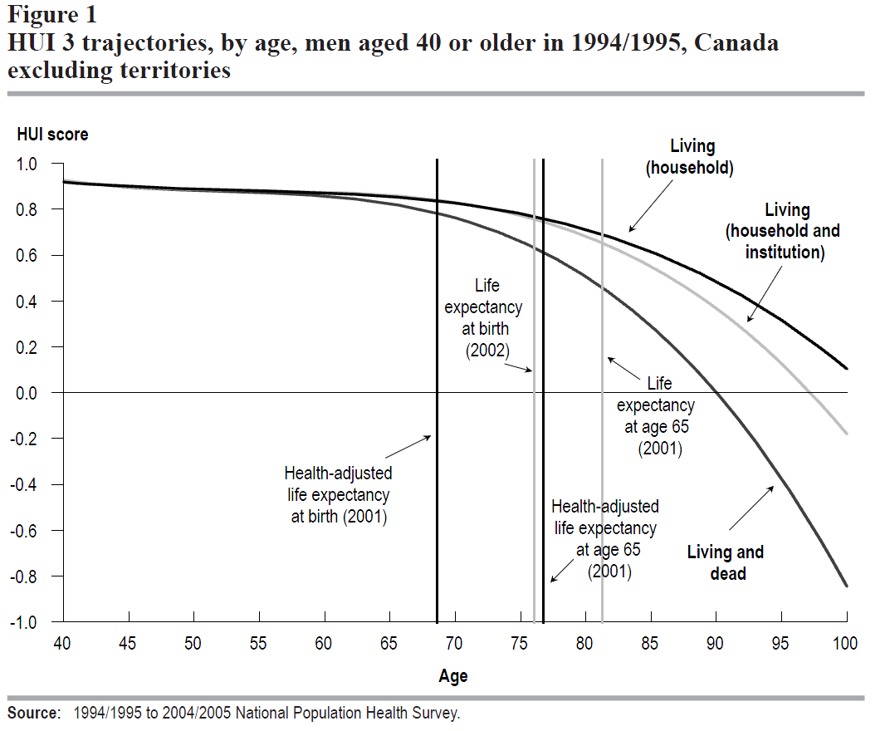
Orpana, Heather M., Nancy Ross, David Feeny, Bentson McFarland, Julie Bernier, and Mark S. Kaplan, “The Natural History of Health-Related Quality of Life: A 10-year Cohort Study.” Health Reports, Vol. 20, No. 1, March, 2009, pp 29-35
Notes:
Both slides illustrate the selection biases associated with following only those who survive and remain in the community or only those who survive.
The “effect” of the “living and dead” for males illustrates their higher rates of mortality.

Slide 14
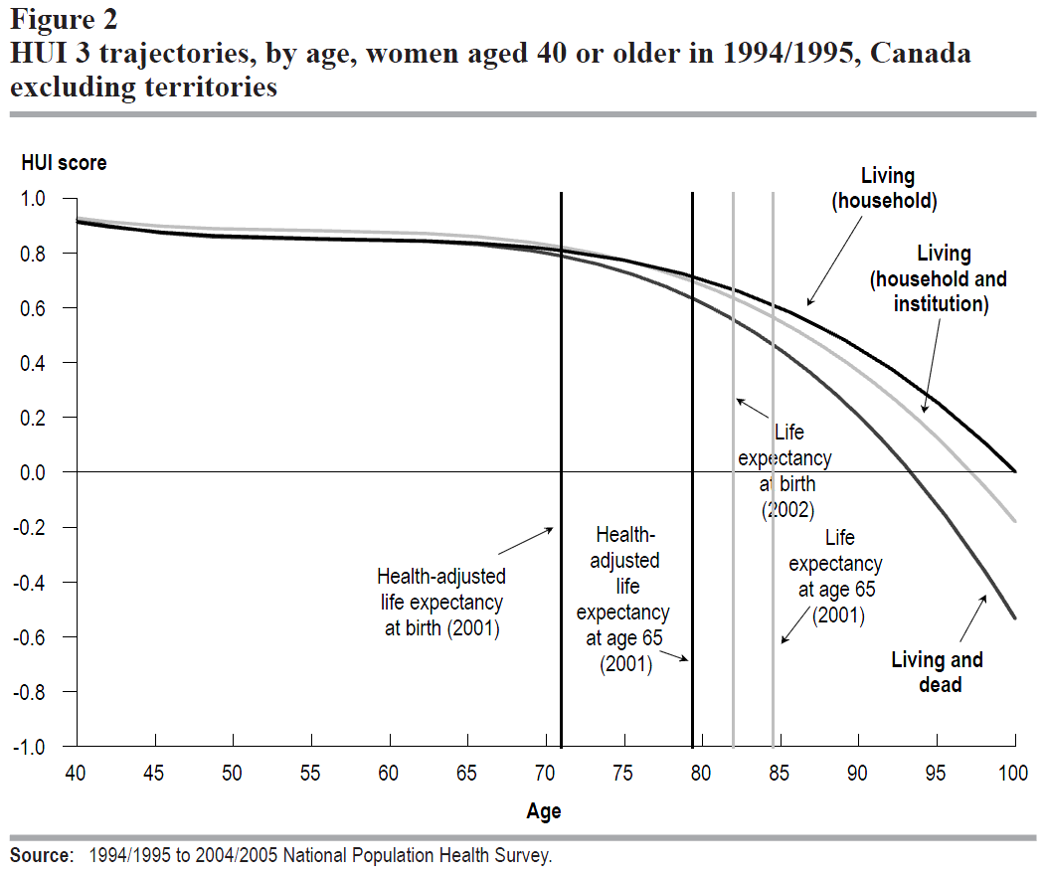
Orpana, Heather M., Nancy Ross, David Feeny, Bentson McFarland, Julie Bernier, and Mark S. Kaplan, “The Natural History of Health-Related Quality of Life: A 10-year Cohort Study.” Health Reports, Vol. 20, No. 1, March, 2009, pp 29-35

Slide 15
Assessing Net Benefit
Measuring net benefit for functional outcomes
Many different functional scales (Katz ADL, Lawton/ Brody IADL, SF-36 Physical Function, etc)
Challenge to synthesize results into a single effect size
Consider absolute magnitude of the change in function and defining proportion improved, not changed, or worsened
Benefits and harms may be completely different constructs so how do you compare?
Benefit might be reduced caregiver burnout, harm might be a fall- how do you compare these?

Slide 16
Assessing Harms
Often inadequate assessment/ representation of harms
Few RCTs of older people so harms not well quantified (need to utilize observational studies better)
Harms usually restricted to the screening itself; eg, pain of biopsy. Need to broaden scope (daughter must miss ½ day of work to take mom to mammogram)

Slide 17
Health Related Quality of Life
HRQOL particularly important for older adults with limited life expectancy
Many RCTs have not included HRQOL as an outcome measure, so we are stuck not being able to broaden our scope of benefit and harm to include HRQOL

Slide 18
What’s needed to enhance this field?
Consistent and complete ascertainment and reporting of study population baseline risk
understand population’s natural history of progression or risk for functional decline
investigate impact of effectiveness of interventions in subgroups at higher risk for poor outcomes
Standardized reporting of intervention descriptions to help better characterize complex interventions and to compare across different interventions
More research needed to test consistent models or intervention components
Detailed reporting about instruments for ADL/IADL and HRQOL measures
Focused and consistent set of agreed upon measures and reporting of measures
Consistent use and reporting of a constellation of outcomes that characterize net health benefit or harm

Slide 19
Comments & Questions
19

