Slide 1
Director’s Update
Carolyn Clancy, MD
National Advisory Council
November 4, 2011

Slide 2
NAC Members With Expiring Terms
Nancy E. Donaldson
Arthur (Tim) Garson
Junius J. Gonzales
Lisa M. Latts
Keith J. Mueller
Xavier Sevilla
Bruce Siegel (Chair)
Jane Sisk – retired from CDC

Slide 3
Overview
The Big Picture
  FY 2012 Budget Request
Recent Accomplishments
  In the News
  Impact Case Studies
AHRQ Program Updates
Today’s Agenda

Slide 4
FY 2012 Budget Proposal
The President’s proposed FY 2012 budget for AHRQ includes:
  $65 million for patient safety research, including $34 million to reduce and prevent healthcare-associated infections
  $46 million for patient-centered health research, of which $24 million comes from the Patient-Centered Outcomes Research Trust Fund
  $28 million for health information technology

Slide 5
Overview
The Big Picture
  FY 2012 Budget Request
Recent Accomplishments
  In the News
  Impact Case Studies
AHRQ Program Updates
Today’s Agenda

Slide 6

Nighttime-Breathing Treatments Most Effective to Treat Sleep Apnea
AHRQ comparative effectiveness report on treating sleep apnea:
  Estimated 12 million Americans have sleep apnea; millions more undiagnosed
  “CPAP” breathing machine most effective
  Mouthpiece worn at night also effective
  All treatments have possible side effects
www.effectivehealthcare.ahrq.gov/

Slide 7

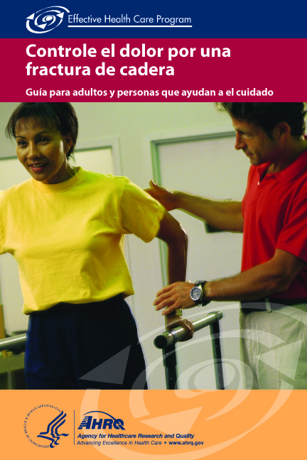

Guides Help Spanish Speakers Make Treatment Decisions
Guides in Spanish discuss treatment options for:
  Heart disease
  Managing pain from broken hip
  Rotator cuff tears
  Depression after brain injury
  Human growth hormone for children with cystic fibrosis
  Radiotherapy for head and neck cancer
AHRQ offers Spanish guides for a total of 23 different conditions
www.effectivehealthcare.ahrq.gov/index.cfm/informacion-en-espanol

Slide 8

Guides Compare Benefits,
Risks of Treatments for GERD
Plain-language summary guides for clinicians and consumers, based on evidence review from Effective Health Care Program
Compare treatments for GERD (gastroesophageal reflux disease)
Proton pump inhibitor medications are effective, but no differences between types and dosages
GERD (also known as acid reflux) affects up to 4 percent of Americans, costing an estimated $3,355 annually per patient
www.effectivehealthcare.ahrq.gov/

Slide 9

DMARDs Effective in
Treating Juvenile Arthritis
AHRQ comparative effectiveness report on treating juvenile arthritis:
  Affects up to 400 of every 100,000 children in the USA
  Development of disease-modifying anti-rheumatic drugs (DMARDs) has improved treatment of arthritis
  DMARDs more effective than traditional treatments in improving symptoms
  Long-term effects unknown
www.effectivehealthcare.ahrq.gov/

Slide 10
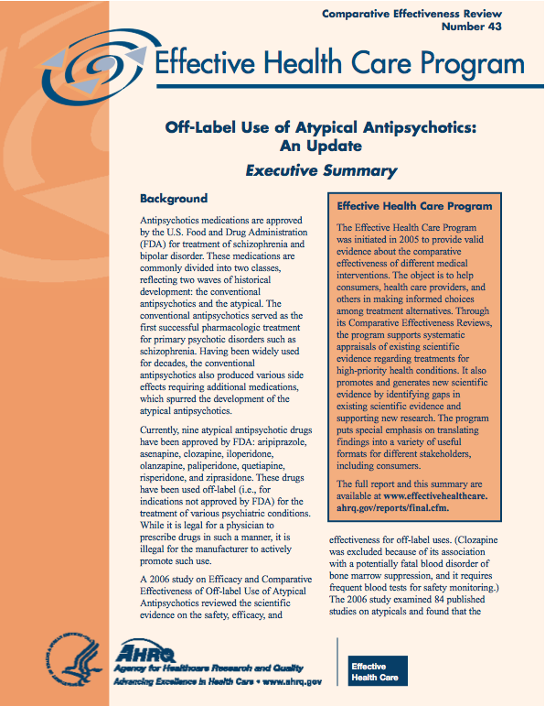
Little Evidence for Some ‘Off-Label’ Uses of Atypical Antipsychotic Drugs
Effective Health Care Program report shows little evidence to support off-label use of atypical antipsychotic medications (APMs) for substance abuse, eating disorders, or insomnia
Evidence does support use of some atypical APMs for dementia, anxiety, and obsessive-compulsive disorder
www.effectivehealthcare.ahrq.gov

Slide 11
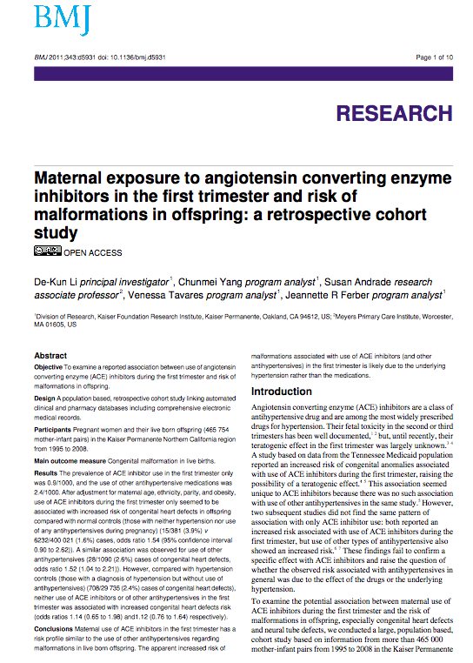
Birth Defects May Be Linked to Hypertension, NOT Treatment
Taking ACE inhibitors in first trimester of pregnancy poses no greater risk of birth defects than other high blood pressure medications or no drugs at all
Findings suggest high blood pressure itself may increase risk of birth defects, rather than treatment
ACE inhibitors are widely prescribed to treat hypertension
New study from Effective Health Care Program’s DEcIDE Network published in BMJ
Li DK, Yang C, Andrade S, et al. Maternal exposure to angiotensin converting enzyme inhibitors in the first trimester and risk of malformations in offspring: a retrospective cohort study. BMJ 2011; 343:d5931

Slide 12
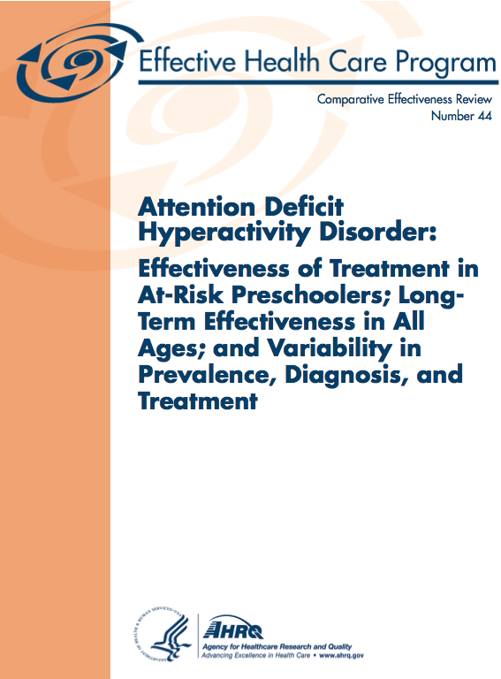
Formal Parent Training Effective To Treat Young Children With ADHD
AHRQ comparative effectiveness review on ADHD intervention and evaluation:
  Approximately 5 percent of children worldwide diagnosed with ADHD
  Formal training for parents is effective and does not harm children age 6 and under
  Less evidence supporting use of drugs such as Ritalin to treat children age 6 and under
www.effectivehealthcare.ahrq.gov/

Slide 13



AHRQ Creates Clinical Preventive Services Research Centers
3-year grants totaling $4.5 million
  Research focuses on improving clinical preventive services
  Advances national research agenda in health equity, patient safety, and health systems implementation
  Three centers:
    Northwestern University in Chicago
    University of North Carolina at Chapel Hill
    University of Colorado Anschutz Medical Campus
www.ahrq.gov/about/cp3

Slide 14
Research Centers for Excellence in Clinical Preventive Services
Centers will complement other Federal investments in prevention and public health by focusing on the role of primary care in improving the health of all Americans
Designed to support the National Prevention Strategy
Three focus areas:
  Safety: University of North Carolina at Chapel Hill
  Equity: Northwestern University
  Implementation: University of Colorado
3-year initial awards (with potential competitive renewal)
$1.5M per year per award
Initially funded through the ACA Prevention & Public Health Fund

Slide 15
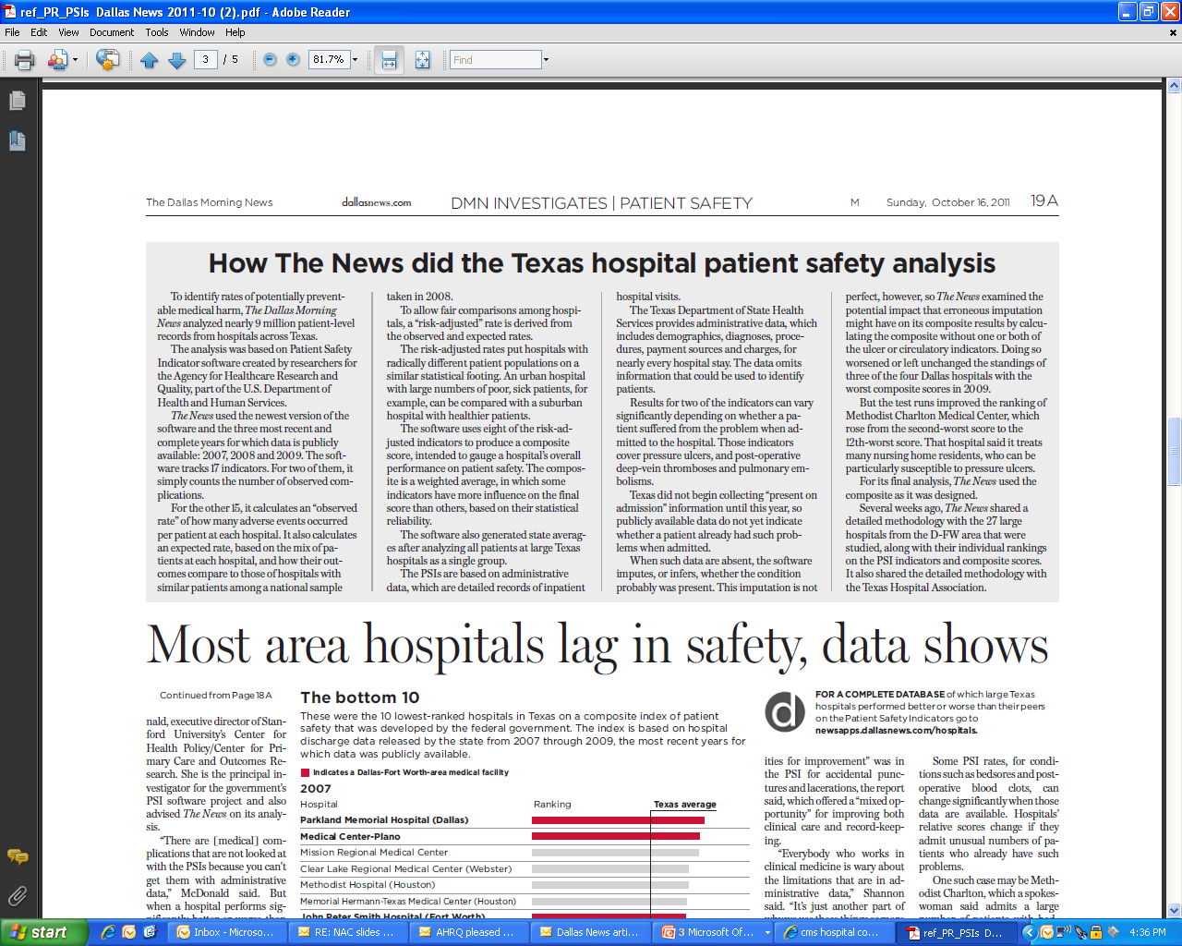
In the News
The Dallas Morning News reported on patient safety in TX hospitals using the AHRQ Patient Safety Indicators, Sunday, Oct. 16, 2011

Slide 16
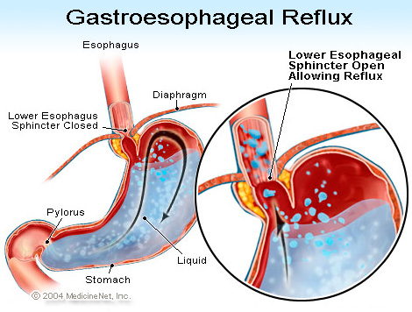
Knowledge Transfer Case Study: Washington State Medicaid
AHRQ’s Effective Health Care Program (EHC)
Used 6 EHC products:
  Vaginal Birth After Cesarean: to design new program
  Cesarean Delivery on Maternal Request: to enact legislation to develop patient decision aids
  Comparative Effectiveness of Management Strategies for Gastroesophageal Reflux Disease: to initiate clinical decisionmaking algorithm resulting in savings
Photo: MedicineNet, Inc.
(KT-CDOM/COE-67)

Slide 17

Knowledge Transfer Case Study:
Hawaii Dept. of Human Services
CAHPS Survey and Medicaid Medical Directors Learning Network
  Used survey findings for public reporting and pay-for-performance initiatives
  Found that CAHPS Health Plan Survey’s instruction reduced likelihood of bias and error
  Developed consumer guide using CAHPS results for adult care
  Members use performance information to choose plans based on quality of care
(KT-CQuIPS-68)

Slide 18
MEPS Impact Citation
Private Sector Uses
MEPS data used in various ways:
  By Kaiser Family Foundation as a source of online query tools in slide tutorial providing overview of health policy data source
  By Duke University to study whether use of physician assistants increases office visits
  By Deloitte Health Solutions to develop estimates of health expenditures by family size and income level for the report, The Hidden Costs of U.S. Health Care for Consumers: A Comprehensive Analysis
  By Johns Hopkins University’s Joint Center for Political and Economic Studies to estimate potential cost savings of eliminating health disparities for racial and ethnic minorities
CFACT 11-03

Slide 19
MEPS Impact Citations
Private Sector Uses
Mayo Clinic
  Used MEPS data to describe incidence of transitions to and from Medicaid and to characterize populations and determine whether insurance instability is associated with changes in health care utilization
  New America Foundation
  Used MEPS data in report on health insurance reform to illustrate how administrative costs could reach 45% for families purchasing non-group health insurance
(CFACT 11-03)

Slide 20
MEPS Impact Citations
Public Sector Uses
Oregon Department of Consumer and Business Services
  Used MEPS data on average total monthly group health insurance premiums in Health Insurance in Oregon, a yearly report for policymakers
(CFACT 11-02)

Slide 21

Missouri Department of
Health and Senior Services
AHRQ’s Safety Net Monitoring Initiative: Tools for Monitoring the Health Care Safety Net and the Healthcare Cost and Utilization Project (HCUP)
  Used in compiling first report of status of Missouri’s safety net
  Analyzed 118 measures of county-level safety net
  Ranking system highlighted counties with limited access, gaps in services, shortages of providers
  Policymakers can now identify priority areas in need of resources
(CDOM 11-02)

Slide 22

Health Literacy Missouri: University of Missouri Center for Health Policy
AHRQ’s Health Literacy Universal Precautions Toolkit
  Incorporated into practice management module for health literacy training, coaching for physicians
  Physicians work with literacy expert to develop plan for their practice
  Module approved by American Board of Internal Medicine as Maintenance of Certification program
Photo: Arkansas Progressive
(CP3 11-03)

Slide 23
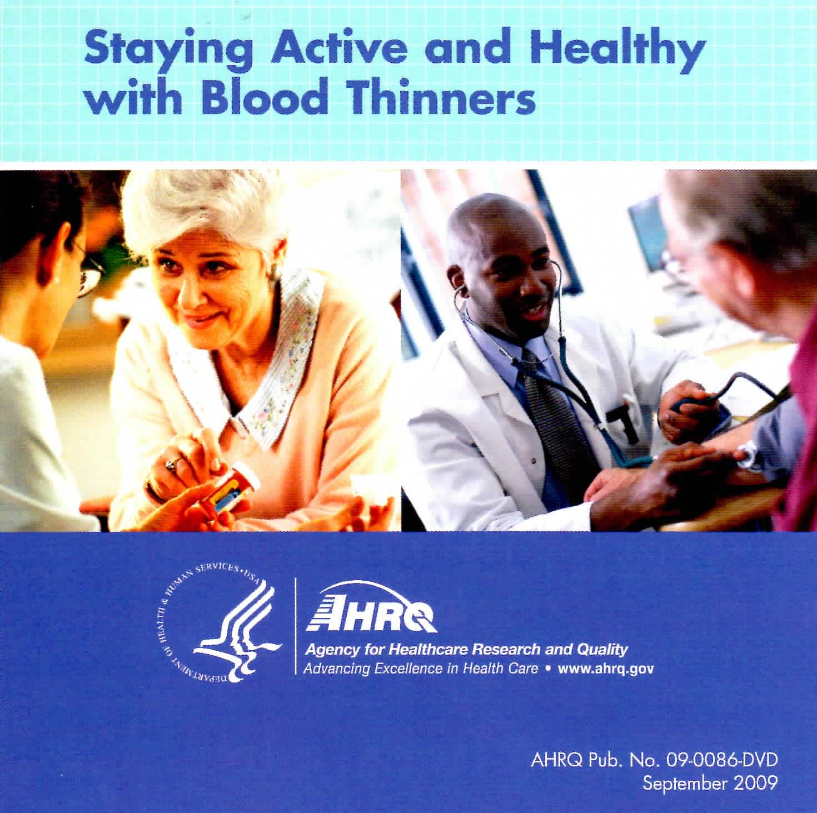
Fletcher Allen Health Care (VT)
AHRQ’s Staying Healthy and Active with Blood Thinners
  Incorporated into inpatient TV system and hospital patient education
  DVD had highest viewership of all educational listings
  Reaches 10-15 patients each week
  Coupled with individual education by a pharmacist and review of information with a nurse at discharge
(CQuIPS 11-03)

Slide 24
OSF Medical Group (IL/MI)
AHRQ’s Staying Active and Healthy with Blood Thinners
  Included in educational program helping patients safely manage anticoagulation therapy
  Used in primary care anticoagulation clinics in 5 regions, 1 hospital
  Clinics treat about 3,800 patients
  Links electronic medical record to AHRQ’s anticoagulation education material
(CQuIPS 11-04)

Slide 25
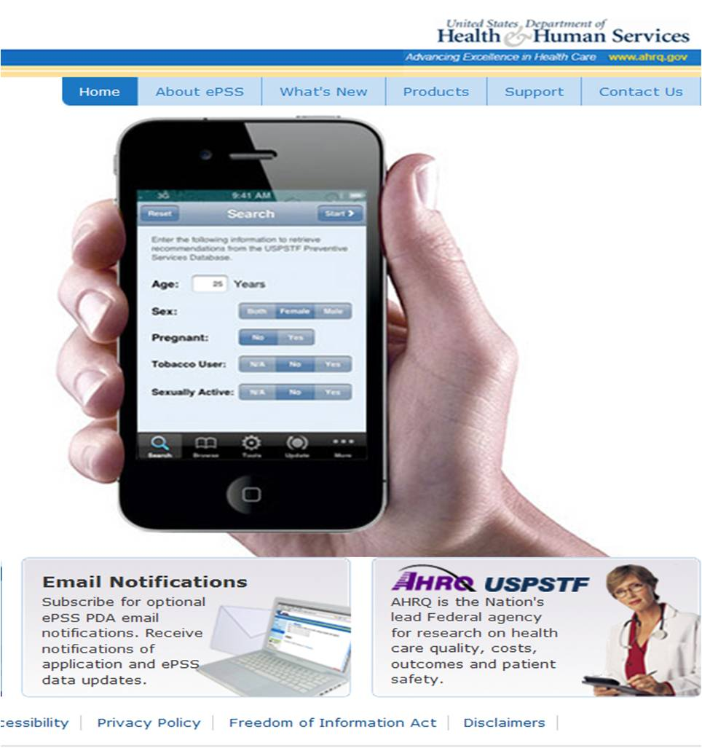
Spanish Catholic Center of Catholic Charities (DC)
U.S. Preventive Services Task Force Recommendations & ePSS
  Developed comprehensive preventive health screening flowchart that uses recommendations from USPSTF and Centers for Disease Control and Prevention
  Trained clinicians on how to use AHRQ’s electronic Preventive Services Selector (ePSS) on handheld devices and computers
  Flowchart and training used in two medical clinics in DC
(KT-CP3-69)

Slide 26
Overview
The Big Picture
  FY 2012 Budget Request
Recent Accomplishments
  In the News
  Impact Case Studies
AHRQ Program Updates
Today’s Agenda

Slide 27
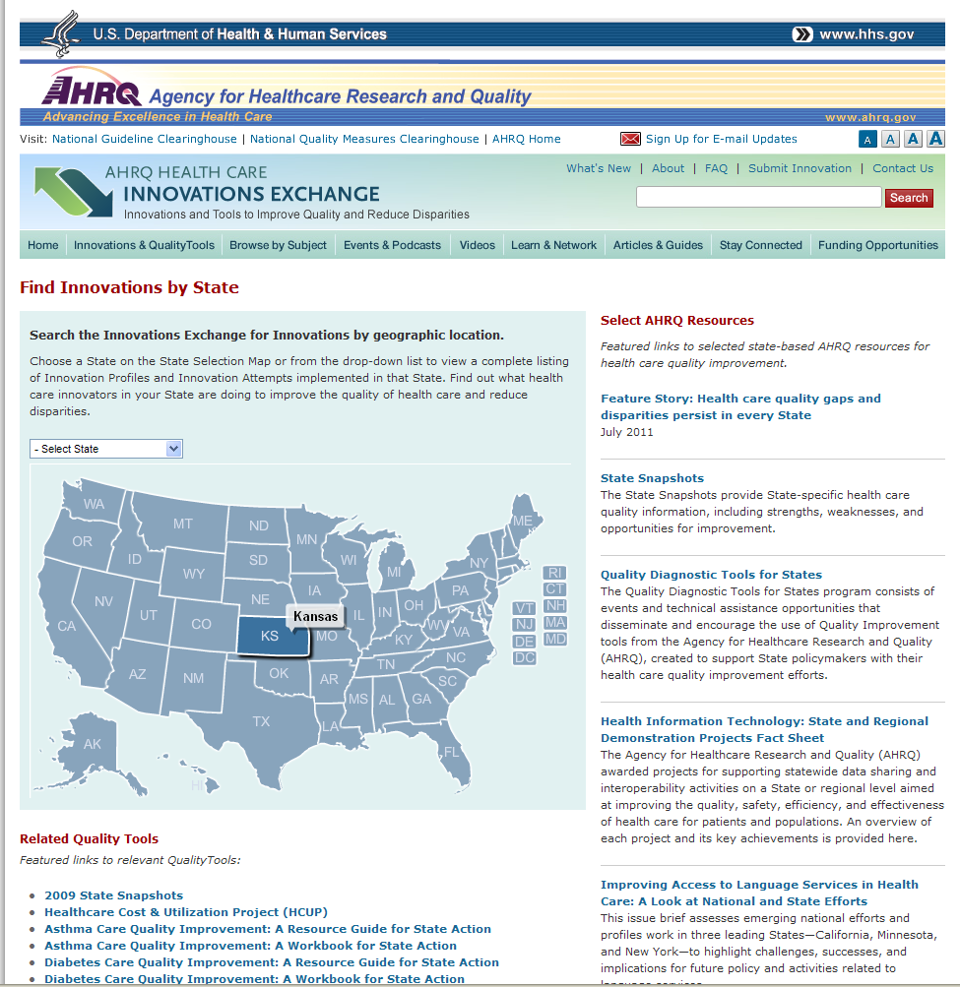
Notes:
AHRQ pursues these goals by investing in five areas of health services research. Each of these areas has great potential to help transform the health care system of the 21st century into an information-rich, patient-focused enterprise.
AHRQ provides support for independent, user-driven research that is designed to help people and organizations at the federal, state and local levels make a wide range of informed choices.
Informed choices. That’s the ultimate goal. But as a nation, I think we’d all agree, we don’t make informed choices about health care often enough.
Whether you are a doctor, a pharmacist, a nurse or anyone else who has to make health care decisions, you can benefit from comparative effectiveness research. This research is designed to help you, the busy and often time-challenged clinicians, find out what the latest and best science says about treating various conditions.

Slide 28

Questions are the Answer: 2011
New ads running this fall in medical journals, including NEJM, JAMA, American Family Physician, Annals of Internal Medicine, Journal of the American Academy of Physician Assistants, Journal for Nurse Practitioners, etc.
  Focus group feedback from patients indicates that they feel physicians are rushed and don’t have time for questions
  Primary care physicians and nurses say patients need to prioritize questions (no time to go over every study found on the Internet)

Slide 29
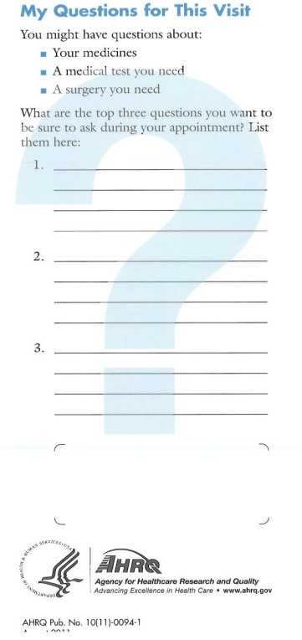

Added Focus on Prioritizing
Web site updated to include videos featuring patients and clinicians
Products include:
  Web site expansion
  Brochure
  Waiting room video
  Notepads with room to write top three questions
  Tips for before, during, and after appointments

Slide 30

Patient Engagement is a Team Sport
Collaboration is key
  Ongoing outreach to medical groups, health clinics, and waiting room settings
  Strong partnerships with national, State, and local organizations
  Networks dedicated to putting the patient at the center of care
  Consumer and community involvement
Video #1
Video #2

Slide 31
Infrastructure for Maintaining Primary Care Transformation (IMPaCT)
Purpose: Support State-level initiatives using primary care extension agents in small and medium sized primary care practices to assist with primary care redesign and transformation
Spread: Each of the four grantees will create State-level collaborations with at least three other States to assist them with their State-level primary care transformation effort
Awards: Four 2-year grants made in September 2011, each for a total of $1,000,000

Slide 32
IMPaCT Grantees
HEROs: New Mexico’s Health Extension as a Model for Primary Care Transformation (PI: Arthur Kaufman, University of New Mexico Health Sciences Center)
North Carolina IMPaCT: Advancing and Spreading Primary Care Transformation (PI: Darren DeWalt, University of North Carolina)
PA SPREAD: PA Spreading Primary Care Enhanced Delivery Infrastructure (PI: Robert Gabbay, Penn State Hershey College of Medicine)
Primary Care Extension in Oklahoma: An Evidence-Based Approach to Dissemination and Implementation (PI: James Mold, University of Oklahoma Health Sciences Center)

Slide 33
Update From the U.S. Preventive Services Task Force
Draft recommendation statements available for comment:
  Screening & Management of Obesity in Adults
  October 26 – November 23, 2011
  Screening for Cervical Cancer
  October 19 – November 16, 2011
  Screening for Prostate Cancer
  October 11 – November 8, 2011
  Screening for Hearing Loss in Older Adults
  October 4 – November 1, 2011
  Screening for Coronary Heart Disease With Electrocardiography
  September 27 – October 25, 2011

Slide 34
New Efforts to Increase Transparency & Stakeholder Engagement
Briefings on screening for prostate and cervical cancer
  Open to all, approximately 150 phone lines utilized on each call
  Each briefing provided:
    An overview of the USPSTF and its recommendation-making process
    A summary of the evidence on the benefits and harms of screening
    A description of the specific recommendations
    A discussion of the USPSTF rationale
Beginning in December 2011, posting all draft Research Plans for public comment
  Includes analytic framework, key questions, and inclusion/exclusion criteria
  First topic, screening for peripheral arterial disease

Slide 35
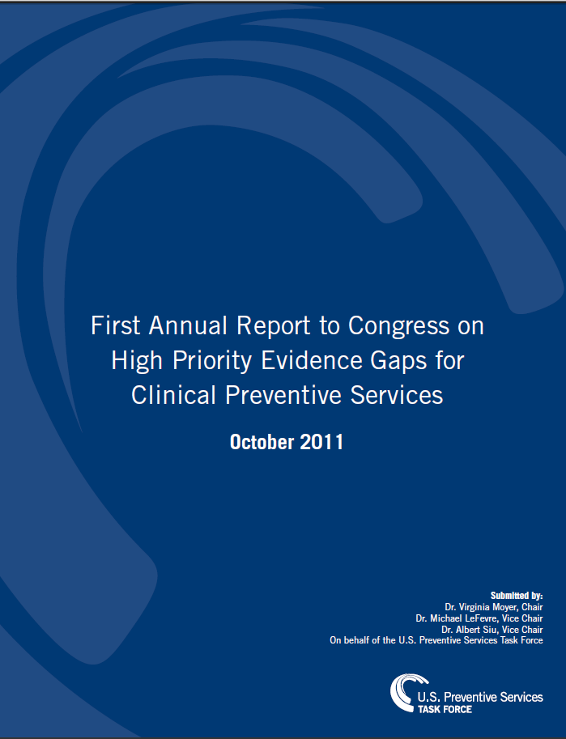
First Annual Report to Congress
Delivered to Congress on October 27
in conjunction with a similar, complementary report from the Community Preventive Services Task Force

Slide 36
2011 – 2015 CERTs Centers
Six Research Centers recently awarded 5-year cooperative agreements
of ~$850,000 per year
Coordinating Center changed/renamed as the CERTs Scientific
Forum with increased scientific support of internal and external CERTs
collaborations, including an annual project or activity
Kaiser Permanente Center for Health Research, Portland OR | Scientific Forum
Brigham and Women’s Hospital | Health information technology
Cincinnati Hospital Children’s Medical Center | Pediatric health care quality
Duke University Medical Center | Cardiovascular disorders
Rutgers University | Mental health disorders
University of Alabama – Birmingham | Musculoskeletal disorders
University of Illinois – Chicago | Medication safety

Slide 37
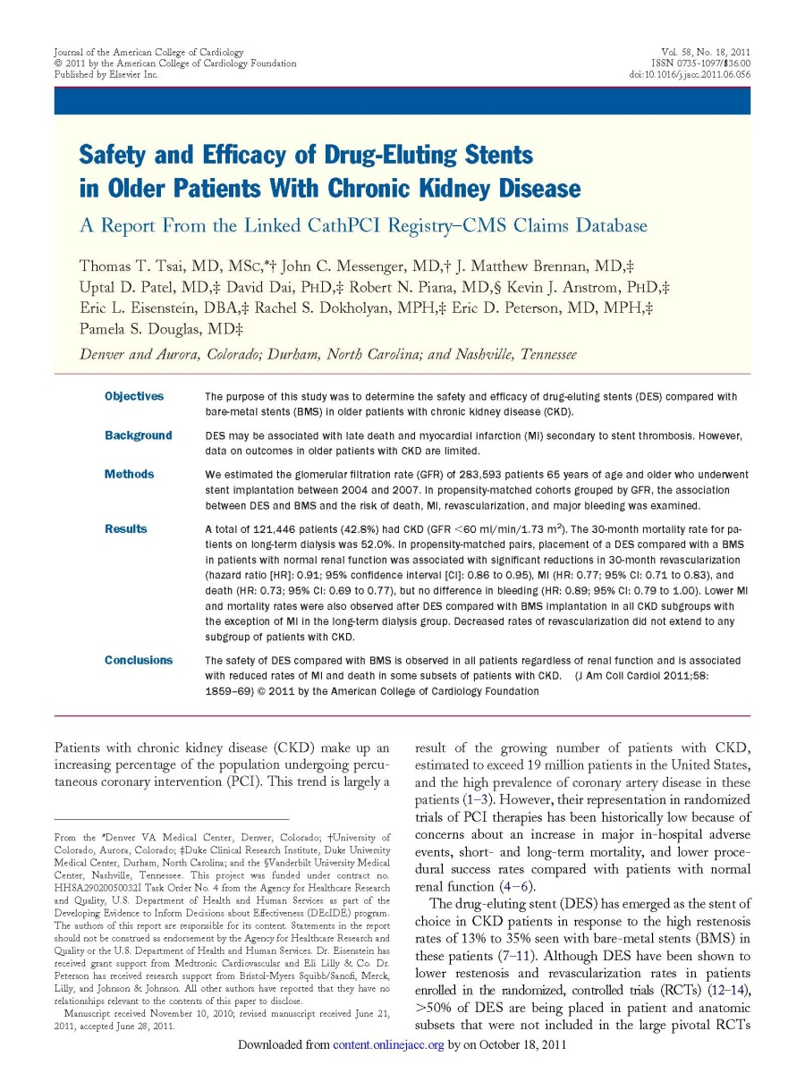
New Research From Effective Health Care Program – Stents in CKD
Many drug-eluting stents (DES) are being placed in patient subsets that were not represented in large, pivotal RCT’s
New study examines the safety & efficacy of (DES) compared to bare-metal stents (BMS)
Focuses on “real world,” i.e., Medicare-eligible patients over 65 yrs. with chronic kidney disease (CKD)
Study links American College of Cardiology registry to CMS data
Results: In patients with CKD treated with a DES versus BMS, treatment with a DES appeared to be safe with an associated reduction in the rates of MI and death
Tsai TT et al., J Am Coll Cardiol, 2011; 58:1859-1869.
http://www.effectivehealthcare.ahrq.gov

Slide 38
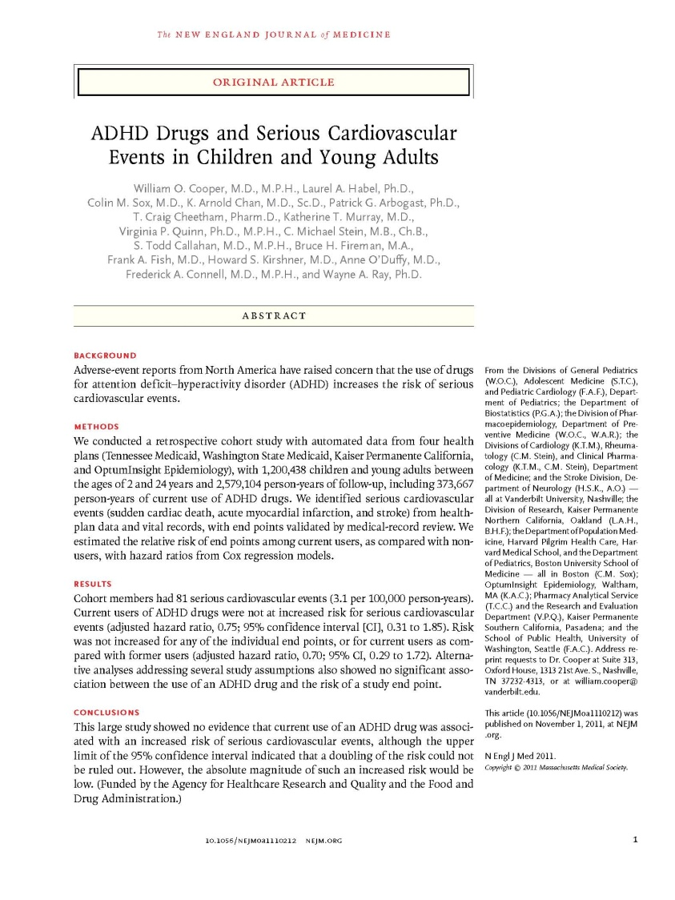
New Research From Effective Health Care Program – Child ADHD
Collaboration with AHRQ & FDA to examine serious cardiovascular events in children taking medications for ADHD
Largest study to date – analyzed data from more than 1.2 million children and young adults from ages 2 to 24
Study found no evidence of increased risk of serious cardiovascular effects among children and young people who use ADHD medications
The possibility of a small risk cannot be ruled out because of the small number of cardiovascular events observed in the patients studied
Cooper WO, et al. ADHD drugs and serious cardiovascular events in children and young adults. N Engl J Med 2011
http://www.effectivehealthcare.ahrq.gov

Slide 39


New on AHRQ’s Public Reporting Front
Report reviews key methodological decision points that report sponsors may encounter when generating provider performance scores (MW (Friedberg and CL Damberg, RAND – available at http://www.ahrq.gov/qual/value/perfscoresmethods)
Ground-breaking study tests alternative public reporting approaches to providing consumers with information on provider cost and resource use measures (J. Hibbard, AHRQ Annual Meeting, Sept. 20, 2011)
Over half of States now produce a public report using AHRQ Quality Indicators (QIs); CMS’ HospitalCompare uses AHRQ QIs to report on hospital quality nationwide

Slide 40
New Work Underway:
Feasibility of Collecting Data on Physicians and Their Practices
Conduct environmental scan of past and existing physician data collection efforts and policy issues they can address
Discuss strategic options of what is possible in the future (collaborations or new survey instruments)
Develop a prototype survey instrument to illustrate possibilities
(AHRQ work with Mathematica Policy Research)

Slide 41

Significant Findings:
AHRQ’s HIV Research Network (HIVRN)
The process of tracking CD4 counts and meds and reporting this to HIVRN members has significantly increased compliance with NIH prophylaxis guidelines
Cost of care has remained fairly constant over past 3 years even though drug costs have risen slightly
HIV-1 incidence is rising in youth (ages 12-24) due to new infections acquired through risk behaviors

Slide 42
News From AHRQ’s
Healthcare Cost and Utilization Project (HCUP)
45th State joins HCUP partnership: Alaska!
HCUP finding: Septicemia was the single most expensive condition treated in U.S. hospitals at approximately $15.4 billion in 2009 (HCUP Statistical Brief available at http://www.hcup-us.ahrq.gov/reports/statbriefs/sb122.jsp)
New HCUP data: Nationwide Emergency Department Data Sample (NEDS) for 2009 now available

Slide 43
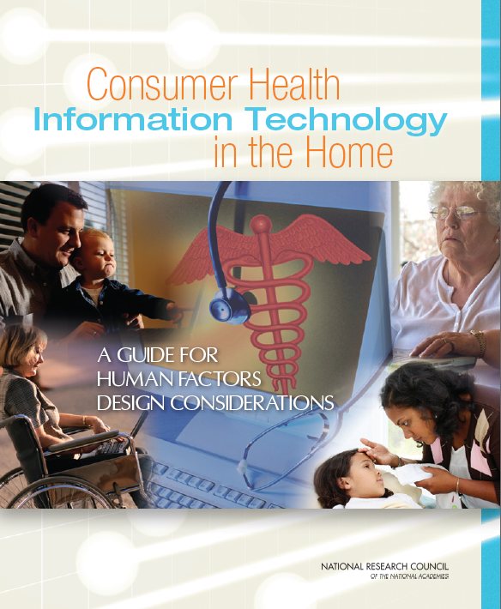
Consumer Health IT in the Home:
Design Considerations
AHRQ-funded guide published by National Research Council
  Rapid growth of home health care has raised many issues
  Guide provides human factors design considerations in health IT applications
  Helps designers and developers understand realities and complex nature of managing health at home
www.nap.edu/catalog.php?record_id=13205

Slide 44
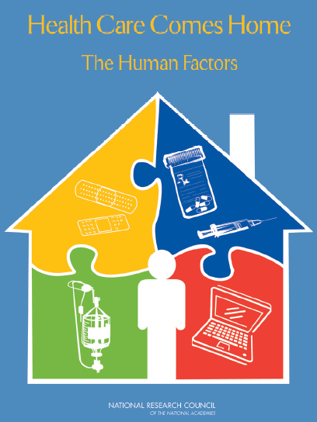
Health Care Comes Home:
The Human Factors
AHRQ-funded report published by the National Research Council
Health care services are rapidly moving into the home
Addressing human factors can improve care
Outlines foundation for integrating human factors with design and implementation of home health devices, technologies, and practices
Discusses how AHRQ, FDA, and other Federal agencies can collaborate to improve the quality of care at home
www.nap.edu/catalog.php?record_id=13149

Slide 45
Active Aging Research Center
Specialized Center (P50) to improve health and functioning of aging individuals through health IT
Awarded to the University of Wisconsin-Madison
Focus on the problems that often cause older adults to leave their homes:
  Falls
  Unreliable home care
  Difficulty managing a chronic disease
  Declining driving skills
http://www.chess.wisc.edu/chess/projects/aarc.aspx

Slide 46
Award of Pathways to Quality
Health IT horizon scanning effort
Background report on current efforts to measure quality through health IT (available in 6 months)
Future resource and research needs (anticipated in 18 months)

Slide 47
2010 MEPS-IC Family Premium Estimates Now Available for Use in Setting State Tax Credits for Small, Private Sector Firms Under Health Care Reform
Small firms have fewer than 50 employees; Source: Center for Financing, Access, and Cost Trends, AHRQ, Insurance Component of the Medical Expenditure Panel Survey, 2010

Slide 48
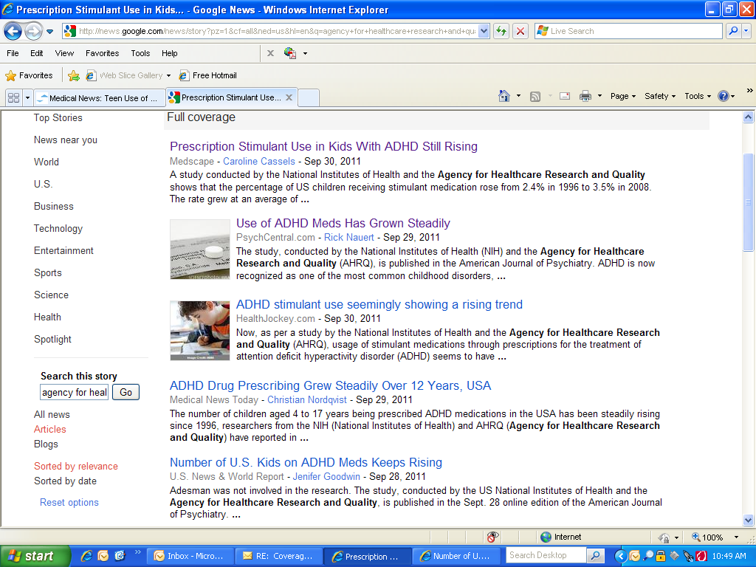
MEPS Informs Policy and Practice

Slide 49
Advancing HHS Data Strategy and Planning Efforts
AHRQ and the Assistant Secretary for Planning and Evaluation serve as co-chairs of HHS Data Council
Two departmental workgroups established to advance an HHS data strategy and related planning efforts
  Research and Development for HHS data collection
    Provides recommendations on R&D efforts to facilitate improvements in the quality, utility, timeliness, and efficiency of HHS surveys and data systems
  HHS Data Integration and Alignment
    Provides recommendations on data integration and alignment efforts that enhance analytic capacity and improve the harmonization of data sources
    Seeks proposals that fill data gaps related to ACA implementation; granularity; longitudinal capacity; clinical detail; health resources and determinants and that facilitate quick response mechanisms

Slide 50
Consumer Assessment of Health Providers and Systems (CAHPS)
CMS Collaboration
  Working with the CAHPS Consortium to ensure that patient experience survey for Home and Community-based Services (HCBS) is based on CAHPS Survey design principles
  Pay for reporting: Home Health Agency receives full Annual Payment Update provided they submit Home Health CAHPS data by requested deadlines
HRSA Collaboration
  Developing a CAHPS survey for use in HRSA’s 8,000 Federally qualified health centers

Slide 51


National Healthcare Quality and Disparities Report (NHQR/DR)
2011 NHQR/DR in final departmental clearance, expected release date –January 2012
Work has started on the 2012 reports, 10th in the series

Slide 52
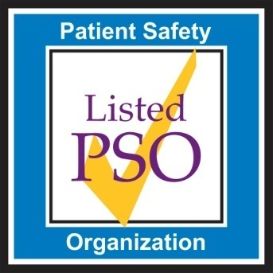
Patient Safety Organizations (PSOs)
Number of listed PSOs – 79 in 31 States
VTE Common Format beta version published October 27
March 2012 – AHRQ to launch program working with high readmission rate hospitals
Common Format for readmissions in development

Slide 53
AHRQ Patient Safety Portfolio
New 2011 Projects
Upcoming Projects
Health Care Simulation – 11 new grants
Perinatal Safety Program – in development
Patient/Consumer Reporting of Patient Safety Events
Risk Assessment of Clinical Laboratory Testing Processes
Environmental Scan of Patient Safety Education and Training in the U.S.
Survey of Patient Safety Culture for Community Pharmacies
Evidence Review of Patient Safety Practices

Slide 54

AHRQ Annual Conference
2011 AHRQ Annual Conference (September 18 - 21, 2011) – 1800 attendees!
2012 AHRQ Annual Conference – September 9 -12, 2012 – Bethesda North Marriott Hotel and Conference Center

Slide 55
NAC Subcommittee
Meet to review criteria identified by Expert Panel in Year 1
Review measures nominated for potential inclusion in the improved core sets
  What:
    Measures developed by PQMP COEs
    Measures nominated through public process
  How? Use criteria in Candidate Measure Form
  Support: Summary descriptions provided by CCTAC
Discuss and reach consensus on measures that meet criteria
Report out to NAC chair
AHRQ and CMS recommend to Secretary
Secretary posts improved core sets annually starting 1/1/2013

Slide 56
Today’s Agenda
Director’s Update
AHRQ’s Patient-Centered Outcomes Research Dissemination/Implementation Activities
Public Comment
Lunch
  Briefing on the IOM Future of Nursing Report and Campaign for Action
Exploratory Discussion: What Do We Want Out of Physician Performance Measures? Developing a Conceptual Frame
Public Comment
Chairman’s Wrap-up

