Slide 1
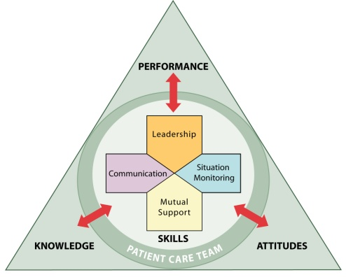
Enhancing Safety for Patients With Limited English Proficiency Train-the-Trainer Instructor Guide
TM

