Slide 1
Federal Cloud Computing Initiative Matthew Goodrich November 5, 2010
Section 508 Coordinator Conference Cloud Computing and Section 508 Panel
GSA Confidential and Proprietary – Not for Distribution

Slide 2
Federal Cloud Computing Initiative:
Program Overview
Federal Cloud Computing Initiative began in March 2009 at the request of the Federal CIO, Vivek Kundra.
Mission: Drive the government-wide adoption of cost effective, green, and sustainable Federal cloud computing solutions.
The Cloud Computing Program Management Office (PMO) was established at GSA in April 2009.
PMO manages the Cloud Computing Executive Steering Committee, which reports to the Federal CIO Council.
4 additional government-wide governance groups were established within the program:
Cloud Computing Advisory Council.
Cloud Computing Security Working Group.
Cloud Computing Standards Working Group.
SaaS Email Working Group.
2

Slide 3
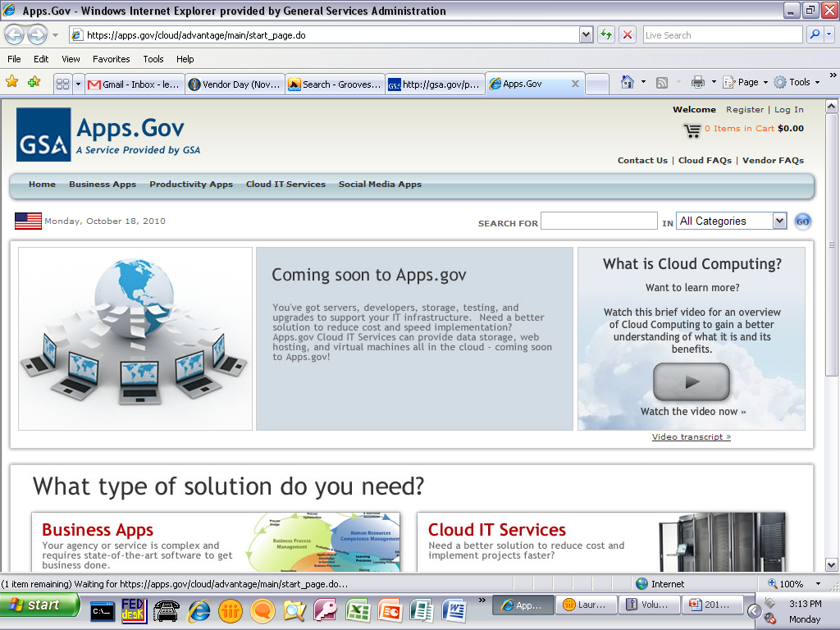
Apps.gov
The Federal Government’s Cloud Computing Storefront
First Federal storefront site to commoditize cloud services so that buyers may cross-compare products and purchase (launched September, 2009). Currently offering SaaS and social media products.
3

Slide 4
Infrastructure-as-a-Service (IaaS):
Apps.gov to offer cloud Storage, VMs, and Web Hosting
IaaS Services
IaaS Awarded (October 2010
Awardees will complete security authorizations with GSA to support Moderate Level Security for Government
Services will be made available through purchase on apps.gov
Storage
Virtual Machines
Server Hosting
Online Web Based Storage
Store Files & Data Objects
Online VMs / Computing
Multiple CPU & OS Types
Online Server Hosting
DNS and CDN Capabilities
On-demand Self Service
Online, self service provisioning capabilities for services
Ubiquitous Network Access
Accessible via the Internet with a sufficiently robust architecture
Location Independent Resource Pooling
Massively scalable services, independent of location of resources
Rapid Elasticity
Scale up or down dynamically based on consumption and/or request
RFQ Required Cloud Computing Characteristics
Measured Service
Utilization and consumption GUI dashboard and electronic interfaces
4

Slide 5
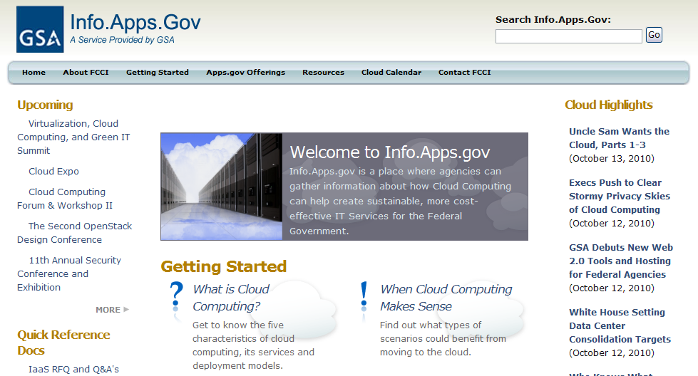
Info.Apps.Gov:
Cloud Computing InfoPortal
Keeping you informed in upcoming events!
News and Information on Cloud and Data Center Topics
Reference Documents at your fingertips!
Provides tools to navigate the cloud landscape.
Launched in April 2010, Info.Apps.gov is a central Government site providing information about cloud computing and how to procure/use cloud services. It helps create sustainable, more cost-effective IT Services for the Federal Government. It is built on open source and it is hosted in the Cloud!
5

Slide 6
Cloud Email:
Software-as-a-Service (SaaS) Email Procurement
Inter-agency SaaS Email Working Group established in June 2010.
Developing an RFQ for a government-wide BPA of SaaS email solutions.
RFI completed.
13 respondents.
RFI responses will be leveraged to create RFQ requirements.
Pre-solicitation day held November 1 to solicit vendor and government feedback on draft SOW.
GSA completed security authorization of Google Apps which may be leveraged by other agencies.
USAID leveraged Google Apps security authorization package to greatly reduce timeline for system implementation
6

Slide 7
FedRAMP:
Federal Risk And Authorization Management Program
Unified Government-wide Risk Management Program
Provides joint security authorization and continuous monitoring
Agencies participate by leveraging the results for covered products
Agencies retain their responsibility and authority to ensure their security needs are met in the use of systems
Vendor Benefits
Government-wide authorization and security compliance cost reduction
Agency Benefits
Cost savings through reduced duplication
Rapid acquisition
Increased security assurance
Problem: Independent agency risk management has inefficiencies
Agency
A&A
Vendor
Solution: Unified risk management eliminates inefficiencies
Agency
A&A
Vendor
FedRAMP
7

Slide 8
FDCCI: Federal Data Center Consolidation Initiative
The Initiative’s Six Key Phases
Phase 1
IT Asset Inventory Baseline
(Complete)
Phase 2
Application Mapping & Quick Wins
Phase 3
Analysis & Strategic Decisions
Phase 4
Design & Transition Planning
Phase 5
Consolidation & Optimization Execution
Phase 6
On-going Optimization Support
Milestones – Phase 1 | Due Dates – Phase 1 | Status – Phase 1
Initial Data Center Asset Inventory | April 30, 2010 | Complete
Initial Data Center Consolidation Plan | June 30, 2010 | Complete
Final Data Center Asset Inventory | July 30, 2010 | Complete
Final Data Center Consolidation Plan | August 30, 2010 | Complete
Approval of Final Data Center Consolidation Plans | December 31, 2010 | OMB will work with agencies to review, adjust and approve final consolidation plans.
The scope of the Initiative is limited to CIO Council agencies
In February 2010, the Administration launched this Initiative
Three agency guidance workshops were provided by the team as well as peer reviews were conducted of the agency’s Initial and Final Plans
Per the CIO Council Memo published October 1, 2010; “As of July 30, 2010, based on agency submissions, there are 2,094 Federal data centers”
8

Slide 9
Cloud and Section 508: Enforcement Mechanisms from the FCCI Perspective
Section 508 requires that federal agencies' electronic and information technology is accessible to people with disabilities.
Section 508 applies to the purchase of ALL electronic and information technology products and services.
Apps.gov and Info.Apps.Gov have both undergone 508 testing and scans mutliple times and are fully 508 compatible for our customers.
We rely on Schedule 70 mandates for 508 compliance for all SaaS products currently on Apps.gov.
IaaS RFQ and requirements mandated that vendors not only acknowledge that their service offerings are 508 compliant but be able to demonstrate their compliance as well.
Email SaaS Draft RFQ has the same requirements as the IaaS RFQ.

