Slide 1
The Singlepoint Filing Website Project
Karen Gano, Connecticut Attorney General’s Office
Tom Pollak, The Urban Institute
Mark Greider, Strictly Software, Inc.,
Cindy Lott, Nat’l State AG’s Program at Columbia Law School
Bob Carlson, Missouri Attorney General’s Office
Notes:
Introduce self
Coordinate all NP and Charity law issues for MO AG
Any NP issue, on my desk
Why is AG important to NP’s?

Slide 2
We ♥ Questions

Slide 3
The Singlepoint Filing Website Project
The Concept:
Unified electronic registration system that will allow nonprofit organizations and their professional fundraisers to comply with every state’s registration requirements at one online location
The 3 part plan
8 States in pilot project
Step One: Seek Funding + Create System
Step Two: Launch System in pilot states
Step Three: Include other states
Notes:
Three reasons why:
Public disclosure
Responsible disclosure
Provide information to enforcers

Slide 4
Singlepoint Filing System Benefits for Nonprofit Organizations
Save Time: File in multiple States at one time
Less data entry: System auto-fills data from Form 990/Form 990-EZ
Fewer mistakes: System performs all arithmetic
System verifies that forms are complete
Immediate feedback that forms were received by the State(s)
Notes:
Three reasons why:
Public disclosure
Responsible disclosure
Provide information to enforcers

Slide 5
Singlepoint Filing System Benefits for State Charity Offices
More accurate and complete data
Don’t have to manually keypunch data into State charity systems
Less software development required due to uses of existing systems (990 Online system, IRS Fed-State System, Urban Fed-State backend system)
Access to multiple State’s data for analysis
Public access to Nonprofit data
Notes:
Three reasons why:
Public disclosure
Responsible disclosure
Provide information to enforcers

Slide 6
Singlepoint System Flow
Notes:
Three reasons why:
Public disclosure
Responsible disclosure
Provide information to enforcers

Slide 7
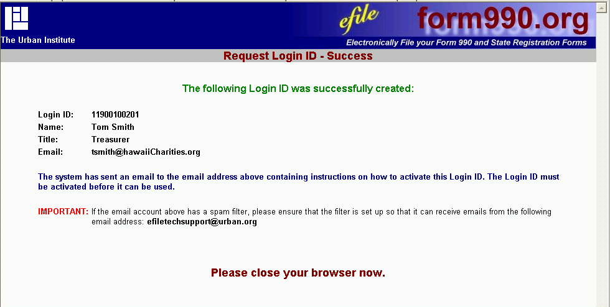
Log-in

Slide 8
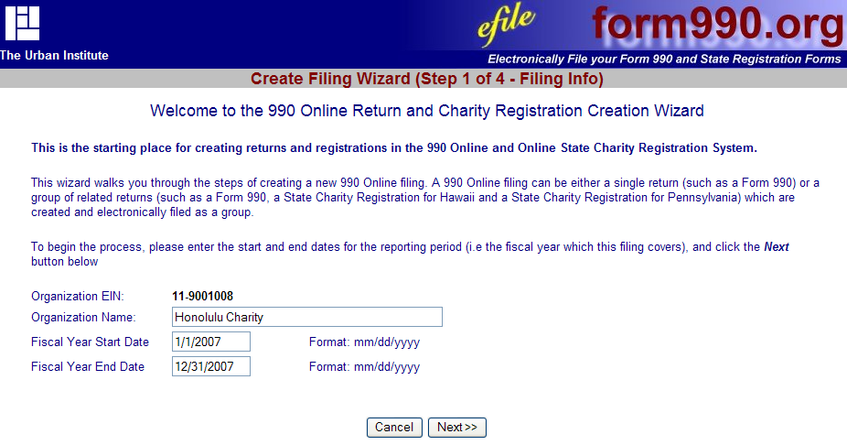
Enter your organization

Slide 9
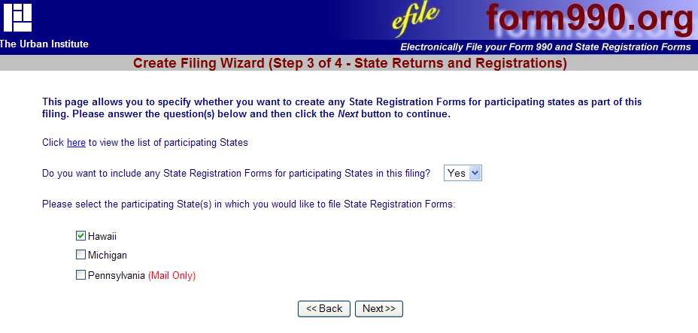
Pick your states

Slide 10
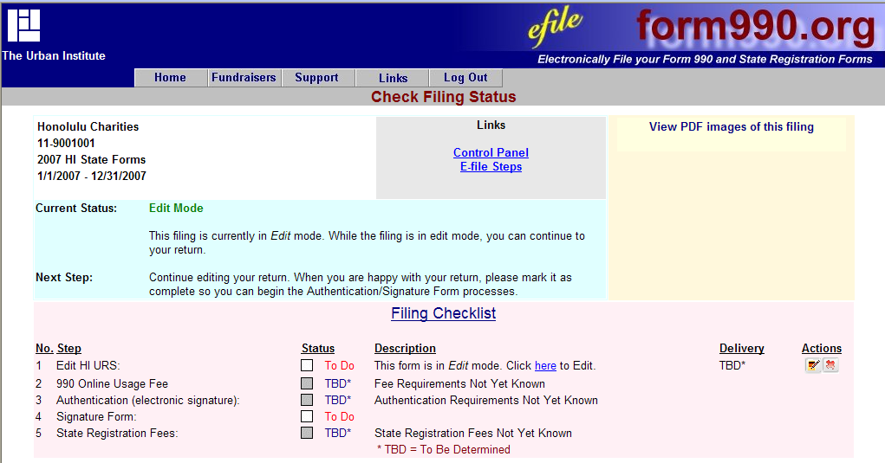
Review what is needed

Slide 11
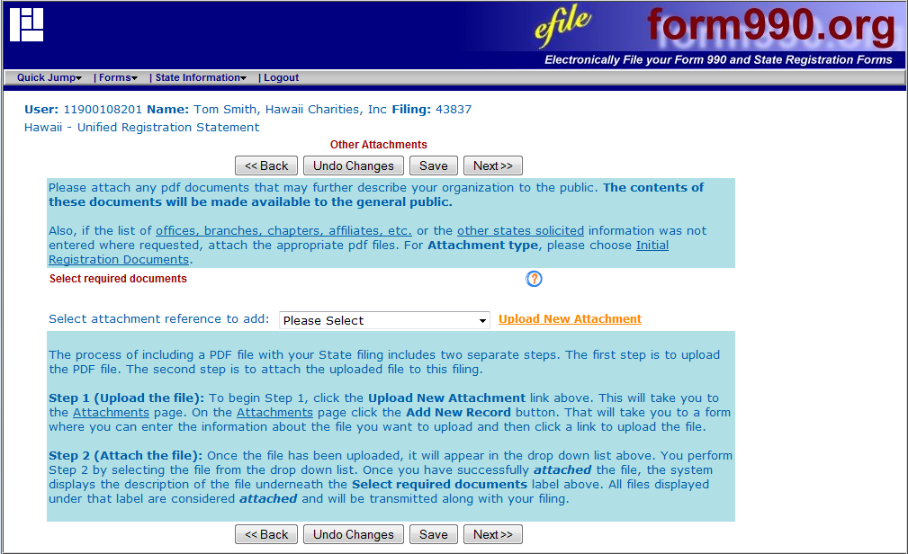
Upload documents

Slide 12
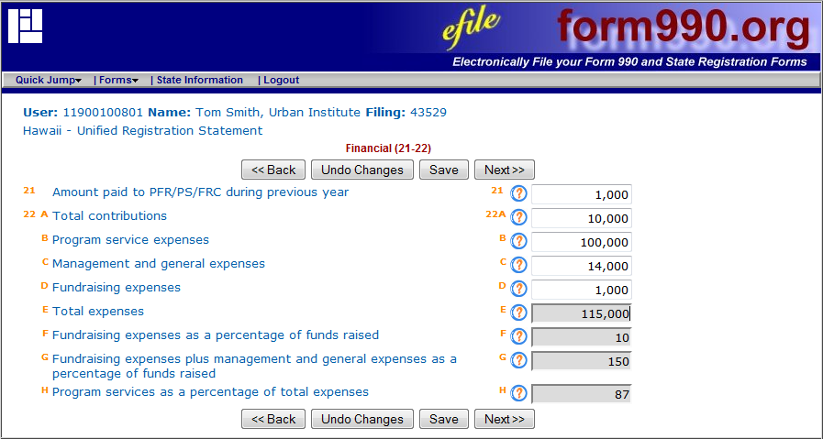
Enter information

Slide 13
Contact Information
Karen Gano, Karen.Gano@ct.gov
Tom Pollak, TPollak@urban.org
Bob Carlson, bob.carlson@ago.mo.gov
Mark Greider, mgreider@strictlysoftware.com
Cindy Lott, clott@law.columbia.edu

