Slide 2
2012 PATH Data Reporting
Tison Thomas
Substance Abuse and Mental Health Services Administration (SAMHSA)
Rachael Kenney & Amy SooHoo
SAMHSA Homeless and Housing Resource Network (HHRN)

Slide 3
Agenda
Introduction
Updating Providers
Accessing the PATH Report
Structure of the PATH Report
Reminders
Voluntary Outcome Measures
Validation and Data Checks
The Future of PATH Reporting
Questions

Slide 4
Introduction
Annual PATH reporting is required to meet federal requirements
Data is utilized by project officers within the Center for Mental Health Services (CMHS) to describe and evaluate the PATH program on a national basis
Data is also used for program planning purposes, to maintain program accountability, and to assist in program monitoring

Slide 5
Updating Providers
If you are having trouble logging in with an old ID (e.g. ST1005), please register on the PATH website and send your ID and state name to path@samhsa.hhs.gov. We will assign your ID access and e-mail you back within 2 business hours.

Slide 6

Updating Providers

Slide 7
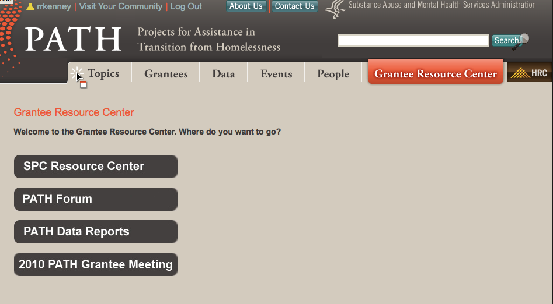
Updating Providers

Slide 8
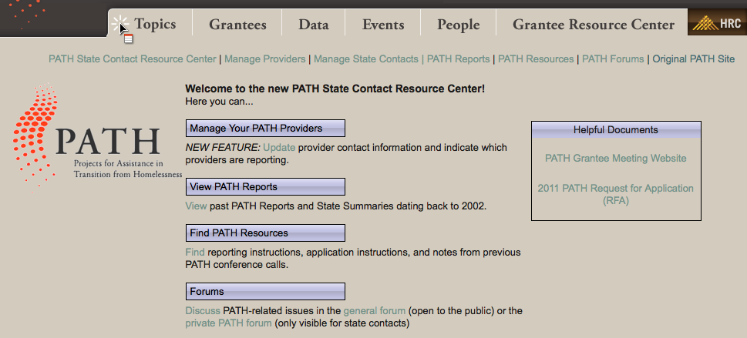
Updating Providers

Slide 9
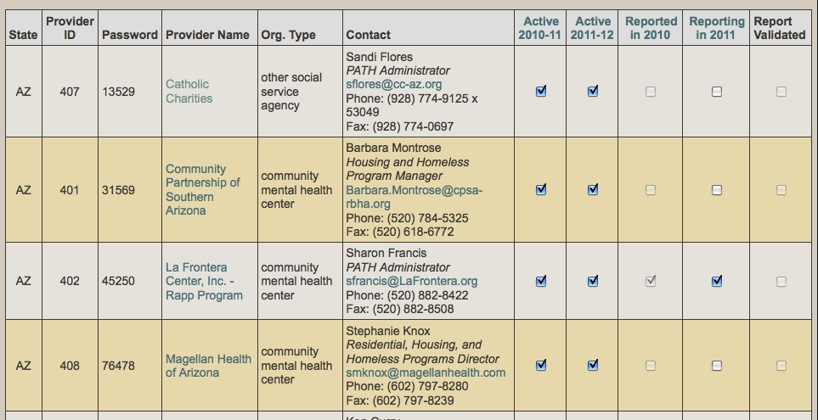
Updating Providers

Slide 10
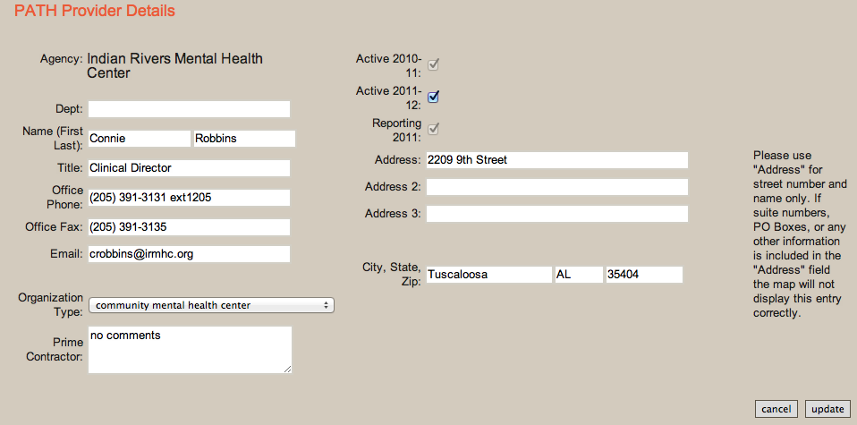
Updating Providers

Slide 11
Accessing the PATH Report
http://pathprogram.samhsa.gov

Slide 12
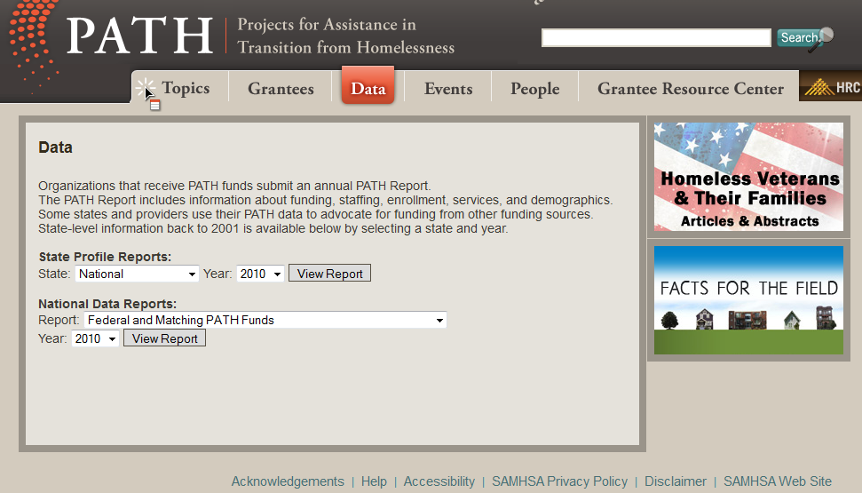
Accessing the PATH Report

Slide 13
Accessing the PATH Report

Slide 14
Structure of the PATH Report
Table A: Budget Information
Table B: Persons Served
Table C: Available Services
Table D: Demographics

Slide 15
Reminders
Reports are due no later than October 31, 2012.
  State PATH Contacts may change this deadline to an earlier date.
The report you are entering is called the 2012 PATH Report.
Providers who collect data from January 1-December 31 should enter data collected from January 1, 2012-September 30, 2012. This change applies only to providers with this specific data collection period.

Slide 16
Reminders
Reporting Estimates
Providers are encouraged to report on actual number of persons served, not estimates
If providing an estimate, provide rationale for how the estimate was calculated in the text box in Table B

Slide 17
Table A: Budget
A1: Total dollar amount towards PATH eligible clients
A2: Federal funds from state
A3: Match funds from state or your program
A4: Number of staff
A5: Full time equivalent staff
A6: Type of program

Slide 18
Table B: Persons Served
B1: PATH eligible clients
B2a: Individuals outreached
B2b: Individuals outreached who became enrolled during the current year
B2c: Individuals outreached but not enrolled
B2d: Individuals outreached but not eligible
B3: All persons enrolled in PATH
B4: Individuals receiving any PATH-funded service

Slide 19
Table C: Services Provided
Reminders
For all questions in Table C, please:
Indicate funding source
Indicate number of persons who received the service if the service was 100% or partially PATH funded
Enter zero (0) if the service was provided but not PATH funded or not provided

Slide 20
Table C: Services Provided
Reminders
Item Cd (Community Mental Health Services)
Include the number of individuals enrolled in PATH receiving mental health services paid for by PATH and the number of individuals enrolled in PATH who were successfully linked to mental health services as a result of the PATH program
If individuals were successfully linked to mental health services that were not paid for by PATH, the service should be reported as "Partially PATH-Funded"

Slide 21
Table C: Services Provided
Reminders
Exception for Item Cd (Community Mental Health Services) only:
  Providers can enter number of individuals served if “Service Provided but not PATH Funded” is selected
  In this instance, the response will automatically be changed to "Partially PATH-Funded"

Slide 22
Voluntary Outcome Measures
The PATH report includes five voluntary outcome measures (Items Ck1 – Ck5):
  Housing (transitional, supportive, or permanent)
  Earned Income
  Income Benefits
  Medical Insurance Coverage (Medicaid, Medicare, and/or state/local plans)
  Primary Medical Care

Slide 23
Voluntary Outcome Measures
Reporting on these outcomes in 2012 is voluntary
Providers must indicate “not reporting” for any outcome measure not reported

Slide 24
Voluntary Outcome Measures
Assisted Referral
Assisting the consumer with the following:
Obtaining the application AND
Obtaining the appropriate supporting documentation AND
Completion of the application AND
Filing the application with the appropriate agency or organization (or business, if for employment)
OR…

Slide 25
Voluntary Outcome Measures
Assisted Referral
…OR
Referral to a program that specializes in assisting consumers with an application process and who can provide certification that the application has been successfully filed by the consumer

Slide 26
Voluntary Outcome Measures
Attainment
The PATH provider confirms that the individual attained the indicated service through self report or confirmation by other providers (written documentation is not required)
An individual is counted as attaining a service when they begin receiving the service—not at the time the application process is complete

Slide 27
Table D: Demographics
Age
Race
Gender
Veteran status
Housing status
Length of time homeless

Slide 28
Table D: Demographics
Reminders
Demographic information is reported only for individuals who became enrolled
Each question must add up to B3 (individuals enrolled in PATH)
  Exception is question D8, which is reported only for those who are literally homeless
    The sum for D8 must equal D7a (living outdoors) + D7b (living in a short-term shelter)

Slide 29


Table D: Demographics
Reminders
Item D3 (Race/Ethnicity)
I’m a White Latina.
I’m Hispanic.
Select
D3g
Two or More Races
Select
D3d
Hispanic or Latino

Slide 30
Validation
PATH report will not validate if there are mathematical errors or missing answers
Validation errors are displayed in a pop-up window during the validation process. You may see any or all of these messages:
Please answer the following questions
The following dates are not valid
The following numbers are not valid
The following rules are violated

Slide 31
Data Checks
Are 0 persons outreached?
B2a=0
Are 100% of persons outreached enrolled?
B2a=B2b
Is the percentage of eligible persons outreached who became enrolled in services less than 44%?
B2b/(B2a-B2d) < .4
Is the value of B3 50% less or 100% more than what was reported in 2011?
(B3 2011- B3 2012)/B2 2012 <.5 or > 1

Slide 32
Data Checks
Is the federal cost of enrolling an individual in PATH services greater than $802?
A2/B3
Is the percentage of individuals enrolled in PATH who receive community mental health services (CMHS) less than 37%? Or are community mental health services not offered?
Cd/B3 < .37 or Cd=0
Are persons less than 13 years or 13-17 years old included in the report?
D1a+D1b>0

Slide 33
The Future of PATH Reporting

Slide 34

Questions
SAMHSA Homeless and Housing Resource Network
Lunise Joseph
Jennifer Martinez
Cheri Peterson
Amy SooHoo
path@samhsa.hhs.gov
(617) 467-6014

