Slide 1
CTEP IND LOI Review and Approval Process

Slide 2
Study Proposals
Letter of Intent
May be sent in response to solicitation
May be sent by investigator with interesting idea
If using combinations, one agent must be held under CTEP IND
After LOI Approval → 30 - 60 days to submit a protocol
If CTEP is the IND holder and sponsor of trial, CTEP monitors the trial

Slide 3
LOI Elements and Review
Background & rationale
Trial design
Eligibility
Dosing
Correlative studies
Endpoints
Statistical plan
Accrual plan
Documented accrual
Competing studies
Source of support for clinical trial & correlatives
Science/Design
Feasibility
Components of a competitive Letter of Intent
http://ctep.cancer.gov/guidelines/index.html

Slide 4
LOI Review Process
Review and Priority Scoring of Clinical and Laboratory Components by IDB
Science
Feasibility
Consistency with CTEP development plan
Not duplicative
Review at Protocol Review Committee (PRC)
Industry partner for review and agreement to supply agent
Full approval letter with protocol documents
~ 1/3 LOIs received are approved

Slide 5
Elements of a Competitive LOI - Rationale/Hypothesis
Rationale should be explicitly stated.
Specific reason to test an agent should be offered.
in vitro or in vivo experiments
molecular biological rationales
prior clinical data
Succinctly stated
Primary endpoint of the study
Study design of study provides an answer to the proposed question.

Slide 6
Elements of a Competitive LOI - Rationale/Hypothesis, cont’d
A poorly stated rationale and hypothesis:
Cancer X has a poor prognosis and there is no approved effective therapy. It is possible that agent Y will demonstrate activity against cancer X in humans.

Slide 7
Elements of a Competitive LOI - Rationale/Hypothesis, cont’d
A well-stated rationale and hypothesis:
Cancer X is known to over express the Q receptor in 75% of specimens sampled from patients who have a recurrence after definitive regional therapy.
Drug A binds to and inactivates the growth stimulating effects of receptor Q, and in multiple animal tumor models of cancer X, drug A has been shown to have twice the tumor shrinkage rate as commercially available drugs, and cures 30% of all mice treated.
We hypothesize that drug A will demonstrate an overall response rate of at least 30% by RECIST when administered to chemotherapy naïve patients with cancer X, whose cancers have recurred following regional therapy, compared to 15% who historically respond when treated with commercially available drugs.

Slide 8
Elements of a Competitive LOI - Supportive Data
Supportive data:
Don’t need to provide information already known to CTEP (i.e., from solicitation)
Do include summary of unpublished data, with figures, pre-prints or a summary from a grant progress report or grant application, if available, for the reviewers.
Example:
Good: “of 8 patients with prostate cancer in the phase I trial, who had disease progression after prior therapy with docetaxel, 4 receiving docetaxel with agent Y had PR sustained from 3-9 months”
Bad: “we saw some activity in our (unpublished) phase I trial that we want to pursue in this phase II trial”

Slide 9
Elements of a Competitive LOI - Endpoints/Statistics
Primary endpoint must be explicitly state
Statistics supporting the endpoint and trial design must be provided
Poorly-stated endpoint/statistics:
We will assess progression free survival (PFS), toxicity, serum protein X levels and QOL. We will declare a PFS of 35% to be interesting.

Slide 10
Elements of a Competitive LOI - Endpoints/Statistics
Well-stated endpoint/statistics:
The primary end point will be 6 month progression free survival (PFS). Secondary exploratory evaluations of toxicity and serum protein X will be made
Based on our institutions prior 5 trials including 200 patients, the proportion of patients alive without progression following standard therapy is 15% (95% c.i. 10-19%). Therefore, the null hypothesis is that 15% will remain alive without progression at 6 months, and our hypothesis is that use of drug Y will increase the PFS to 35%
A two-stage design will be used. If at least 4/20 patients achieve a PFS of 6 months, a total of 44 patients will be accrued, assuming a 10% ineligibility rate. If 11/40 evaluable patients achieve a PFS of 6 months, we will conclude agent Y should be further explored in this setting

Slide 11
Criteria for Correlative Studies
Importance of correlatives hypothesis
Biological rationale
Relevant preclinical data
Rationale for assay selection
Assay validation techniques
Investigator(s) technical assay experience
Comparability with published results
Statistics for data analysis:
Prevalence of target
Study power for chosen endpoint
Impact on future studies

Slide 12
Elements of a Competitive LOI - Feasibility
Patient population/accrual:
Describe prior patient population and accrual rate
Provide justification for anticipated improvement over historical accrual rate
Although our last trial in AML accrued only 5 patients in 3 years from 1998-2001, we have since recruited Drs. X, Y, and Z, who together have seen 200 potentially eligible new patients in the last 12 months, and were responsible for consenting 45, 62, and 93 patients per year for clinical trials before they left St. Elsewhere. Thus, we anticipate being able to accrue 4 patients/month to this trial, despite our pathetic prior track record
Competing studies:
Note when competing trials are to be completed
Funding and institutional support

Slide 13
Elements of a Competitive LOI
LOIs must contain specific information:
rationale/ hypothesis
supportive data
trial design
patient population
treatment plan
statistical evaluation
Clarity and brevity are valued

Slide 14
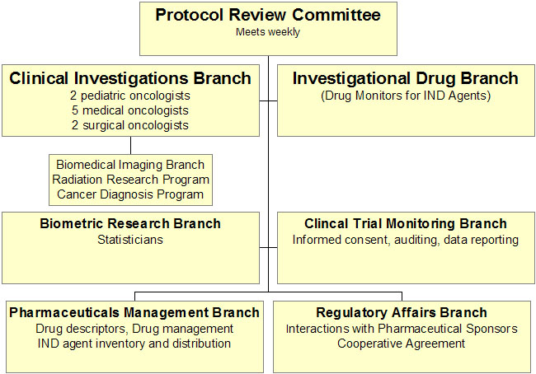
Who reviews your LOI?
AND Industry development partner

Slide 15
Consensus review of LOI
Summary of Consensus review
Comments requiring response
Comments from industry partner
Comments not requiring trial modification
Commitment of drug supply

Slide 16
CTEP on the Web - CTEP.CANCER.GOV
Program information
Recent solicitations
CTEP IND agents/contacts
Forms and Documents
LOI Forms
Protocol Templates
Guidelines
Components of a competitive Letter of Intent
http://ctep.cancer.gov/guidelines/index.html
Correlative study and tissue banking
Funding Opportunities
Informatics initiatives - AdEERS, CDUS
Model agreements - CDA, MTA, CTA, CRADA and CRADA appendices.

Slide 17
From Bench to Bedside
AGENTS
NCI
Industry
Academia
Review of
Data
CTEP
DTP
Preclinical
Development
CTA/CDA
NExT Committee
Clinical
Development
Development
Plan*
CTEP
IDSC
Investigators
Solicited, unsolicited LOIs
Solicitation
Letter of
Intent
Approval
STUDIES

