Slide 1
Purchase Management Essentials
Overview of the GSA SmartPay® Purchase Card
Purchase Management Essentials
Overview of the GSA SmartPay® Purchase Card
Presented by: Ms. Sarah Smith
Office of Charge Card Management
2012 GSA SmartPay Training Conference – Nashville, Tennessee
July 31, 2012 to August 2, 2012
Notes:
1

Slide 2
Introduction
Introduction
This presentation will provide A/OPCs information about the GSA SmartPay Purchase Card, which are available to Federal government agencies and organizations. The Office of Charge Card Management (OCCM) will also discuss the roles and responsibilities in managing the Purchase Card program, share leading practices, and provide some general resources available to agencies/organizations.

Slide 3
Agenda
Agenda
Overview of the GSA SmartPay Program ………….………. 7
The GSA SmartPay Purchase Card…………….……………. 16
Key Roles and Responsibilities………..………..…..……….. 28
Fraud, Waste, and Abuse…………………………………....… 34
Charge Card Management Leading Practices………….…. 43
General Resources….………………………………….………. 46

Slide 4
Overview of the GSA SmartPay Program

Slide 5
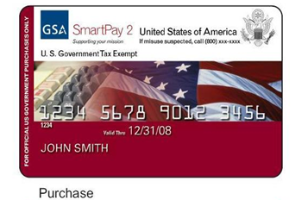
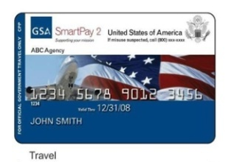
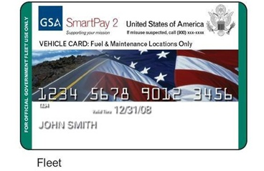
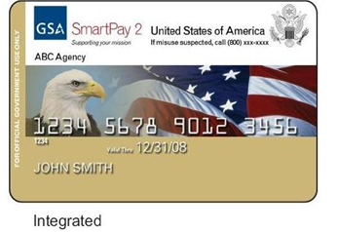
GSA SmartPay Program Overview
GSA SmartPay Program Overview
More than 350 Federal government agencies/
organizations can access charge card products
and services through the GSA SmartPay2
master contract.
Federal government agencies/organizations issue
task orders against the GSA SmartPay2 master
contract for charge card products and services
from one of three contractor banks:
Citibank
JP Morgan
U.S. Bank
Agencies/organizations pay no direct fees for using
the GSA SmartPay Program
Agency/organizations have the opportunity to earn refunds

Slide 6
GSA SmartPay Program Benefits
There are a number of benefits to using the GSA SmartPay Program as a payment solution, including:
Safety and Transparency – Improves financial controls and provides access to spending, and performance data
Electronic Access to Data – Provides agencies/organizations with online access to accurate, comprehensive transaction detail
Refunds – Agencies/Organizations earn refunds based on dollar volume of transactions; in Fiscal Year 2011, refunds totaled nearly $298 million
Worldwide Acceptance – Provides greater access to merchants across the globe
Favorable Pricing – Enhances the government negotiation leverage through strategic sourcing of enterprise data

Slide 7
FY 2011 GSA SmartPay Statistics
FY 2011 GSA SmartPay Statistics
FY 2011 Total Program Spend: $30.8 Billion
FY 2011 Total Transactions: 100.4 Million
FY 2011 Total Cards Issued: 3.6 Million
FY 2011 Net Agency Refunds: $297.9 Million
Purchase | FY 09 | FY 10 | FY 11
Spend | $19.3B | $19.2B | $19.0B
Transactions | 21.9 M | 22.2M | 21.3M
Cardholders | 270 K | 257K | 278K
Travel | FY 09 | FY 10 | FY 11
Spend | $8.9 B | $9.5B | $9.6B
Transactions | 45.3 M | 50.0M | 49.8M
Cardholders | 2.2 M | 2.2M | 2.5M
FY 2010
FY 2009
FY 2011
FY 2010
FY 2009
FY 2011
FY 2009
FY 2010
FY 2011
Fleet | FY09 | FY 10 | FY11
Spend | $1.5 B | $1.8 B | $2.2 B
Transactions | 25.9 M | 27.7M | 29.3M
Cards | 650 K | 633K | 856K
Spend
(Billions)
Transactions
(Millions)
Cards
(Millions)

Slide 8
Pop Quiz!
True or False: GSA SmartPay Purchase Cards are considered credit cards.
False
True
Answer: The answer is A. Cards under the GSA SmartPay Program are not credits cards. They are considered “charge cards” because the cards do not earn interest.

Slide 9
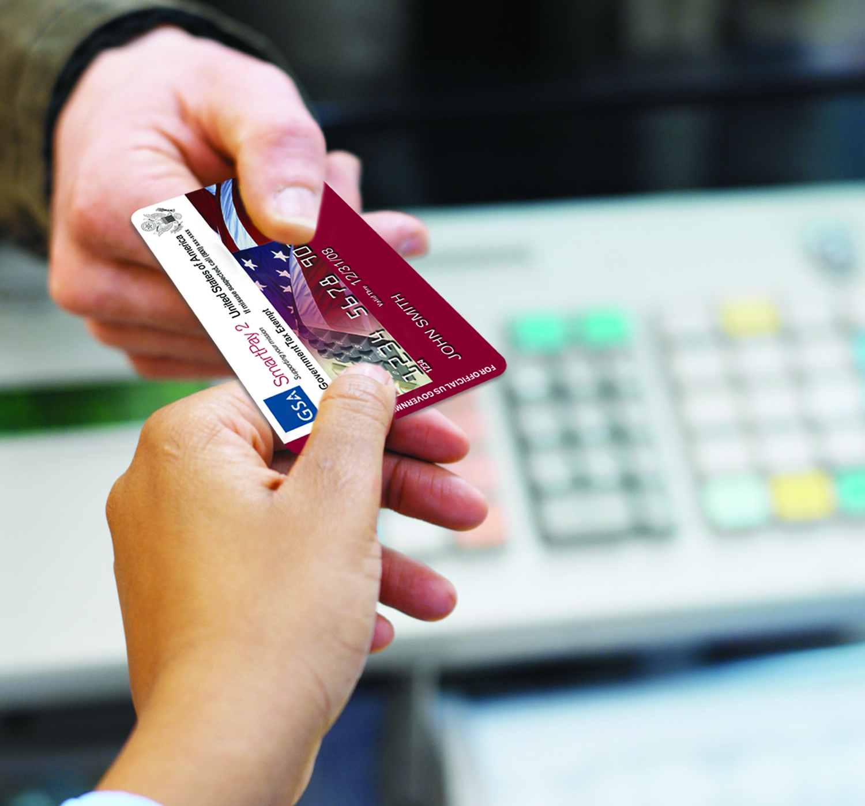
GSA SmartPay Products and Services
In accordance with the GSA SmartPay 2 master contract, servicing banks may provide products and services that include both Tier I and Tier II services. These include:
Magnetic stripe charge cards
Stored value and declining balance cards
Cardless Accounts
Contactless & Contact Chip Cards
Foreign Currency Cards

Slide 10
Pop Quiz!
True or False: ATM withdrawals can be made with a GSA SmartPay Purchase Card.
False
True
Answer: The answer is B. As long as your agency allows it and it is listed as a service in the task order with your GSA SmartPay contractor bank.

Slide 11
GSA SmartPay Program Stakeholders
GSA SmartPay Program Stakeholders
There are several GSA SmartPay stakeholders and the graphic below illustrates each programmatic relationship.
Office of Management and Budget
Oversight of government-wide charge card program
Agency/ Organizations
Use card products and services to support missions
Office of Charge Card Management
Provides overall program management and advocacy
Network Brands
Provides the transaction network for GSA SmartPay2 charge cards
Banks
Provide charge card products and services through GSA SmartPay2 Master Contracts
Issue charge cards

Slide 12
Bank Roles and Responsibilities
Bank Roles and Responsibilities
The GSA SmartPay Program contractor banks – Citibank, JP Morgan Chase, and U.S. Bank – have important responsibilities, which include providing:
Products and services
Free training
Requested reports to A/OPCs
Assistance with audits and investigations
Sales and productivity refunds
Commercial billing and automated payment systems
Internal card controls
Electronic Access Systems (EAS) to allow cardholders to view current statements, payment history, and account information, and to to make payments electronically
Bank EAS
Internet-based
Master contract-specified
Agency-specified

Slide 13
The GSA SmartPay Purchase Card

Slide 14
GSA SmartPay Purchase Card
GSA SmartPay Purchase Card
In accordance with the Federal Acquisition Regulation (FAR), the GSA SmartPay Purchase Charge Card is the preferred method of payment for supplies, goods, and services that are below the micro-purchase threshold of $3,000.
The Purchase Card is a procurement
and payment mechanism for
micro-purchases
For purchases above the micro-
purchase threshold, the Purchase
Card may be used as an ordering
and payment mechanism, but not a
contracting mechanism
Centrally billed
FY 2011 Statistics
Spend: $19.0 Billion
Transactions: 21.3 Million
Cardholders: 278 K
Purchase | FY 09 | FY 10 | FY 11
Spend | $19.3B | $19.2B | $19.0B
Transactions | 21.9 M | 22.2M | 21.3M
Cardholders | 270 K | 257K | 278K

Slide 15
Pop Quiz!
Joan, a contracting officer from ABC Agency, has placed an order with a contractor on GSA Federal Supply Schedule for $15,000. Can Joan use her GSA SmartPay purchase card?
Yes, but only as a payment mechanism, not a contracting mechanism
No, $15,000 is over the micro-purchase threshold
Answer: The answer is A. As long as the award was made using the ordering procedures in accordance with FAR 8.4 and the vendor agrees to accept the purchase card.

Slide 16
Pop Quiz!
Can George use Amazon to purchase office supplies under $3000 with the GSA SmartPay purchase card if he finds a deal that is less than the schedule price?
Yes
No
Maybe
Answer: The answer is C. Some agencies have policies that require purchase from specific BPAs or sources. If there is not a policy in place, this could be allowable.

Slide 17
Understanding Micro-purchase
Understanding Micro-purchase
In accordance with the FAR, a micro-purchase is an acquisition of supplies, goods or services in which the amount does not exceed $3,000.
The limit is $2,000 in the case of construction, $15,000 in the case of contingency operations inside of the United States, and $25,000 in the case of contingency operations outside of the United States
Cardholders cannot split purchases in order to stay below authorized spend limits
For purchases above the micro-purchase threshold, the Purchase Card may be used as an ordering and payment mechanism, however not as a contracting mechanism

Slide 18
OMB A-123, Appendix B (1 or 2)
OMB A-123, Appendix B (1 of 2)
Office of Management and Budget (OMB) Circular A-123, Appendix B, Improving the Management of Government Charge Card Programs (revised January 15, 2009):
Consolidates and updates current government-wide charge card program requirements and guidance issued by OMB, GSA, Treasury and other Federal agencies
Establishes standard minimum requirements and best practices for improving the management of government charge card programs
Provides a single source document to incorporate
updates, new guidance, or amendments to
existing guidance

Slide 19
OMB A-123, Appendix B (2 of 2)
OMB A-123, Appendix B (2 of 2)
This OMB Circular directs agencies to:
Develop and maintain charge card management plan
Provide charge card management training
Implement risk management controls, policies, and practices in implementing charge card management programs
Maintain and report data and performance metrics
Assess credit worthiness of all new travel card applicants
Manage charge card refunds
Implement strategic sourcing for certain commodities & analyze purchase card spending data
Adhere to Section 508 of the Rehabilitation Act
Account for environmental quality of products procured with charge cards
Recover state and local taxes levied on charge card purchases
Develop and maintain written policies and procedures for appropriate use of convenience checks
Issue policies and procedures to ensure effective management of Federal property

Slide 20
Leading Practices – Training
Leading Practices – Training
Training cardholders is also a powerful tool in managing an agency/organization’s GSA SmartPay Program. A/OPCs are encouraged to:
Ensure cardholders and A/OPCs fulfill training requirements
Provide a comprehensive face-to-face training as orientation for new cardholders, if possible
Engage in bank-sponsored training
Attend the Annual GSA SmartPay Training Conference
Ensure training is easily accessible
Address standards of conduct/ethics and clearly
state consequences for misuse

Slide 21
Pop Quiz!
How many cardholders and A/OPCs do you think have taken our GSA SmartPay Online Training since February 2011?
50,000
100,000
More than 265,000
Answer: The answer is C. Since release in February 2011, more than 266,250 people have taken one or more of the GSA SmartPay online training courses on the GSA SmartPay website.

Slide 22
GSA SmartPay Online Training
GSA SmartPay Online Training
GSA SmartPay offers free online purchase card and travel card training for cardholders and A/OPCs:
Cardholders can register, set up a profile, and manage their online training courses and certificates.
Level 1 A/OPCs can run reports and search for cardholders within their agency.
https://training.smartpay.gsa.gov

Slide 23
Pop Quiz!
What do you think is our most popular section of the website?
The SmartBlog
FAQs
State Tax Information Page
Bank Contact Information
Answer: The answer is C. In March of 2012, the GSA SmartPay website had 46, 599 visitors and 11,525 of them visited the SmartTax section.

Slide 24
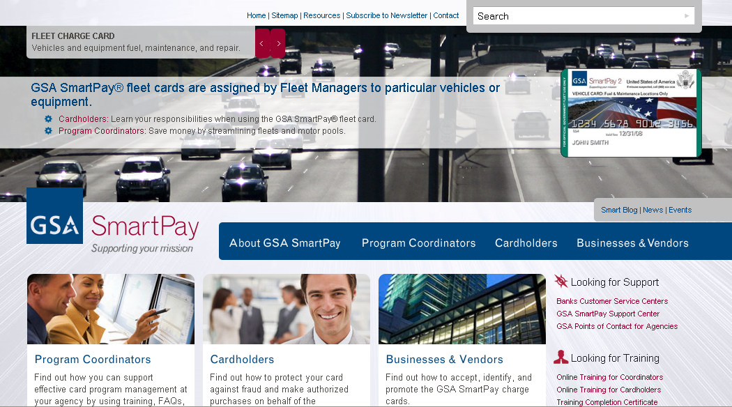
The GSA SmartPay Website
The GSA SmartPay Website
Home of all GSA SmartPay charge card information, resources, guidance, news, and more.
What's New
Program Statistics
New Legislation
GSA SmartTax
Managing Your Program
GSA SmartBlog
Accepting GSA SmartPay® Cards
Online Training for Cardholders and A/OPCs
http://smartpay.gsa.gov

Slide 25
Key Roles and Responsibilities

Slide 26
Key Roles and Responsibilities
Key Roles and Responsibilities
There are several key roles and responsibilities for effective GSA SmartPay Purchase Card management:
A/OPCs
Agency / Organization Program Coordinator
Component Program Managers
A/O and C/O
Approving Officials
Certifying Officials
Cardholders
Employees issued government purchase charge cards

Slide 27
A/OPC Roles and Responsibilities
A/OPC Roles and Responsibilities
A/OPC are liaisons between the agency/organization management, GSA SmartPay contractor banks, cardholders, and GSA OCCM. Roles may differ with each organization, but could include:
Manage agency/organization GSA SmartPay Purchase Card Program
Develop agency/organization-specific policies and procedures
Serve as liaison between the agency/organization management, contract vendors, banks, cardholders, and GSA
Keep necessary account information current
Audit purchase card accounts
Ensure centrally billed accounts are properly approved
Monitor & take appropriate action for fraud, waste, or abuse

Slide 28
AO Roles and Responsibilities
AO Roles and Responsibilities
Approving Officials (AO) are often the first line of defense against fraud, waste, and abuse. Roles may differ with each agency/organization, but could include:
Review and approve all GSA SmartPay Purchase Card transactions
Resolves all questionable charges
Monitor employee compliance with charge card regulations/guidance
Certify monthly invoices
Verify receipt of purchases and/or transactions

Slide 29
Cardholder Roles and Responsibilities (1 of 2)
Cardholder Roles and Responsibilities (1 of 2)
Cardholders must use the charge card in accordance with agency/organization policy and government regulations. Other responsibilities could include:
Use card for OFFICIAL expenses ONLY
Keep up to date with required program and agency-specific training
Keep up to date on communications from A/OPCs, and take appropriate action, as required
Contact A/OPCs for card use questions
Immediately report a lost or stolen card
Gain access to the bank’s Electronic Access System (EAS)
Accurately monitor and track expenses, as well as keep all receipts, in accordance with agency policy
Ensure accounts are reconciled in a timely manner and submit full payment for each undisputed bill

Slide 30
Cardholder Roles and Responsibilities (2 of 2)
Cardholder Roles and Responsibilities (2 of 2)
Cardholders must NEVER:
Use the GSA SmartPay Charge Card for personal use
Allow monthly bill to become overdue; this could result in suspension or cancellation of a GSA SmartPay Charge Card
Wait for receipt of the monthly bill to file claims
Pay for another employee’s charge card expense(s)
Write Personal Identification Numbers (PIN) on the GSA SmartPay Charge Card or carry the PIN on their person (e.g., wallet or purse)

Slide 31
Fraud, Waste, and Abuse

Slide 32
Risk Management
Risk Management
In accordance with OMB A-123, Appendix B, Chapter 4 Risk Management, agencies are directed to develop internal controls to:
Review of cardholder statements & account activity
Investigate questionable or suspicious transactions
Make timely, accurate, and appropriate payments
Ensure disciplinary actions are taken when cards are misused
Review of ATM cash withdrawals for reasonableness and association with official travel
Provide training to cardholders, approving officials, and other relevant stakeholders

Slide 33
Understanding Fraud
Understanding Fraud
Fraud is any felonious act of corruption or attempt to cheat the government or corrupt the government’s agents. For the GSA SmartPay Purchase Card, fraudulent activity is NOT:
Sanctioned
Authorized
Part of official government business
Pertinent to an employee’s official government capacity
For the purpose for which the card was issued for

Slide 34
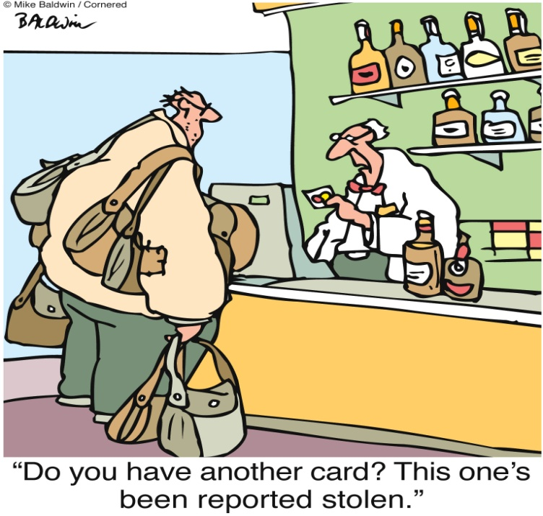
What is Fraud?
What is Fraud?
Non-cardholder fraud involves use of the card or cardholder data by an unauthorized person. High-risk situations for non-cardholder fraud include:
Card was never received
Card was lost
Card was stolen
Altered or counterfeit cards
Account takeover

Slide 35
What is Waste and Misuse?
What is Waste and Misuse?
Waste is defined as any charge card activity that fosters, or results in, unnecessary costs or other program inefficiencies. Misuse is defined as use of charge card to buy authorized items at terms that are excessive (e.g. price, quantity), are questionable (government need). Examples include:
Purchases exceed the cardholder's limit
Purchase not authorized by the agency
Purchases for which there is no funding
Purchases for personal consumption
Purchases that do not comply with governing card type policies

Slide 36
Mitigating Fraud, Waste, Abuse Risk
Mitigating Fraud, Waste, Abuse Risk
Misuse by employees impacts agency/organization charge card performance and refund earning potential. Some leading practices to mitigate this risk include:
Emphasize standards of conduct/ethics and clearly state consequences for misuse
Periodically monitor authorization controls and set reasonable transaction limits
Restrict spend use through Merchant Category Code (MCC) blocks
Deactivate cards as appropriate – cards with little or no activity should be considered for closure
Manage delinquency and implement proper training
Review card activity through reports generated from
the bank’s EAS

Slide 37
Deactivation Leading Practices
Deactivation Leading Practices
To help streamline agency/organization charge card programs and mitigate the risk of fraud, waste, and abuse, deactivating cards that are no longer in use can be a powerful and proactive practice.
A/OPCs can quickly deactivate/reactivate cards electronically or by contacting the bank’s designated representative
If a card is deactivated, authorizations are declined at point of sale
Notify cardholder of deactivation, and communicate procedures to re-activate (e.g., who to call and when to call)
Be wary of automatic billing (e.g. magazine subscriptions) and forced transactions (e.g. vendor manually processing the charge card)
Close charge card accounts for cardholders who leave the agency (will vary by agency policy and business line)

Slide 38
Possible Indicators of Fraud/Misuse
Possible Indicators of Fraud/Misuse
Be aware of activities that may indicate questionable cardholder activity.
Account closed due to fraud and new card has been issued
Multiple authorizations declined
Frequent transaction disputes
Consistently meets or exceeds monthly limit
Addressing Issues of Fraud
Report any suspected or actual fraud
File a complaint with agency’s Office of the Inspector General
Use agency fraud reporting hotlines

Slide 39
Possible Consequences
Possible Consequences
Potential consequences of cardholder fraud, waste, and abuse may include the following:
Reprimand
Counseling
Card Cancellation
Performance Evaluation Notation
Employment Suspension
Employment Termination
Criminal Prosecution

Slide 40
Charge Card Management Leading Practices

Slide 41
Reporting Leading Practices
Reporting Leading Practices
GSA SmartPay contractor banks are required to issue reports to A/OPCs that address transactions, payments, disputes, and delinquencies. A/OPCs should:
Monitor bank reports regularly, which will allow A/OPCs to oversee the agency/organization’s overall charge card financial condition and monitor for fraud waste, and abuse
Use bank reports proactively, not
reactively for activities such as invoice
and payment data, and meeting OMB
requirements
Understand all available reports**
Develop automated reports, specific
to the agency/organization
Available Reports
Reports include, but are not limited to:
Account Activity Report
Declined Authorizations Report
Dispute Report
Unusual Spending Activity Report
Master File
** A full listing of agency reports can be found in section C.3.3.1 of the GSA SmartPay2 Master Contract

Slide 42
Opportunities for Expansion
Opportunities for Expansion
GSA SmartPay Purchase Card best practices:
Coordinate with banks to review agency A/P file to identify
opportunities to expand GSA SmartPay Purchase Card use
for micro-purchases and larger purchases
Explore greater use of card/cardless payment systems for contract payments, including card/cardless as payment option in contract terms and conditions
Maximize use of Federal Strategic Sourcing Initiative BPAs (i.e., office supplies, print management, ground delivery, technology (apps.gov), transportation, photographic equipment, hardware superstore, professional audio/video telemetry/tracking, recording/reproducing and signal data solutions)
Consider use of payment cards, single use accounts, transit subsidy cards, and other innovative payment tools
Further utilize card/cardless payment data as a component of agency strategy to identify/reduce erroneous payments

Slide 43
General Resources

Slide 44
Additional Resources
OMB Circular A-123 Appendix B
http://www.whitehouse.gov/omb/circulars/a123/a123_appendix_b.pdf
GSA Federal Travel Regulations
http://www.gsa.gov/ftr
Federal Acquisitions Regulations
www.acquisition.gov/far
GSA SmartPay2 Master Contract
https://smartpay.gsa.gov/program-coordinators/contract-documents/master-contract
GSA SmartPay Website
https://smartpay.gsa.gov

Slide 45
Bank Contact Information
Bank Contact Information
Citibank (http://www.cards.citidirect.com/welcome.asp)
Customer Service: (800) 790-7206
JP Morgan Chase (https://www.paymentnet.com/Login.asp)
Customer Service: (888) 297-0781
U.S. Bank (https://access.usbank.com/cpsApp1/index.jsp)
Customer Service: (888) 994-6722

Slide 46
Additional GSA SmartPay Courses
GSA SmartPay 2 Program Update
Effective Oversight of Your GSA SmartPay Program
GSA SmartPay 2 Master Contract Basics
GSA SmartPay Innovative Products & Services
GSA SmartPay Purchase Management Essentials
GSA SmartPay Travel Management Essentials
GSA SmartPay Fleet Management Essentials
GSA SmartTax: What You Should Know About State Taxes

Slide 47
Questions

Slide 48
Thank you for your time and attention!
Contact Information:
GSA SmartPay Program Support: (703) 605-2808 gsa_smartpay@gsa.gov
Please take the course survey online by visiting, www.gsasmartpayconference.org/survey or using the link sent to you via email from Feedback Systems. Surveys can be taken through any mobile device.

