Slide 1
Travel Management Essentials
Overview of the GSA SmartPay® Travel Card
Travel Management Essentials
Overview of the GSA SmartPay® Travel Card
Presented by: Mr. Perry Hampton, Director QMBA
Office of Charge Card Management
2012 GSA SmartPay Training Conference – Nashville, Tennessee
July 31, 2012 to August 2, 2012
Notes:
1

Slide 2
Introduction
Introduction
This presentation will provide A/OPCs and cardholders information about the GSA SmartPay Travel Card, which are available to Federal government agencies and organizations. The Office of Charge Card Management (OCCM) will also discuss the roles and responsibilities in managing a Travel Card program, share leading practices, and provide some general resources available to agencies/organizations.

Slide 3
Agenda
Agenda
Overview of the GSA SmartPay Program ………….………. 6
GSA SmartPay Travel Card ………..………..…..……………. 11
Charge Card Management Roles and Responsibilities..… 17
Charge Card Management Leading Practices………….…. 23
General Resources….………………………………….………. 30

Slide 4
Polling the Audience
How many audience members are new to the GSA SmartPay Training Conference this year?
This is my first year!
I have attended the GSA SmartPay Training Conference before

Slide 5
Polling the Audience
How many audience members are:
Level 1 through 3 A/OPCs
Level 4 or below A/OPCs
Cardholders
Industry
Other
Unsure

Slide 6
Overview of the GSA SmartPay Program

Slide 7
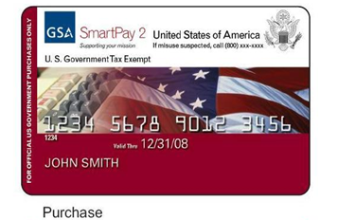
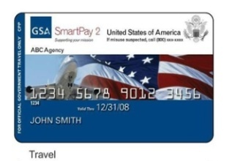
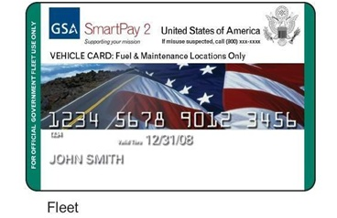
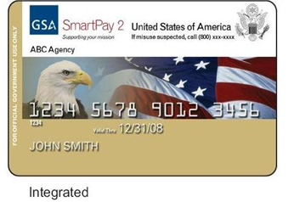
GSA SmartPay Program Overview
GSA SmartPay Program Overview
More than 350 Federal government agencies/
organizations can access charge card products
and services through the GSA SmartPay2
master contract.
Federal government agencies/organizations issue
task orders against the GSA SmartPay2 master
contract for charge card products and services
from one of three contractor banks:
Citibank
JP Morgan
U.S. Bank
Agencies/organizations pay no direct fees for using
the GSA SmartPay Program
Agency/organizations have the opportunity to earn refunds

Slide 8
FY 2011 GSA SmartPay Statistics
FY 2011 GSA SmartPay Statistics
FY 2011 Total Program Spend: $30.8 Billion
FY 2011 Total Transactions: 100.4 Million
FY 2011 Total Cards Issued: 3.6 Million
FY 2011 Net Agency Refunds: $297.9 Million
Purchase | FY 09 | FY 10 | FY 11
Spend | $19.3B | $19.2B | $19.0B
Transactions | 21.9 M | 22.2M | 21.3M
Cardholders | 270 K | 257K | 278K
Travel | FY 09 | FY 10 | FY 11
Spend | $8.9 B | $9.5B | $9.6B
Transactions | 45.3 M | 50.0M | 49.8M
Cardholders | 2.2 M | 2.2M | 2.5M
FY 2010
FY 2009
FY 2011
FY 2010
FY 2009
FY 2011
FY 2009
FY 2010
FY 2011
Fleet | FY09 | FY 10 | FY11
Spend | $1.5 B | $1.8 B | $2.2 B
Transactions | 25.9 M | 27.7M | 29.3M
Cards | 650 K | 633K | 856K
Spend
(Billions)
Transactions
(Millions)
Cards
(Millions)

Slide 9
GSA SmartPay Program Benefits
There are a number of benefits to using the GSA SmartPay Program as a payment solution, including:
Safety and Transparency – Improves financial controls and provides access to spending, and performance data
Electronic Access to Data – Provides agencies/organizations with online access to accurate, comprehensive transaction detail
Refunds – Agencies/Organizations earn refunds based on dollar volume of transactions; in Fiscal Year 2011, refunds totaled nearly $298 million
Worldwide Acceptance – Provides greater access to merchants, across the globe
Favorable Pricing – Enhances the government negotiation leverage through strategic sourcing of enterprise data

Slide 10
GSA SmartPay Program Stakeholders
GSA SmartPay Program Stakeholders
There are several GSA SmartPay stakeholders and the graphic below illustrates each programmatic relationship.
Office of Charge Card Management (OCCM)
Provides overall program management and advocacy
Office of Management and Budget (OMB)
Perform oversight of the government-wide charge card program
Agencies/Organizations
Use charge card products and services to support their missions and operations
MasterCard/ VISA
Partner with the banks to issue GSA SmartPay charge cards
Banks
Provide charge card products and services through the GSA SmartPay 2 master contract; partner with MasterCard/VISA to issue cards

Slide 11
GSA SmartPay Travel Card

Slide 12
GSA SmartPay Travel Charge Card
GSA SmartPay Travel Charge Card
The Travel Card can be used for official government travel and travel-related costs, and allows access to GSA City Pair reduced airfares.
Agency/organizations are able to
reduce travel processing costs
and earn refunds
Annual spend has nearly tripled since
the program’s inception in 1998
FY 2011 Statistics
Spend: $9.6 Billion
Transactions: 49.8 Million
Cardholders: 2.5 Million
Travel | FY 09 | FY 10 | FY 11
Spend | $8.9 B | $9.5B | $9.6B
Transactions | 45.3 M | 50.0M | 49.8M
Cardholders | 2.2 M | 2.2M | 2.5M
Notes:
Another benefit of the travel card is access to the GSA City Pair program
This program provides substantial reductions in ticket prices between paired cities.
You can not get these reduced prices unless you purchase the tickets with SmartPay2 travel card.

Slide 13
Regulatory History of the Travel Card
Regulatory History of the Travel Card
There are several historical laws and regulations that govern the use of the GSA SmartPay Travel Card.
Travel and Transportation Reform Act of 1998 (P.L. 105-264) mandates Travel Card use for government travel expense payment
Exemptions (e.g., employees who travel less than five times a year) are allowed in accordance with the Federal Travel Regulation (FTR)
Consolidated Appropriations Act of 2008 (P.L. 110-161) requires each agency/organization to evaluate the credit worthiness of an individual before issuing a Travel Card (existing cardholders exempt)
Office of Management and Budget Circular A-123, Appendix B establishes requirements for improving charge card programs, which include maintaining a charge card management plan, training, risk management controls, and managing refunds. These can be supplemented by individual agency policies and procedures
Notes:
The Government Travel Card were introduced in the 1980’s but
Employees were not required to use them until passage of the Travel and Transportation Reform Act (TTRA) of 1998 (Public Law 105-264).
This law mandates use of the GSA SmartPay travel card for official government travel expenses.
The Federal Travel Regulations does allows exempts at the discretion of the agencies.
In 2008 and 2009, 2 major laws impacting the program were passes:
Consolidated Appropriations Act
OMB Circular A-123, Appendix B
And this year Local Travel policy changes were implemented.
The Consolidated Appropriations Act of 2008 greatly impacted the travel charge card program.
It introduced “credit worthiness assessments” for all New cardholders
This credit check must be done before issuance of the travel card.
Existing cardholders are exempt from this requirement.
OMB Circular A-123, Appendix B focuses on “improving the Management of the Government Charge Card Program
You should become very familiar with this directive because it
consolidates into one documents program requirements and guidance from OMB, GSA, Treasury and other Federal agencies.
establishes minimum program requirements and
identifies some of the best practices for charge card program management
Your individual agencies can supplement the policies and procedures in this guide.
You can implement more restrictive guidelines for your individual organizations but you can not be more liberal.

Slide 14
Travel Card Use for Local Travel
Travel Card Use for Local Travel
There have been recent changes to the FTR about local travel, using the GSA SmartPay Travel Card use.
New optional use of the card for local travel will be for agencies, at their discretion
DoD Joint Travel Regulations already permits use of the Travel Card for local travel expenses
Examples of local travel include -- but are not limited to -- taxi fares, public transportation, and ferry tickets
OCCM recommends that agencies/organizations develop and issue internal policies addressing oversight and internal controls for managing use of the Travel Card for local travel
Notes:
Effective June 4, 2010, local travel policy was changed in the Federal Travel Regulations.
Federal civilian agencies can now authorize their employees to use the travel charge card for local travel
New optional use of the card for local travel will be for civilian agencies, at their discretion
DoD Joint Travel Regulations already permits use of the Travel Card for local travel expenses.

Slide 15
Types of GSA SmartPay Travel Cards
Types of GSA SmartPay Travel Cards
Centrally Bill Accounts (CBA) and Individually Billed Accounts (IBA) Travel Cards.
Standard Travel Cards:
Total credit/cash limits will vary based on agency/organization policy
Spilt disbursement is mandatory
Billing statement mailed to cardholder’s address
Restricted Travel Cards:
Total credit/cash limits will vary based on agency/organization policy
A/OPC “Activation/Deactivation” may be required
Spilt disbursement is mandatory
Billing statement mailed to cardholder’s address
Centrally Billed Accounts (Transportation Accounts and Unit Cards):
Limited use
Credit limit consistent with agency/organization mission
Government liability
Account Manager is responsible for management and reconciliation
Notes:
There are two types of billing accounts in the SmartPay 2 charge card program:
IBA – Individually Billed Accounts – Individually Liability
CBA – Centrally Billed Accounts – Government Liability
IBA’s are billed directly to the traveler issued the charge card. IBA’s have two types of cards, Standard Cards and Restricted Cards.
Standard Cards will be given to anyone that has a credit score of 660 and above.
Restricted Cards will be given to anyone who has a credit score 659 and below.
CBA’s accounts are billed directly to the Government and paid directly by the Government. The Government is responsible for paying all centrally billed charges including those that are improperly incurred through employee action.
Stored Value and Declining Balance Cards
These services are very flexible and can be customized to specialized needs such as
when employees don’t meet the credit worthiness check or for
specialized travel such as change of station travel
There are also pre-paid cards and cardless account offerings.
These cards can be loaded and reload with specific dollar values
Stored Value & Declining Balance cards, also known as “Pre-paid travel cards” can be issued quickly to those that do not hold a permanent travel card
Uses include:
travel funds for non-travel cardholders that must go on emergency travel
cardholders that do not meet the GSA Federal Acquisition Regulation (FAR) travel card requirement
Cardless Accounts
Provide vendor-specific charge accounts without physical cards
Facilitate faster point of sale transactions

Slide 16
Charge Card Management Roles and Responsibilities

Slide 17
A/OPC Roles and Responsibilities
A/OPC Roles and Responsibilities
Agency/Organization Program Coordinators (A/OPC) are liaisons between the agency/organization management, GSA SmartPay2 contractor banks, cardholders, and GSA OCCM. Roles may differ with each organization, but could include:
Managing all agency/organization GSA SmartPay Card programs
Promoting appropriate use of GSA SmartPay Charge Cards
Monitoring and taking appropriate action for fraud, waste, or abuse
Resolving technical and operational problems between GSA SmartPay2 contracting bank and cardholders, as required
Developing agency/organization-specific policies and procedures, as necessary
Maintaining open lines of communication

Slide 18
AO Roles and Responsibilities
AO Roles and Responsibilities
Approving Officials (AO) are often the first line of defense against fraud, waste, and abuse. Roles may differ with each agency/organization, but could include:
Review and approve all GSA SmartPay Charge Card transactions and verify transactions are appropriate and necessary for accomplishing the agency/organization’s mission
Monitor for and resolve all questionable charges
Monitor employee compliance with charge card regulations/guidance
Certify monthly invoices
Verify receipt of purchases and/or transactions
Notes:
Approving Officials have a different set of duties.
They are often the first line of defense against misuse, abuse and fraud.
They perform the operational, audit and tracking associated with processing travel expenses.
Approving Officials are a critical part of the charge card program. Proper care must be taken to ensure that Approving Officials completely understand their role and responsibilities, and that they assist in monitoring card use appropriately.

Slide 19
Cardholder Roles and Responsibilities (1 of 2)
Cardholder Roles and Responsibilities (1 of 2)
Cardholders must use the charge card in accordance with agency/organization policy and government regulations. Other responsibilities could include:
Keep up to date with required program and agency-specific training
Keep up to date on communications from A/OPCs, and take appropriate action, as required
Contact A/OPCs for card use questions
Immediately report a lost or stolen card
Gain access to the bank’s Electronic Access System (EAS)
Accurately monitor and track expenses, as well as keep all receipts, in accordance with agency policy
Ensure accounts are reconciled in a timely manner and submit full payment for each undisputed bill
Notes:
And of course we have the cardholder’s responsibilities.
The things they should do are listed here.
Cardholders SHOULD:
Use of the charge card appropriately, in accordance with agency/organization policy, other laws, and governmental regulations
Keep up to date with required program & agency-specific training, including refresher training
Look out for communications from A/OPCs / CPMs and take appropriate action
Contact their APC for questions regarding use of the card
Immediately report a lost or stolen card
Register for Electronic Access System (EAS) on-line access
Use card for OFFICIAL travel expenses ONLY
Track expenses while on travel in order to have accurate information for filing travel claims
Keep receipts for All transactions charged on travel card
File travel claim within 5 days of return from TDY
Submit payment in full for each monthly bill

Slide 20
Cardholder Roles and Responsibilities (2 of 2)
Cardholder Roles and Responsibilities (2 of 2)
Cardholders must NEVER:
Use the GSA SmartPay Charge Card for personal use
Obtain ATM advances which exceed the expected out-of pocket-expenditures
Allow monthly bill to become overdue; this could result in suspension or cancellation of a GSA SmartPay Charge Card
Wait for receipt of the monthly bill to file claims
Pay for another employee’s charge card expense(s)
Write Personal Identification Numbers (PIN) on the GSA SmartPay Charge Card or carry the PIN on their person (e.g., wallet or purse)
Notes:
The things they shouldn’t do are listed here:
Cardholders SHOULD NOT:
Use the Travel Card for personal use
Obtain ATM travel advances which exceed the expected out of pocket expenditures for a trip
Allow monthly bill to become overdue; this could result in suspension or cancellation of Travel Card
Wait for receipt of the monthly bill to file travel claims
Pay for another individuals travel expense
Write their personal identification number (PIN) on the card or carry in a wallet

Slide 21
Bank Roles and Responsibilities
Bank Roles and Responsibilities
The GSA SmartPay Program contractor banks – Citibank, JP Morgan Chase, and U.S. Bank – have important responsibilities, which include:
Provide AO or A/OPC the ability to view current statements, payment history, and account information to make payments electronically
Issue required reports to A/OPCs
Provide assistance with audits and investigations
Notes:
Our SP2 banks are at the center of all program operations and have significant responsibilities:
You should work closely with your banks on all aspects of your programs.
Listed are roles and responsibilities of GSA SmartPay2 contractor banks.
Contractor banks provide charge card products and services to agencies/organizations through the Master Contract and partner with MasterCard/Visa to issue cards
Provide training and training support
Issue required reports, data analysis, and additional reporting support
Provide assistance with audits and investigations
Provide sales and productivity refunds
Offer commercial billing and automated payment systems
Provide controls for preventing card misuse
Allow the cardholder to view current statements, payment history, and account information to make payments electronically

Slide 22
Charge Card Management Leading Practices

Slide 23
Opportunities for Efficiencies
Opportunities for Efficiencies
GSA SmartPay Travel Card best practices:
Emphasize that use of the GSA SmartPay
Travel Card for expenses on official Federal
government travel is required by the Federal
Travel Regulations and that it benefits agencies from a refund perspective
Leverage GSA SmartPay contract bank processes to reduce improperly assessed State taxes on IBA Travel Cards (currently 11 States do not tax these cards)

Slide 24
Charge Card Leading Practices
Charge Card Leading Practices
There are some leading practices that may help AOs and A/OPCs in more effectively managing their GSA SmartPay Charge Card Program.
Monitor appropriate reports and remind cardholders to pay their bills in a timely manner, to avoid becoming delinquent
Publish “Frequently Asked Questions” on the agency/organization’s internal website
Create a monthly newsletter for agency/organization travel policies and procedures
Develop automated reports, to eliminate manually performing data analysis

Slide 25
Mitigating Fraud, Waste, Abuse Risk
Mitigating Fraud, Waste, Abuse Risk
Misuse by employees impacts agency/organization charge card performance and refund earning potential. Some leading practices to mitigate this risk include:
Establish policies and procedures to detect and mitigate the risk of fraud, waste, and abuse and emphasize standards of conduct/ethics and clearly state consequences for misuse
Monitor authorization controls and set reasonable transaction limits
Review card activity through bank EAS reports and restrict spend use through Merchant Category Code (MCC) blocks
Deactivate cards as appropriate – cards with little or no activity should be considered for closure
Manage delinquency and implement proper training
Establish internal controls to ensure accounts are closed, when necessary

Slide 26
Leading Practices – Reporting
Leading Practices – Reporting
GSA SmartPay contractor banks are required to issue reports to A/OPCs that address transactions, payments, disputes, and delinquencies. A/OPCs should:
Monitor bank reports regularly, which will allow A/OPCs to oversee the agency/organization’s overall charge card financial condition and monitor for fraud waste, and abuse
Use bank reports proactively, not
reactively for activities such as invoice
and payment data, and meeting OMB
requirements
Understand all available reports**
Develop automated reports, specific
to the agency/organization
Available Reports
Reports include, but are not limited to:
Account Activity Report
Declined Authorizations Report
Pre-Suspension Report
Transaction Dispute Report
Renewal Report
** A full listing of agency reports can be found in section C.3.3.1 of the GSA SmartPay2 Master Contract

Slide 27
Leading Practices – Deactivation
Leading Practices – Deactivation
To help streamline agency/organization charge card programs and mitigate the risk of fraud, waste, and abuse, deactivating cards that are no longer in use can be a powerful and proactive practice.
A/OPCs can quickly deactivate/reactivate cards electronically or by contacting the bank’s designated representative
If a card is deactivated, authorizations are declined at point of sale
Notify cardholder of deactivation, and communicate procedures to re-activate (e.g., who to call and when to call)
Be wary of automatic billing (e.g. magazine subscriptions) and forced transactions (e.g. vendor manually processing the charge card)
Close charge card accounts for cardholders who leave the agency (will vary by agency policy and business line)

Slide 28
Leading Practices – Training
Leading Practices – Training
Training cardholders is also a powerful tool in managing an agency/organization’s GSA SmartPay Program. A/OPCs are encouraged to:
Ensure cardholders and A/OPCs fulfill training requirements
Provide a comprehensive face-to-face training as orientation for new cardholders, if possible
Engage in bank-sponsored training
Attend the Annual GSA SmartPay Training Conference
Ensure training is easily accessible
Address standards of conduct/ethics and clearly state consequences for misuse

Slide 29
General Resources

Slide 30
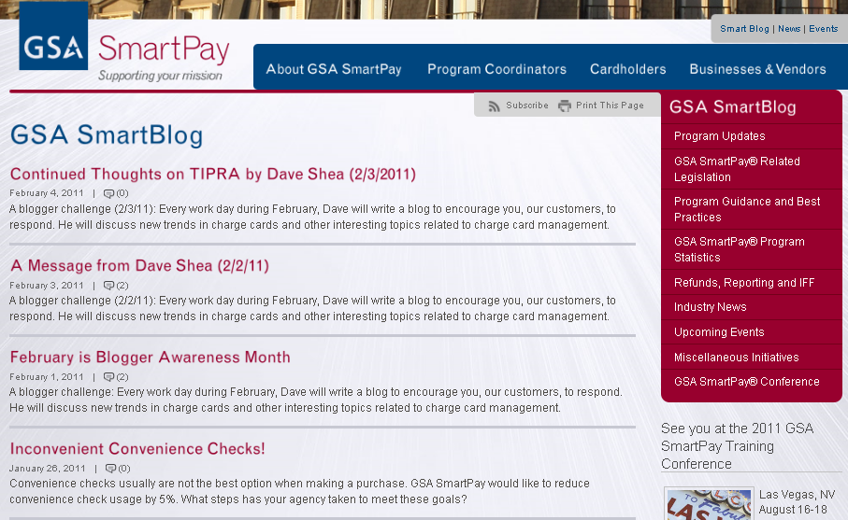
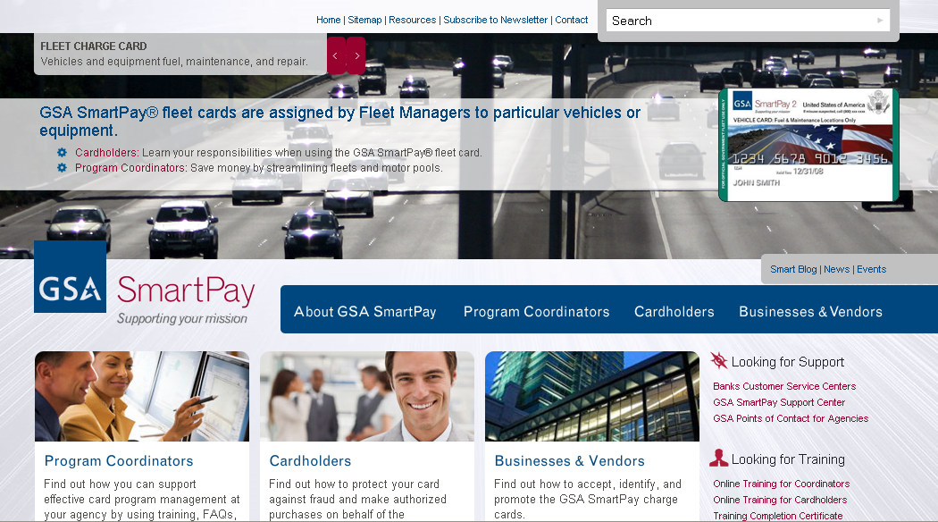
The New GSA SmartPay Website and Blog
The New GSA SmartPay Website and Blog
To provide customers with enhanced charge card information, OCCM launched an improved GSA SmartPay website, which includes a blog and enhanced training content.
What's New
Program Statistics
New Legislation
State Tax Information
Managing Your Program
GSA SmartBlog
Accepting GSA SmartPay® Cards
Online Training for Cardholders and A/OPCs
http://smartpay.gsa.gov

Slide 31
Additional Resources
OMB Circular A-123 Appendix B
http://www.whitehouse.gov/omb/circulars/a123/a123_appendix_b.pdf
“Helpful Hints for Travel Card Use” and “A Guide for Managing your GSA SmartPay Travel Charge Card Program” Brochures
http://apps.fss.gsa.gov/cmls
GSA Federal Travel Regulations
http://www.gsa.gov/ftr
Federal Acquisitions Regulations
www.acquisition.gov/far/
The Department of Defense, JFTR (for military employees)
http://www.defensetravel.dod.mil/perdiem/trvlregs.html
The Department of Defense JTR (for civilian employees)
http://www.defensetravel.dod.mil/perdiem/trvlregs.html

Slide 32
Bank Contact Information
Bank Contact Information
Citibank (http://www.cards.citidirect.com/welcome.asp)
Customer Service: (800) 790-7206
JP Morgan Chase (https://www.paymentnet.com/Login.asp)
Customer Service: (888) 297-0781
U.S. Bank (https://access.usbank.com/cpsApp1/index.jsp)
Customer Service: (888) 994-6722

Slide 33
Additional GSA SmartPay Courses
GSA SmartPay 2 Program Update
Effective Oversight of Your GSA SmartPay Program
GSA SmartPay 2 Master Contract Basics
GSA SmartPay Innovative Products & Services
GSA SmartPay Purchase Management Essentials
GSA SmartPay Travel Management Essentials
GSA SmartPay Fleet Management Essentials
GSA SmartTax: What You Should Know About State Taxes

Slide 34
Questions

Slide 35
Thank you for your time and attention!
Contact Information:
GSA SmartPay Program Support: (703) 605-2808 gsa_smartpay@gsa.gov
Please feel free to provide your feedback and thoughts on our website, available at http://smartpay.gsa.gov/feedback. Also, don’t forget to visit the GSA SmartBlog at: https://smartpay.gsa.gov/blogs.
Don’t forget to take the course survey online by visiting, www.gsasmartpayconference.org/survey or using the link sent to you via email from Feedback Systems. Surveys can be taken through any mobile device.

