Slide 1
Influenza Vaccine Update
Clinician Outreach and Communication Activity (COCA) Conference Call
March 23, 2010

Slide 2
Continuing Education Disclaimer
In compliance with continuing education requirements, all presenters must disclose any financial or other relationships with the manufacturers of commercial products, suppliers of commercial services, or commercial supporters as well as any use of unlabeled product(s) or product(s) under investigational use.
CDC, our planners, and our presenters wish to disclose they have no financial interests or other relationships with the manufacturers of commercial products, suppliers of commercial services, or commercial supporters. This presentation does not involve the unlabeled use of a product or products under investigational use.
There is no commercial support.

Slide 3
Accrediting Statements
CME: The Centers for Disease Control and Prevention is accredited by the Accreditation Council for Continuing Medical Education (ACCME) to provide continuing medical education for physicians. The Centers for Disease Control and Prevention designates this educational activity for a maximum of 1 AMA PRA Category 1 Credit. Physicians should only claim credit commensurate with the extent of their participation in the activity.
CNE: The Centers for Disease Control and Prevention is accredited as a provider of Continuing Nursing Education by the American Nurses Credentialing Center's Commission on Accreditation.
This activity provides 1 contact hour.
CEU: The CDC has been approved as an Authorized Provider by the International Association for Continuing Education and Training (IACET), 8405 Greensboro Drive, Suite 800, McLean, VA 22102. The CDC is authorized by IACET to offer 0.1 CEU's for this program.
CECH: The Centers for Disease Control and Prevention is a designated provider of continuing education contact hours (CECH) in health education by the National Commission for Health Education Credentialing, Inc. This program is a designated event for the CHES to receive 1 Category I contact hour in health education, CDC provider number GA0082.
ACPE: CDC is accredited by the Accreditation Council for Pharmacy Education as a provider of continuing pharmacy education. This program is a designated event for pharmacist to receive 1.0 Contact Hours in pharmacy education.

Slide 4
Objectives
At the conclusion of this hour, each participant should be able to:
Describe recent changes in Advisory Committee on Immunization Practices (ACIP) recommendations for use of influenza vaccines
Describe recent epidemiologic findings and vaccine
coverage for groups at higher risk for influenza-related complications
Discuss the U.S. safety monitoring in place for 2009
influenza A (H1N1) monovalent vaccines
Describe preliminary findings from the U.S. Vaccine
Adverse Event Reporting System (VAERS) regarding the safety of H1N1 vaccines

Slide 5


Today’s Presenters
Anthony (Tony) Fiore, MD
Influenza Division
National Center for Immunization and
Respiratory Diseases
Centers for Disease Control and
Prevention
Karen Broder, MD
Immunization Safety Office
Division of Healthcare Quality Promotion
National Center for Emerging and Zoonotic
Infectious Diseases
Centers for Disease Control and
Prevention

Slide 6
Influenza Vaccine Update
Anthony Fiore, MD, MPH
Influenza Division
National Center for Immunization and Respiratory Diseases
Centers for Disease Control and Prevention (CDC)
Atlanta, GA
Clinician Outreach and Communication Activity
Teleconference on March 23, 2010

Slide 7
Epidemiology Update

Slide 8
Influenza Surveillance
Outpatient Illness
Geographic Spread
Hospitalizations
Virus Monitoring
Antiviral Resistance
Mortality
Notes:
8

Slide 9
Percentage of Visits for Influenza-like Illness (ILI) Reported by
the U.S. Outpatient Influenza-like Illness Surveillance Network (ILINet), Weekly National Summary, October 1, 2006 – March 13, 2010

Slide 10
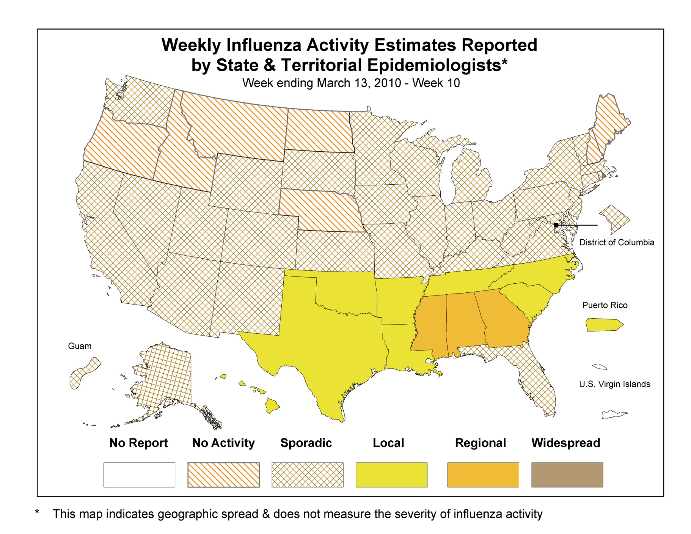

Slide 11

Cumulative rate of hospitalization/10,000 population for five age groups and three seasons,
Emerging Infections Program, 2007-2009
* Pan H1N1 is for data from Sep 1, 2009 to Jan 21, 2010

Slide 12
2009 H1N1 Hospitalizations
Frequency of Underlying Conditions in Adults
EIP April 15, 2009 – February 16, 2010 (n=4,987)
85% of adults with
underlying condition
Notes:
12

Slide 13
2009 H1N1 Hospitalizations
Frequency of Underlying Conditions in Children
EIP April 15, 2009 – February 16, 2010 (n=2600)
58% of children with
underlying condition
Notes:
13

Slide 14
Influenza Positive Tests Reported to CDC by U.S. WHO/NREVSS Collaborating Laboratories, National Summary, 2009-10
Number of Positive Specimens
Percent Positive
>99% of subtyped viruses are 2009 H1N1
No antigenic drift
>99% susceptible to oseltamivir
All susceptible to zanamivir
>99% resistant to adamantanes

Slide 15
Number of Influenza-Associated Pediatric Deaths by Week of Death:
2006-07 season to present
2009-10
Number of Deaths Reported=267
2006-07
Number of Deaths Reported = 77
2007-08
Number of Deaths Reported = 88
2008-09
Number of Deaths Reported =133
2009 Influenza A (H1N1) Deaths Reported Current Week
Other Influenza Deaths Reported Current Week
2009 Influenza A (H1N1) Deaths Reported Previous Weeks
Other Influenza Deaths Reported Previous Weeks

Slide 16
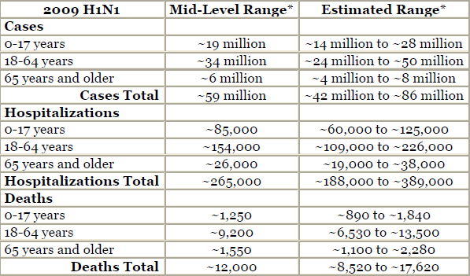
CDC Estimates of 2009 H1N1 Influenza Cases, Hospitalizations and Deaths: Results
April 2009 through February 13, 2010
http://www.cdc.gov/h1n1flu/estimates_2009_h1n1.htm

Slide 17
2009 H1N1 Deaths

Slide 19
Summary of key epidemiologic findings: 2009 pandemic influenza A(H1N1) studies
Highest incidence of lab confirmed infections in school age children
Distribution of hospitalizations and deaths different from seasonal influenza
  Highest hospitalization rates among 0 through 4 year olds
  Hospitalization rates for Apr-Oct 2009 exceed cumulative rates for seasonal influenza among school age children and 19 through 49 year old adults
  Fewer severe cases among adults >65 years old than expected
50-70% of deaths and hospitalizations among persons with an underlying medical condition that confers higher risk for complications
  Pregnancy is a higher risk condition
  Newly recognized risk conditions?
    Morbid obesity (BMI>40) –?proxy for unrecognized medical condition
    Indigenous populations –?proxy for chronic medical conditions, poverty or medical care access
    Neuromuscular diseases – even worse than usual?

Slide 20
Recommendations for Composition of the 2010-11 Northern Hemisphere Influenza Vaccines
Pandemic A(H1N1) 2009 viruses pose a public health risk for the 2010-2011Northern Hemisphere influenza season.
Currently circulating pandemic A(H1N1) 2009 viruses remain similar to the WHO/FDA recommended vaccine virus
Trivalent influenza vaccine should contain:
  an A/California/7/2009 (H1N1)-like virus
    Same as was used in the monovalent vaccine
  an A/Perth/16/2009 (H3N2)-like virus
    New to N hemisphere vaccine
    Same as 2010 S hemisphere vaccine
  a B/Brisbane/60/2008-like virus
    Same as 2009-10 N hemisphere vaccine
FDA. Vaccines and Related Biological Products Advisory Committee Meeting, February 22, 2010

Slide 21
H1N1 Vaccination Coverage: Updated Interim Results
Slides prepared by:
James A. Singleton, MS
H1N1 Vaccination Coverage Monitoring Team
Immunization Services Division
CDC

Slide 22
National 2009 H1N1 Flu Survey (NHFS)
Weekly national estimates of H1N1 and seasonal coverage, and behavioral factors
Random-digit-dialed telephone survey of 6,000 households per month (landline and cell-only samples)
Conducted October 2009 – June 2010
Results through February 13, 2010
  Results through January 2 published in MMWR January 22, 2010 / 59(02);44-48
Information from other surveys and data systems to be provided in the future
*

Slide 23
H1N1 Vaccination Coverage by mid-January, NHFS, December 27 – January 30
Age Groups
Sample sizes: 13,157 children and 7,269 adults

Slide 24
H1N1 Vaccination Coverage by mid-January, NHFS, December 27 – January 30
Initial Target Groups
High risk conditions include current asthma, other lung condition, heart condition, diabetes, kidney condition, sickle cell or other anemia, neurologic or neuromuscular condition, liver condition, or a weakened immune system caused by a chronic illness or related medicines.
** Persons reporting they work in a healthcare facility or provide direct patient care as part of routine work.
*** Persons with regular close contact with a child aged <6months and not a HCP
Initial target group sample size: 16,135 children and adults, including 43 pregnant women

Slide 25
Racial/Ethnic Disparities in H1N1 and Seasonal Vaccination Coverage by mid-January
NHFS, December 27 – January 30
 | Difference in coverage rate, Black – White |  | Difference in coverage rate, Hispanic – White
 | H1N1 | Seasonal | H1N1 | Seasonal
Children | -7.5 | -1.0 | 1.6 | -2.6
Adults | -6.3* | -10.5* | -5.5* | -14.2*
All | -5.9* | -8.3* | -2.2 | -11.3*
* Coverage rate difference statistically significant, p<0.05

Slide 26
Summary of H1N1
Vaccine Coverage Data
By February 13, ~86 million people had received ~97 million doses of H1N1 vaccine
Most doses went to target groups
Coverage was higher in children than adults
An estimated 39% of health care workers were vaccinated
Of children <10 years who were vaccinated, as many as 60% had received their 2nd dose
H1N1 vaccine coverage in adults was significantly higher in whites than blacks or Hispanics
H1N1 coverage did not differ significantly by race or ethnicity among children

Slide 27
The “Main Reason” for not getting an H1N1 vaccination among all unvaccinated, by month of interview, NHFS
Percentage reporting reason
Responses are to the question “There are many reasons why people don’t get flu vaccinations. What is the main reason you [will not get/ will probably no get/ have not yet gotten] an H1N1 flu vaccination this flu season?”

Slide 28
Seasonal Influenza Vaccines: Recommendations for Use in the 2010-11 Influenza Season
Advisory Committee on Immunization Practices (ACIP)
Atlanta, February 24, 2010

Slide 29
Advisory Committee on Immunization Practices (ACIP): Influenza Vaccination Recommendation Changes for the US Over Time: 1960-2008
Before 2000:
Persons aged 65 years or older
Persons with chronic medical conditions that make them more likely to have complications of influenza
Pregnant women in the 2nd or 3rd trimester
Contacts (household and out-of-home caregivers) of the above groups
Healthcare workers
Notes:
29

Slide 30
ACIP: Influenza Vaccination Recommendation Changes for the US
Over Time: 1960-2008 (Cont’d)
2000:
Adults aged 50 years and older
2003:
Children aged 6 months through 23 months
Contacts (household and out-of-home caregivers) of children aged 0 through 23 months
Women who will be pregnant during the influenza season
Rationale: Prevent influenza in groups at higher risk
for severe morbidity or mortality
Notes:
30

Slide 31
Expanding Rationale for Vaccination
Prevent outpatient and emergency department visits
Provide protection to persons who are at highest risk
for infection (children)
Increase vaccine use among all within an age group, which might improve coverage among those at higher
risk and reduce transmission by protecting their contacts
  Those who have an indication (and their providers) may be unaware of vaccine recommendation
Address issue that severe morbidity and mortality still occur, rarely but unpredictably, even among the healthy
Provide better access for all to potential health benefit
of influenza vaccine

Slide 32
ACIP: Influenza Vaccination Recommendation Changes for the US
Over Time: 1960-2008 (Cont’d)
2006:
Children aged 6 months through 59 months
Contacts (household and out-of-home caregivers)
of children aged 0 months through 59 months
2008:
All children aged 6 months through 18 years
In 2009-10 season, ~85% of population had an indication for vaccination
Notes:
32
[Insert ACIP refs?]

Slide 33
Rationale: Recommendation to vaccinate all people ages 6 months or older
Annual influenza vaccination is a safe and effective prevention measure that provides a potential benefit for people in all age groups
Morbidity and mortality occurs in all age groups, including among adults aged 19-49
Some persons who have influenza complications
  have no previously identified risk factors,
  have risk factors but are unaware that they should be vaccinated, or
  might be at risk due newly identified risk factors, such as morbid obesity or race/ethnicity
A recommendation that all people ages 6 months or older receive an annual influenza vaccination
  eliminates the need to determine whether each person has an indication for vaccination
  emphasizes the importance of preventing influenza across the population spectrum
  reduces potential barriers to increasing the number of persons protected from influenza, including lack of awareness about vaccine indications among persons at higher risk for influenza complications and their close contacts.

Slide 34
ACIP: Influenza Vaccination Recommendation Changes for the US
Over Time: 1960-2008 (Cont’d)
2006:
Children aged 6 months through 59 months
Contacts (household and out-of-home caregivers)
of children aged 0 months through 59 months
2008:
All children aged 6 months through 18 years
2010*:
All adults
* Advisory Committee on Immunization Practices, February 24, 2010
Notes:
34
[Insert ACIP refs?]

Slide 35
Trivalent influenza vaccines available in the United States, 2010-11 season
Vaccine Type | Manufacturer | Presentation | Hg content (mcg per 0.5 mL) | Age group | Doses
Inactivated | Sanofi Pasteur (Fluzone) (Fluzone High-Dose) | 0.25mL prefilled syringe (7.5 mcg x3) | 0 | 6–35 mos | 1 or 2
 |  | 0.5 mL prefilled syringe or vial(15 mcg x3) | 0 | 36 mos and older | 1 or 2
 |  | 5.0 mL multidose vial (15 mcg x3) | 25 | 6 mos and older | 1 or 2
 |  | 0.5 mL prefilled syringe (60 mcg x3) | 0 | 65 yrs and older | 1
Inactivated | Novartis (Fluvirin) (Agriflu) | 5.0-mL multidose vial (15 mcg x3) | 25 | 4 yrs and older | 1 or 2
 |  | 0.5 mL pre-filled syringe (15 mcg x3) | 0 | 4 yrs and older | 1 or 2
 |  | 0.5 mL prefilled syringes (15 mcg x3) | 0 | 18 yrs and older | 1
Notes:
35

Slide 36
Trivalent influenza vaccines available in the United States, 2010-11 season
Vaccine Type | Manufacturer | Presentation | Hg content (mcg per 0.5 mL) | Age group | Doses
Inactivated | CSL Limited (Afluria) | 0.25 mL prefilled syringe (7.5 mcg x3) | 0 | 6-35 mos | 1 or 2
 |  | 0.5 mL prefilled syringe (15 mcg x3) | 0 | 36 mos and older | 1 or 2
 |  | 5.0 mL multidose vial (15 mcg x3) | 24.5 | 6 mos and older | 1 or 2
Inactivated | GSK (Fluarix) (Flulaval) | 0.5 mL prefilled syringe (15 mcg x3) 5.0 mL multidose vial (15 mcg x3) | 0 25 | 3 yrs and older 18 yrs and older | 1 or 2 1
Live attenuated | MedImmune (Flumist) | 0.2–mL sprayer (10^{6.5-7.5} fluorescent focal units of live attenuated virus) | 0 | 2–49 yrs | 1 or 2
Notes:
36

Slide 37
Update: Monitoring the Safety of U.S. Influenza A (H1N1) 2009 Monovalent Vaccines
Karen Broder, MD
Immunization Safety Office
Division of Healthcare Quality Promotion
National Center for Emerging and Zoonotic Infectious Diseases
Centers for Disease Control and Prevention (CDC)
Atlanta, GA
Clinician Outreach and Communication Activity
Teleconference on March 23, 2010

Slide 38
U.S. H1N1 Vaccine Safety
Monitoring Systems

Slide 39
Background Influenza Vaccine Safety
Seasonal influenza vaccines have an excellent track record for safety that is supported by studies*
Most frequent reaction after inactivated influenza vaccines, administered by injection, is injection site pain (up to 64%)
Most frequent reaction after live attenuated influenza vaccine, administered intranasally, is rhinitis (up to 51%)
Vaccine components in influenza vaccines (e.g., egg protein) may rarely trigger severe allergic reaction (anaphylaxis)
  Influenza vaccines are contraindicated in persons with severe allergies to eggs
Source: CDC Seasonal Influenza Summary for Clinicians 9/2009 http://www.cdc.gov/flu/professionals/vaccination/vaccine_safety.htm

Slide 40
Guillain-Barré Syndrome (GBS)
Immune-mediated acute demyelinating polyneuropathy affecting the peripheral nervous system
Estimated annual incidence rate: 1 case per 100,000 population
In 1976, a type of influenza vaccine was causally associated with GBS*
  1 additional case per 100,000 persons vaccinated
Subsequent studies of influenza vaccines have found small or no increased risk of GBS
  If there is a risk of GBS from seasonal influenza vaccines, it would be no more than ~1 additional case per million people vaccinated
* Institute of Medicine, 2004

Slide 41
2009 H1N1 Vaccine Timeline
September 2009: FDA licenses 2009 Influenza A H1N1 monovalent vaccines
  Inactivated vaccine (MIV) for injection and live attenuated (LAMV) vaccine for intranasal use
  Licensure and manufacturing process for H1N1 vaccines are the same as for seasonal influenza vaccines
July 2009: CDC’s Advisory Committee on Immunization Practices (ACIP) recommends H1N1 vaccination for target groups
October 2009:
  First doses of H1N1 vaccine become available to the public
  Comprehensive vaccine safety monitoring is implemented in the United States

Slide 42
Overall Objectives for
2009 H1N1 Vaccine Safety Monitoring
Identify clinically significant adverse events following receipt of 2009 H1N1 vaccine in a timely manner
Rapidly evaluate serious adverse events following receipt of 2009 H1N1 vaccine and determine public health importance
Evaluate if there is there is a risk of Guillain-Barré syndrome (GBS) associated with the 2009 H1N1 vaccine
Communicate vaccine safety information in a clear and transparent manner to healthcare providers, public health officials, and the public

Slide 44
H1N1 Vaccine Safety Risk Assessment Working Group, National Vaccine
Advisory Committee (NVAC)*
Purpose
  To conduct independent, rapid reviews of available federal immunization safety monitoring data for the 2009 H1N1 influenza vaccines
8 members from Federal Advisory Committees, Institute of Medicine, and public
  Members must meet conflict of interest requirements
  Support from ex-officio members from NVPO, CDC, FDA, NIH, DOD, VA, and other medical experts as needed
National Vaccine Program Office, Department of Health and Human Services coordinates activities
* http://www.hhs.gov/nvpo/nvac/subgroups/h1n1risk.html

Slide 45
Monitoring H1N1 Vaccine Safety Through the Vaccine Adverse Event Reporting System (VAERS)

Slide 46
Vaccine Adverse Event Reporting System (VAERS)
VAERS: Voluntary reporting system jointly managed by CDC and FDA
  Signal detection
  National in scope
  Encourages reports from healthcare providers and accepts reports from vaccinees and others
System enhancements for H1N1 vaccines
  Increase in staffing to process VAERS reports more rapidly
  Enhanced reporting to VAERS by increased visibility on professional websites

Slide 47
VAERS Limitations
Usually cannot assess causality
Variable quality of data
No unvaccinated comparison group
Denominator data lacking
Under-reporting (voluntary, passive reporting)
Variation of reporting
  Stimulated reporting can occur during times of heightened awareness (e.g., media attention)

Slide 48
What to Report to VAERS
Report any clinically significant adverse event following immunization to www.vaers.hhs.gov
  Submit reports of concern even when not sure whether the vaccine caused the adverse event
Include as much information as possible (e.g., vaccination location, date, vaccine type, lot number and dose number)
  Incomplete reports are accepted
Report as soon as possible but there is no time limit

Slide 49

How to submit a VAERS report
1) Online via a secure website at
  https://vaers.hhs.gov
2) Download a form from: http://vaers.hhs.gov/resources/vaers_form.pdf
  Fax a completed form: 877-721-0366
  Mail a completed VAERS form to: VAERS
  P.O. Box 1100
  Rockville, MD, 20849
3) VAERS assistance: 800-822-7967 or email: info@vaers.org

Slide 50
VAERS definition of “Serious” Reports*
Death
Life-threatening illness
Hospitalization
Prolonged existing hospitalization
Persistent or significant disability
Certain other medically important conditions
*Code of Federal Regulations
Title 21 (21CFR 314.80)
Box 8 of VAERS form

Slide 51
How to submit a VAERS report
1) Online via a secure website at
  https://vaers.hhs.gov
2) Download a form from: www.vaers.hhs.gov/pdf/vaers_form.pdf
  Fax a completed form: 877-721-0366
  Mail a completed VAERS form to: VAERS
  P.O. Box 1100
  Rockville, MD, 20849
3) VAERS assistance: 800-822-7967 or email: info@vaers.org

Slide 52
VAERS Reports following Seasonal (LAIV/TIV) and H1N1 (LAMV/MIV) Influenza Vaccines, by AE Category, as of 2/16/10
 | Total Reports |  | Serious Reports* |  |  |  | Non-Serious Reports (%) |  | GBS† Reports (%)
 |  |  | Fatal (%) |  | Non-Fatal (%)
Vaccine type | H1N1 | Seasonal | H1N1 | Seasonal | H1N1 | Seasonal | H1N1 | Seasonal | H1N1 | Seasonal
Live Attenuated | 2050 (100) | 657 (100) | 6 (0.3) | 0 (0) | 93 (4.5) | 56 (8.5) | 1951 (95.2) | 601 (91.5) | 7 (0.3) | 9 (1.4)
Inactivated | 7191 (100) | 5427 (100) | 40 (0.5) | 30 (0.5) | 480 (6.7) | 392 (7.2) | 6671 (92.8) | 5005 (92.2) | 81 (1.1) | 93 (1.7)
Unknown | 640 (100) | 269 (100) | 0 (0) | 3 (1.1) | 32 (5.0) | 30 (11.2) | 608 (95.0) | 236 (87.7) | 5 (0.8) | 10 (3.7)
CUMULATIVE TOTAL | 9881 (100) | 6353 (100) | 46 (0.5) | 33 (0.5) | 605 (6.1) | 478 (7.5) | 9230 (93.4) | 5842 (92.0) | 93 (0.9) | 112 (1.8)
*Serious Reports comprise life-threatening illness, hospitalization, permanent disability, and death.
† Guillain-BarréSyndrome (GBS) cases will also be counted in the Fatal, Non-Fatal Serious, or
Serious columns, as they may be classified.
VAERS reports are public information available under FOIA, except for identifying data.

Slide 53
VAERS Reports following Seasonal (LAIV) and
H1N1 (LAMV) Live, Attenuated Influenza Vaccine, by AE Category and Age Group, as of 2/16/10
 | Live, Attenuated Influenza Vaccines
 | ALL Reports (%) |  | Serious Reports (%) |  |  |  | Non-serious (%)
AGE GROUP | H1N1 (LAMV) | Seasonal (LAIV) | Fatal |  | Non-fatal |  | H1N1 (LAMV) | Seasonal (LAIV)
 |  |  | H1N1 | Seasonal | H1N1 | Seasonal
6-23 mos | 47 (100) | 27 (100) | 0 (0) | 0 (0) | 1 (2.1) | 1 (3.7) | 46 (97.9) | 26 (96.3)
2-4 yrs | 297 (100) | 172 (100) | 0 (0) | 0 (0) | 17 (5.7) | 17 (9.9) | 280 (94.3) | 155 (90.1)
5-18 yrs | 912 (100) | 284 (100) | 2 (0.2) | 0 (0) | 44 (4.8) | 23 (8.1) | 866 (95.0) | 261 (91.9)
19-24 yrs | 151 (100) | 30 (100) | 0 (0) | 0 (0) | 2 (1.3) | 2 (6.7) | 149 (98.7) | 28 (93.3)
25-49 yrs | 525 (100) | 103 (100) | 3 (0.6) | 0 (0) | 28 (5.3) | 13 (12.6) | 494 (94.1) | 90 (87.4)
50-64 yrs | 84 (100) | 15 (100) | 1 (1.3) | 0 (0) | 1 (1.2) | 0 (0) | 82 (97.6) | 15 (100)
≥65 yrs | 17 (100) | 12 (100) | 0 (0) | 0 (0) | 0 (0) | 0 (0) | 17 (100) | 12 (100)
unknown | 17 (100) | 14 (100) | 0 (0) | 0 (0) | 0 (0) | 0 (0) | 17 (100) | 14 (100)
TOTAL | 2050 (100) | 657 (100) | 6 (0.3) | 0 (0) | 93 (4.5) | 56 (8.5) | 1951 (95.2) | 601 (91.5)

Slide 54
VAERS Reports following Seasonal (TIV) and H1N1 (MIV) Inactivated Influenza Vaccine, by AE Category and Age Group, as of 2/16/10
 | Inactivated Influenza Vaccines (S-P, Novartis, CSL, IDB/GSK)
 | ALL Reports (%) |  | Serious Reports (%) |  |  |  | Non-serious (%)
AGE GROUP | H1N1 (MIV) | Seasonal (TIV) | Fatal |  | Non-fatal |  | H1N1 (MIV) | Seasonal (TIV)
 |  |  | H1N1 | Seasonal | H1N1 | Seasonal
6-23 mos | 442 (100) | 376 (100) | 2 (0.5) | 6 (1.6) | 39 (8.8) | 36 (9.6) | 401 (90.7) | 334 (88.8)
2-4 yrs | 494 (100) | 284 (100) | 3 (0.6) | 1 (0.4) | 25 (5.1) | 23 (8.1) | 466 (94.3) | 260 (91.5)
5-18 yrs | 1798 (100) | 716 (100) | 3 (0.2) | 2 (0.3) | 90 (5.0) | 42 (5.9) | 1705 (94.8) | 672 (93.9)
19-24 yrs | 348 (100) | 254 (100) | 1 (0.3) | 1 (0.4) | 18 (5.2) | 9 (3.5) | 329 (94.5) | 244 (96.1)
25-49 yrs | 2285 (100) | 1763 (100) | 11 (0.5) | 4 (0.2) | 171 (7.5) | 105 (6.0) | 2103 (92.0) | 1654 (93.8)
50-64 yrs | 1305 (100) | 1201 (100) | 11 (0.8) | 3 (0.2) | 87 (6.7) | 86 (7.2) | 1207 (92.5) | 1112 (92.6)
≥65 yrs | 443 (100) | 764 (100) | 9 (2.0) | 13 (1.7) | 48 (10.8) | 81 (10.7) | 386 (87.1) | 669 (87.6)
unknown | 76 (100) | 69 (100) | 0 (1.3) | 0 (0) | 2 (2.6) | 9 (13.0) | 74 (96.1) | 60 (87.0)
TOTAL | 7191 (100) | 5427 (100) | 40 (0.6) | 30 (0.6) | 480 (6.7) | 392 (7.2) | 6671 (92.8) | 5005 (92.2)

Slide 55
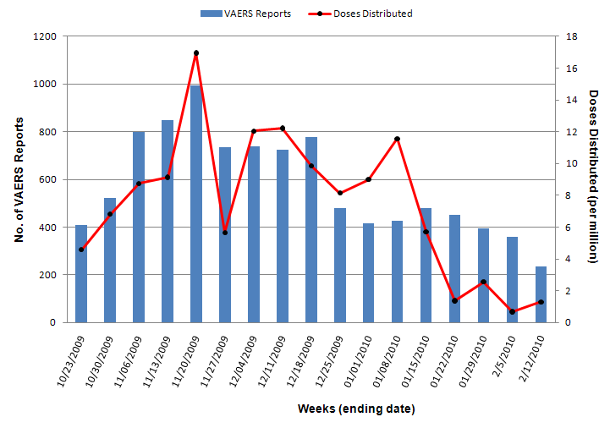
Weekly Number of VAERS Reports and Doses of H1N1 Vaccine Distributed as of February 12, 2010

Slide 56
Reporting rates of adverse eventsª in VAERS after H1N1 influenza vaccines based on reports received as of February 16, 2010
 | All H1N1 vaccines
 | No.^{b} | Est. Doses Distributed | Rate ª
All reports | 9,867 | 126,276,220 | 78.1
Serious reports^{c} | 652 | 126,276,220 | 5.2
ª Per 1,000,000 doses distributed; H1N1 doses distributed data as of 2/12/2010
^{b} CDC unpublished data
^{c} Includes deaths

Slide 57
Reports of Death to VAERS:
Summary as of 2/16/10
Total death reports: 46
Case characteristics
  Vaccine type received: 6 after LAMV, 40 after MIV
  Age range: 16 months – 94 years
  Onset interval range: 0 – 37 days

Slide 58
Reports of Death to VAERS:
Summary as of 2/16/10
Death categories by body system for reported cause of death in 46 persons*
  Cardiac: 22 (includes 1 pregnant)
  Infectious: 8
  Neurologic: 5
  Multiple systems: 4
  Respiratory: 2
  Trauma: 1
  Pregnancy complication: 1
  Unknown: 3
*Some results are preliminary

Slide 59
Summary of Chart Review:
GBS and Anaphylaxis after H1N1 Vaccines to VAERS as of 1/31/10
VAERS Reports | GBS | Anaphylaxis
TOTAL* | 123 | 268
VERIFIED | 64 | 115
INCONCLUSIVE | 1 | 0
PENDING | 1 | 3
RULED OUT | 57 | 150
*Includes reports received in VAERS not coded as GBS and anaphylaxis

Slide 60
H1N1 Vaccine Safety Assessment

Slide 61
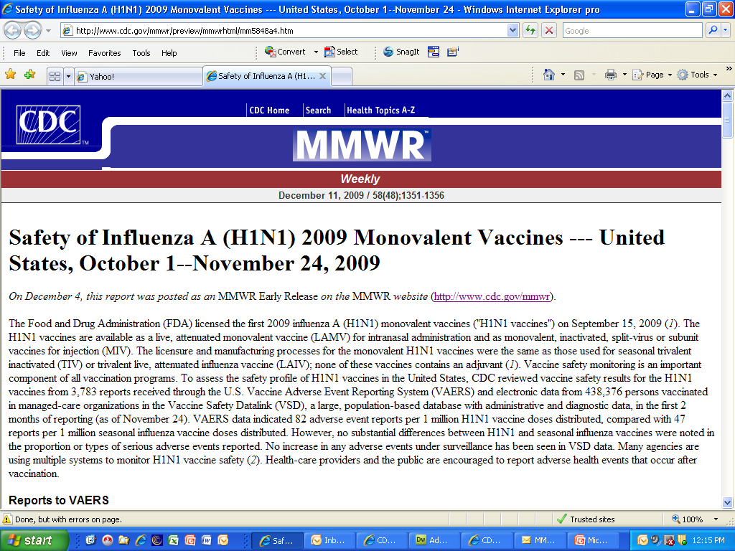
MMWR on Vaccine Safety
No substantial differences were noted between
H1N1 and seasonal influenza vaccine adverse events
No safety signals were seen

Slide 62
Persons Exposed to H1N1 Vaccine in
Monitoring Systems Reviewed by H1N1 VSRAWG
Vaccine Safety Program (CDC ISO) | Description | Population Monitored | H1N1 Vaccine Exposures Captured in System¹ | Summary of Results
Vaccine Adverse Event Reporting System (VAERS) | Spontaneous reporting system managed by CDC and FDA for signal detection | U.S. population | Total: 121,774,220 Inactivated: 100,355,720 Live: 21,418,500 | SAE² proportional reporting after H1N1 vaccine comparable to seasonal influenza vaccine No signals
Vaccine Safety Datalink (VSD) | National active surveillance system access to data of 8 MCOs using RCA³ | 9.5 million | Total: 1,242,892 | No signals identified
Emerging Infections Program GBS Surveillance | Active GBS case finding | 45 million | Ongoing collection of data | Ongoing collection of data
Real-Time Immunization Monitoring System (RTIMS) | Web-based system for active monitoring of health events after vaccination ; focus - school children, health care workers, and pregnant women | U.S. population | 9,231 exposed to vaccine | Cases being validated
¹Data as of 2/5/2010 ; VSRAWG: Vaccine Risk Assessment Working Group
²SAE: Serious Adverse Event
³RCA: Rapid Cycle Analysis

Slide 63
Persons Exposed to H1N1 Vaccine in
Monitoring Systems Reviewed by H1N1 VSRAWG
Vaccine Safety Program (other federal systems) | Description | Population Monitored | H1N1 Vaccine Exposures Captured in System¹ | Summary of Results
Defense Medical Surveillance System (DMSS) | Active surveillance of pre-specified outcomes | 1.4 million | Total:1, 014, 901 Inactivated:958, 769 Live: 56, 132 | No signals identified
Veteran’s Affairs Database | Active surveillance of pre-specified outcomes | 1.2 million | Total: 589,386 (distributed) | No signals identified
Centers for Medicare and Medicaid Services | Guillain-Barre Syndrome | 38 million | Total: 1,746,924 | No signals identified
Indian Health Service | Surveillance of pre-specified outcomes | 1.4 million | Total: 216,642 | No signals identified
Post-licensure Rapid Immunization Monitoring System | Active surveillance of pre-specified outcomes | 30 million (17 million registry enhanced) | Total: 844,081 | No signals identified
¹Data as of 2/5/2010 VSRAWG: Vaccine Risk Assessment Working Group http://www.hhs.gov/nvpo/nvac/reports/vsrawg_report_feb2010.html

Slide 64
VSRAWG Report to NVAC
(February 26, 2010)
“Working Group concluded that the data are adequate to assess the presence or absence of a signal. Additionally, the Working Group concluded that the data do not favor a signal between the outcomes examined and the H1N1 vaccines. A signal is defined as an event that could be temporally occurring more often after vaccine receipt than anticipated by chance alone.”
Available at http://www.hhs.gov/nvpo/nvac/reports/vsrawg_report_feb2010.html

Slide 65

Clinician’s Role in Vaccine Safety Monitoring during the 2009 H1N1 vaccination campaign
Properly store and administer vaccine
Screen for contraindications and precautions
Educate vaccinee (or caregiver) about risks and benefits of vaccine
  Vaccine Information Statements (VIS)*
Use Influenza Vaccination Record (card)
Evaluate and treat patient if an adverse event occurs
Report clinically significant adverse events promptly to VAERS
Available at http://www.cdc.gov/vaccines/Pubs/vis/default.htm

Slide 66
Summary
2009 H1N1 Vaccine Safety Monitoring
Federal government rapidly implemented robust vaccine safety monitoring for H1N1 vaccines in collaboration with partners using new and existing systems
With >125 million doses of H1N1 vaccines distributed in the United States, no safety concerns have emerged
Clinicians play an important role in vaccine safety monitoring and education
Vaccine safety monitoring will continue to be important during future influenza seasons

Slide 67
CDC Resources for
2009 H1N1 Vaccine Safety
MMWR on H1N1 Vaccine Safety http://www.cdc.gov/mmwr/preview/mmwrhtml/mm5848a4.htm
General Questions and Answers on 2009 H1N1 Influenza A Vaccine Safety
http://www.cdc.gov/Flu/protect/keyfacts.htm
For Responses to Questions about Vaccine Safety, phone: 1-800-CDC-INFO
General Questions and Answers on Thimerosal http://www.cdc.gov/h1n1flu/vaccination/thimerosal_qa.htm

Slide 68
Additional CDC Resources for 2009 H1N1 Vaccine Safety
Seasonal Influenza Fact Sheet
http://www.cdc.gov/Flu/protect/keyfacts.htm
General Questions and Answers on Guillain-Barré Syndrome (GBS) http://www.cdc.gov/h1n1flu/vaccination/gbs_qa.htm
National Vaccine Advisory Committee
http://www.hhs.gov/nvpo/nvac/reports/vsrawg_report_feb2010.html

Slide 69
Acknowledgements
CDC
FDA
National Vaccine Program Office
State, local, and territorial health officials
Vaccine Safety Datalink
Clinical Immunization Assessment network
Emerging Infectious Program
American Academy of Neurology
Health Resources and Services Administration (HRSA)
Vaccine Healthcare Centers (VHC) Network
Healthcare providers for reporting to VAERS!

Slide 70
Thank You!

Slide 71
Continuing Education Credit/Contact Hours for COCA Conference Calls
Continuing Education guidelines require that the attendance of all who participate in COCA Conference Calls be properly documented. All Continuing Education credits/contact hours (CME, CNE, CEU, CECH, and ACPE) for COCA Conference Calls are issued online through the CDC Training & Continuing Education Online system http://www2a.cdc.gov/TCEOnline/.
Those who participate in the COCA Conference Calls and who wish to receive CE credit/contact hours and will complete the online evaluation by Apr 23, 2010 will use the course code EC1648. Those who wish to receive CE credits/contact hours and will complete the online evaluation between Apr 23, 2010 and Apr 23, 2011 will use course code WD1648. CE certificates can be printed immediately upon completion of your online evaluation. A cumulative transcript of all CDC/ATSDR CE’s obtained through the CDC Training & Continuing Education Online System will be maintained for each user.

