Slide 1
Open Government
Moderator Training
Joe Peters and Joe Goldman
January 22, 2010
Copyright © 2010 by AmericaSpeaks and Ascentum

Slide 2
Agenda
Introductions
The Big Question
Overview/Goals
Roles & Responsibilities
Organizing and Moderating an Online Dialogue: Best Practices, Tips and Risks
Resources
Moderator Details
  Ground Rules
  Terms
  Scheduling
  Starting
  Monitoring
  Intervening
  Recording
  Tracking
  Handing off/Coordinating

Slide 3







AmericaSpeaks and Ascentum

Slide 4
Introductions
Please share the following information:
  Name
  Position
  Agency
  How have you been involved with your agency’s response to the Open Government Directive?

Slide 5
Questions for you
What is your experience with Moderation?
What is your experience with IdeaScale?
How well prepared do you feel for launch of dialogue?
Which areas of moderation do you feel in most need of support?

Slide 6
The Big Question
Please take a minute and write down on the index card in front of you:
If you only learned one thing about moderating today, what would you want that to be?

Slide 7
Goals
General understanding of how to think about the whole process of organizing an online dialogue
Provide you with practical tips and best practices for moderating your IdeaScale dialogue
Consider strategies for reducing risks involved with online engagement
Offer resources that you can access going forward as you plan your engagement

Slide 8
Roles and Responsibilities
Steps of the Process
Management Team
Planning
Designing
Promoting
Moderating
Analyzing and Reporting
Integrating
Evaluating
Open Government Leader
Producer of Dialogue
Project Manager
Outreach, Public Affairs and Social Marketing
Legal
Technical
Lead Moderator and Shift Moderators
Data Analysis
Reporting
External Experts and Stakeholders

Slide 9
1. Process: Planning
What are your objectives?
What is the timeline?
What are your resources?
What is your organization’s commitment to participants and what can you do to support it?

Slide 10
2. Process: Designing
What kinds of contributions will be most useful?
What do participants need to understand?
What reference material is available?
What are the themes/subject areas?
What are the Ground Rules and Terms of Participation?

Slide 11
Tip: Suggested Context
How will participants’ ideas be used?
What has the agency already done to make itself more open?
What are the major options that the agency is considering for becoming more open that it would be useful to get input on?
Where can participants go to learn more about what the agency does?

Slide 12
Tip: Suggested Ground Rules
Openly share your ideas, comments and perspectives.
Show respect for other people and use appropriate language in your ideas and comments.
Comment on, make suggestions to, and challenge ideas that are posted here, not about the individuals who post them.
Keep your ideas and comments on topic.
Keep an open mind when reading others’ points of view
Moderators will do their best to keep this a constructive and productive space for ideas.
Please refer to our terms of participation for additional information.

Slide 13
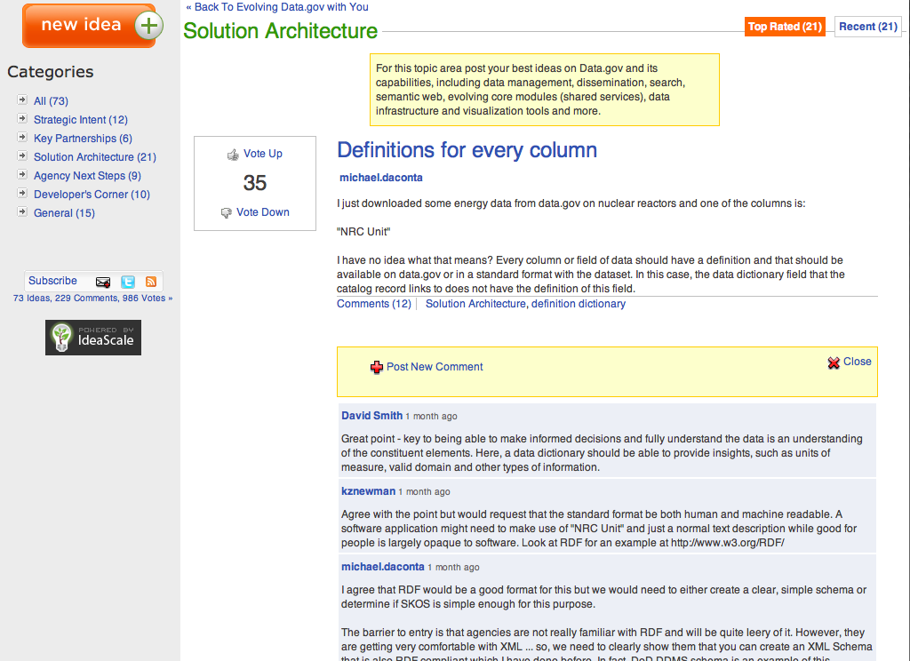
datagov.ideascale.com

Slide 14
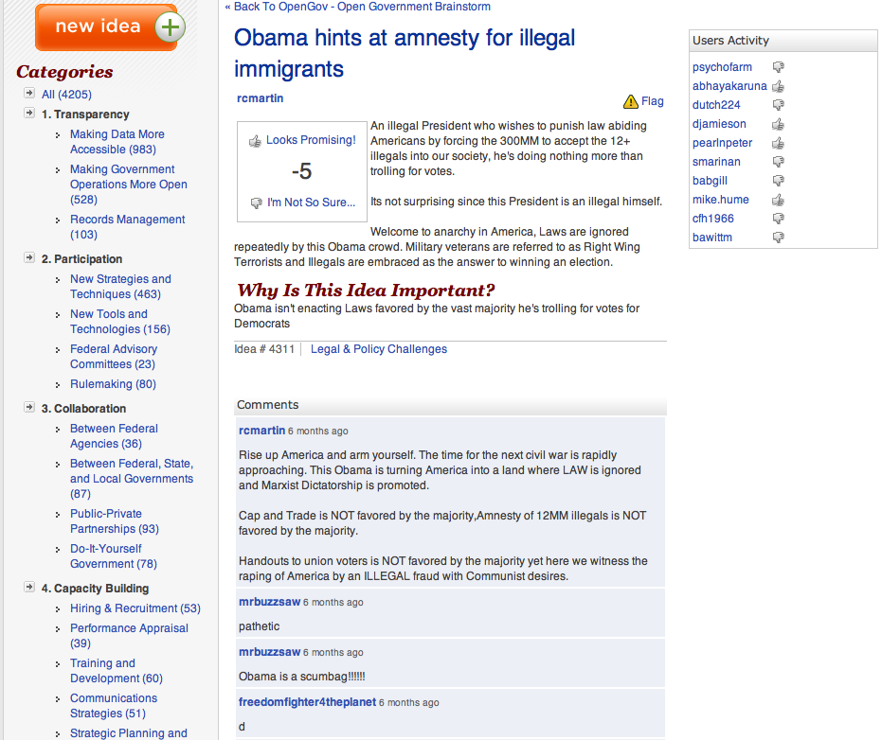
opengov.ideascale.com

Slide 15
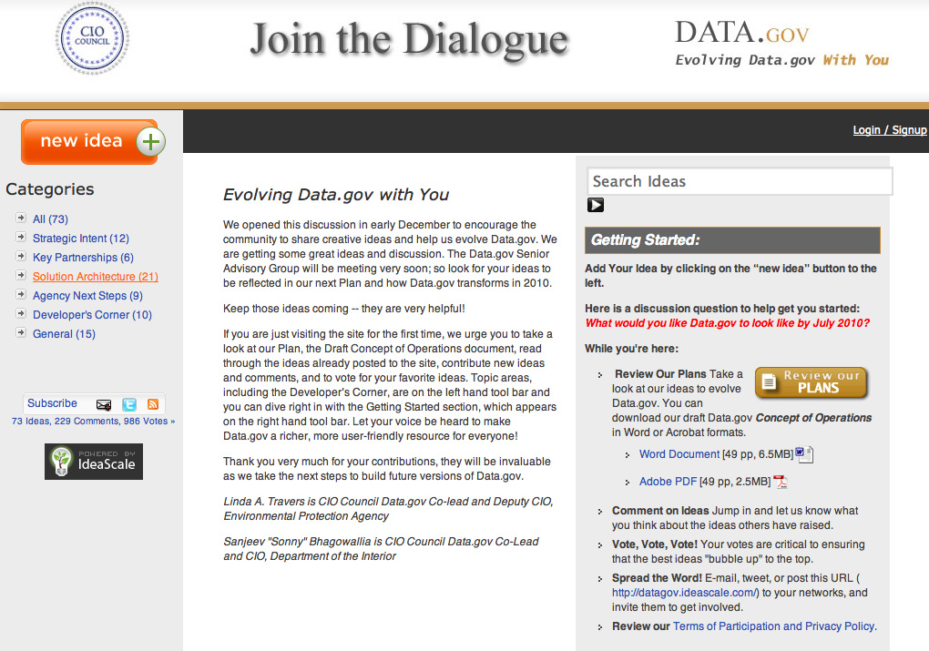
1. Clear rationale for participation
2. Where to begin

Slide 16
3. Process: Promoting/Outreach
Who needs to participate?
How can you reach them?
Who can help you to recruit them?
What is in it for them? Why should they want to participate?

Slide 17
Scenario: Too Few Participants
Dialogue fails to reach critical mass and is partially or fully taken over by interests – rating and flagging system fails to keep discussion on track because not enough participants.

Slide 18
Tip: Outreach Strategies
Strong messaging
Recruit ambassadors and hold regular calls
Conduct briefing for bloggers
Google and other online advertising
Social media especially social networking sites
Targeted media
Use of participants to reach out further

Slide 19
4. Process: Moderating
How are you going to encourage participation and start moderating?
What are you monitoring?
When and how should you intervene?
How are you recording your actions/interventions?
When do you lock down and how do you communicate it?
How are you tracking good ideas with high/low interest?
How are you connected to those analyzing and reporting on the outcomes?
What is the handoff process between moderators?
What is the process if more/less resources are required?

Slide 20
Tip: Principles of Moderation
Set expectations for tone, participation and how ideas will be used
Provide consistent moderation throughout the process
Be proactive in providing feedback especially when responding to trouble
Offer adequate context and framing to ensure high quality participation
Work closely with technical support staff to ensure responsive solutions
Acknowledge contributions and participation

Slide 21
Tip: Encouraging Participation by Setting the Tone
If you don’t set the tone or enforce the ground rules, the community will decide.
Modeling behavior is critical:
  Instructions
  Examples
  Seedlings
  Interventions

Slide 22
Scenario: Off Topic Ideas
There is a large ratio of off-topic ideas that do not contribute to the purpose of the dialogue (b/c subject matter is abstract, people don’t understand intent of dialogue and/or people’s interests aren’t aligned with purpose of dialogue)

Slide 23
2. Concise description of desired ideas in this category
1. Clear and meaningful categories
3. Excellent ideas and constructive comments

Slide 24
Scenario: Unproductive Behavior
There is a large ratio of ideas and comments that don’t technically violate the terms of participation but are in a grey area
  Complaints against agency
  Duplicative comments
  Cleverly worded attacks

Slide 25
Tip: Intervention Tone Spectrum
The Four Fs
Familiar
Formal
Firm
Final

Slide 26
Tips: Tone for Warning Post
Hey guys, let’s keep the language clean and the flames low.
Please treat each other with respect and use appropriate language.
Coarse language and abusive posts are not tolerated on this site.
FINAL WARNING - Coarse language and abuse posts will be immediately removed and accounts suspended.

Slide 27
Tip: Intervention Spectrums to Consider
Reactive
Proactive
Do I intervene when a potential problem may evolve?
Passive
Active
Do I comment on ideas and encourage participation?

Slide 28
Tip: When and How to Intervene?
Organizational Decisions
  Off-topic (commercial, advocacy, left-field)
  Abusive comments and “flames”
  Spelling/grammar mistakes
  Coarse language
  Personal information
Warn, move, remove, edit
Contact participant/poster or not

Slide 29
Tip: The Intervention Log
All actions need to be logged
  Moderator/team environment
  Participant questions removal and rationale
Info to document
  For removal or warning:
    Post, participant, content, rationale, link to terms or ground rules
  Any communications to participants
  Any posts made as moderator

Slide 30
Scenario: Unexpected
Unexpected problems and questions surface during the dialogue.
Potentially need to lock-down IdeaScale
  Review all ideas and posts before published
  Need more moderation resources
  Consider review time
  Communicate this change to participants
  When is this an appropriate action?

Slide 31
Tip: Moderator Connections
How are you tracking good ideas with high/low interest?
How are you connected to those analyzing and reporting on the outcomes?
  Weekly meeting
  Forward ideas
  Other?

Slide 32
Tip: Moderator Handover and Resources
What is the handoff process between moderators?
  On duty blackberry
  Handover note to go with intervention log
What is the process if more/less resources are required?
  At what point is moderation unmanageable?
  Number of messages an hour
  After hours messages

Slide 33
Tip: Are you ready to launch?
Are there key messages ready?
Have you considered/anticipated participant FAQs?
Has the management team been briefed?
Is the moderator schedule set?
Is there technical support ready?

Slide 34
Tip: Closing the Process
What are your messages to the public when the participation timeframe has been completed?
Where will they get additional information?
What if they want to participate in the future?

Slide 35
5. Process: Analysis and Reporting
How will you flag popular or interesting ideas to analysts?
What will you report to management on?
  Idea, comment, rate ratios
  Most popular
  Number of interventions
  Interest group mobilization
  Other analytics
What is the intention/plan to report to the public?

Slide 36
6. Process: Integrating the Results
How will you use the ideas and priorities that emerged from the dialogue?
How will you get credit for using ideas and priorities from the dialogue?

Slide 37
7. Process: Evaluation
What are the lessons learned as moderator?
How have you met the agency’s objectives and commitments?
Was the resourcing level appropriate?
What are the next steps for participation and community?
Will a formal evaluation be undertaken?
  Process indicators (formative evaluation)
  Outcome indicators (summative evaluation)

Slide 38
The Final Question
If you could learn one more thing about moderating, what would that be?

Slide 39
Resources
Open Government Directions
NCDD
Participate DB
Online Community Research Network
NAPA Collaboration Project
AmericaSpeaks and Ascentum

Slide 40
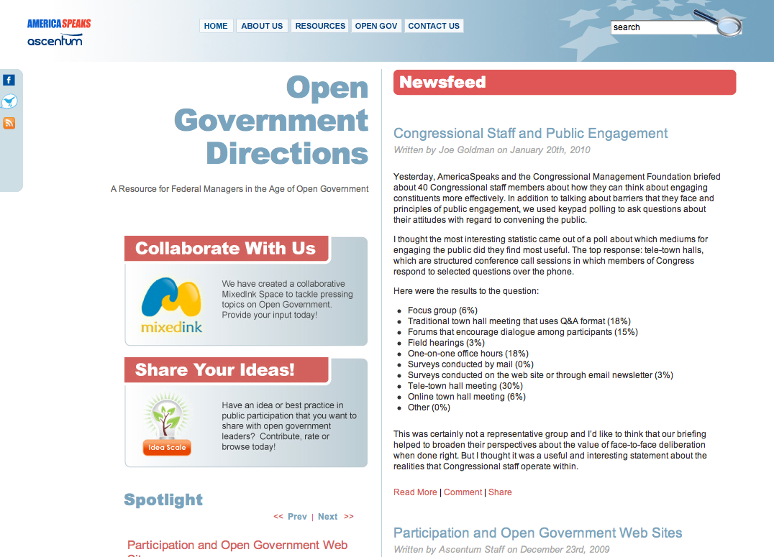
http://opengovernmentdirections.org

Slide 41
Contact Us
Joe Goldman
jgoldman@americaspeaks.org
Joe Peters
jpeters@ascentum.com

Slide 42
Notes

Slide 43
Notes

