Slide 1
Plain Language in Practice: Writing for the Web
Leslie O’Flahavan, E-WRITE Web Manager University
October 1, 2008

Slide 2
Webinar overview
Plain language principles
Why online readers desperately need plain language
Examples of plain language web content
How to edit web content according to plain language principles
Online plain language resources

Slide 3
What is plain language?

Slide 4
Plain language is a communication philosophy
“Plain language…is communication your audience can understand the first time they read or hear it.”
“A communication is in plain language if the…audience for that communication can quickly and easily
  find what they need
  understand what they find
  act appropriately on that understanding”
Notes:
http://www.plainlanguage.gov/whatisPL/index.cfm
http://www.centerforplainlanguage.org/

Slide 5
Plain language is a community
Plain Language Action and Information Network (PLAIN)
Federal agencies with plain language programs
  Bureau of Land Management
  Environmental Protection Agency
  Federal Aviation Administration
  Fish and Wildlife Service
  Health Resources and Services Administration
  National Institutes of Health
  Office of the Federal Register
  Securities and Exchange Commission
Plain Language Awards
  Legal Writing Institute’s Golden Pen Award
  NIH’s Plain Language Initiative’s annual award

Slide 6
Plain language is a government mandate
House passed bill requiring plain language in federal documents; Senate vote pending (2008)
OMB Policies for Federal Public Websites (2004)
Vice President Gore’s National Partnership for Reinventing Government (through 2001)
President Clinton’s 1998 memorandum on plain language
President Carter’s 1978 Executive Order

Slide 7
Plain language:
We know it when we see it

Slide 8
Not plain language
Local Veterans Employment Representatives conduct outreach to employers to engage in advocacy efforts with hiring executives to increase employment opportunities for veterans, encourage the hiring of disabled veterans and generally assist veterans to gain and retain employment.
Notes:
http://www.dol.gov/vets/programs/empserv/employment_services_fs.htm

Slide 9
Why is this not plain?
Local Veterans Employment Representatives conduct outreach to employers to engage in advocacy efforts with hiring executives to increase employment opportunities for veterans, encourage the hiring of disabled veterans and generally assist veterans to gain and retain employment.

Slide 10
Plain language rewrite
Local Veterans Employment Representatives contact employers to encourage them to hire veterans, including disabled veterans, and generally assist veterans in finding and keeping jobs.

Slide 11
Online, any flaws in writing are magnified.

Slide 12
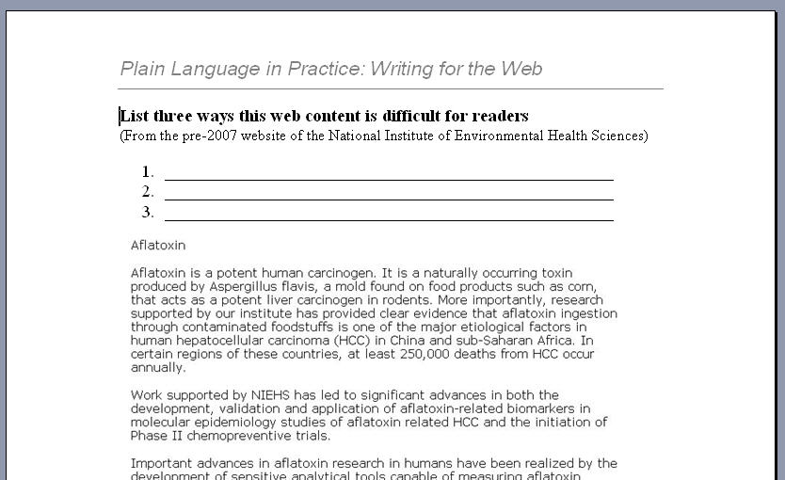
Handouts, Page 1
How is this content difficult for readers?

Slide 13

Handouts, Page 1
How is this content difficult for readers?
Unfamiliar terms
No links to more info
No headings
No scannable features
Wordy phrasing
(“Of particular importance was the finding that …”)

Slide 14
Online readers must work harder than print readers …
They read more slowly
They scan before (or instead of) actually reading
They are frequently “at sea”
They fatigue easily

Slide 15
Writing in plain language makes web content easier to read and understand

Slide 16
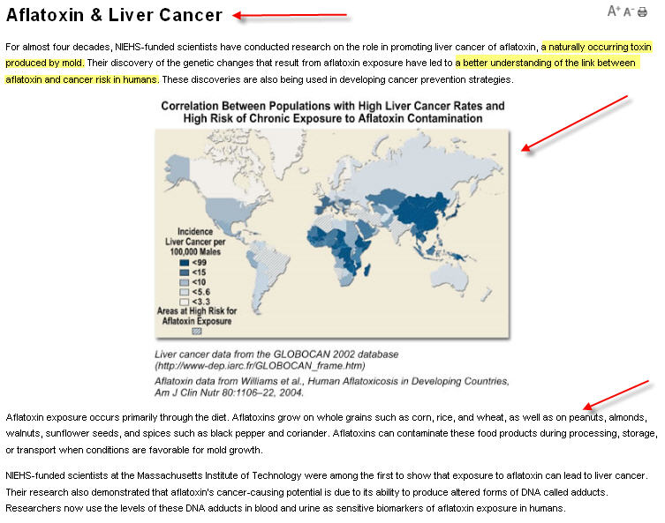
Aflatoxin content in plain language
Notes:
http://www.niehs.nih.gov/health/impacts/aflatoxin.cfm

Slide 17
Overview: plain language web writing at every level
Part 1: Plain language in navigation
Part 2: Plain language on each page
Part 3: Plain language sentences
Part 4: Plain language word choice
Part 5: Plain language in text display

Slide 18
Plain language principles applied to web writing
Part 1: Plain language in navigation
  Use menu terms users understand
  Keep menu terms short
  Help users find the content that’s right for them
Part 2: Plain language on each page
  Give the page a clear title
  Use headings
  Keep paragraphs short
  Link to more information

Slide 19
Plain language principles applied to web writing
Part 3: Plain language sentences
  Make them relatively short (under 20 words)
  Use active voice
  Choose strong verbs
Part 4: Plain language word choice
  Avoid bureaucratese
  Use familiar terms
  Provide definitions whenever you must use technical terms
Part 5: Plain language in text display
  Use vertical lists
  Use tables

Slide 20
Plain language web writing at every level
Part 1: Plain language in navigation
Part 2: Plain language on each page
Part 3: Plain language sentences
Part 4: Plain language word choice
Part 5: Plain language in text display

Slide 21
Part 1: Plain language in navigation
Use menu terms users understand
Keep menu terms short
Help users find the content that’s right for them

Slide 22
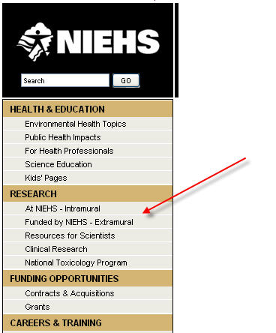
Use terms intended users can understand
Notes:
National Institute of Environmental Health Science
http://www.niehs.nih.gov/index.cfm

Slide 23
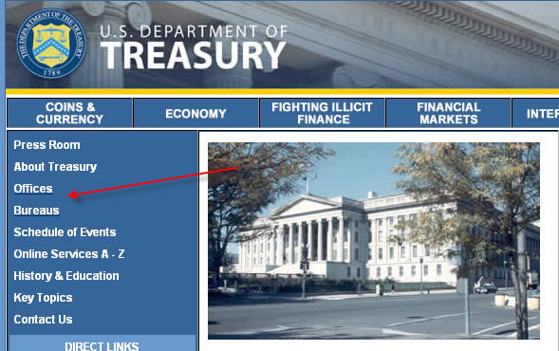
Will users know the difference between an office and a bureau?
Notes:
http://treasury.gov/

Slide 24
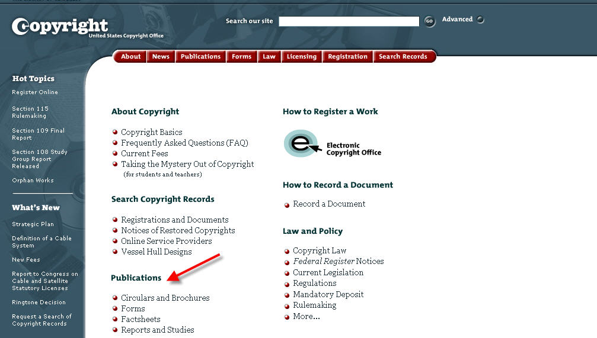
Will users understand the differences between these menu terms?
Notes:
http://copyright.gov/

Slide 25
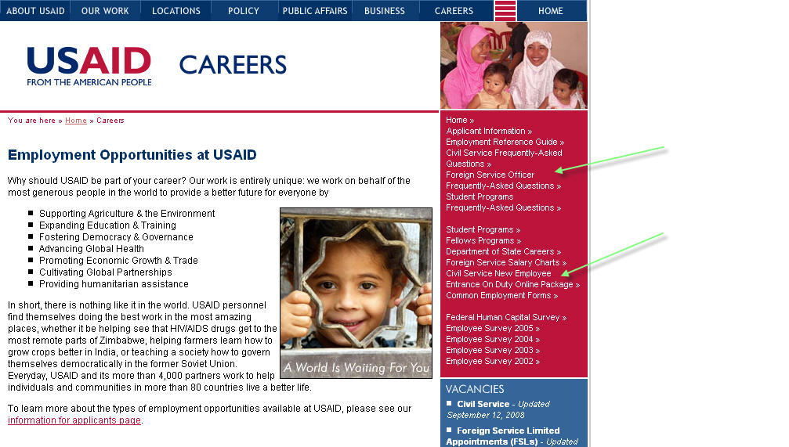
Keep menu terms short
Notes:
http://www.usaid.gov/careers/

Slide 26
Shorter menu terms
Too long: Foreign Service Officer Frequently Asked Questions
Better: Foreign Service Officer FAQs
Too long: Civil Service New Employee Entrance On Duty Online Package
Better: New Employee Online Package

Slide 27
Help users find the right content
When the differences between users are great, site navigation must work hard to help users find the content that’s right for them.

Slide 28
Who are the US Copyright Office’s users?
Copyright holders
Wanna-be copyright holders
Attorneys
Broadcasters
Publishers
Domestic and international
Experts and non-experts

Slide 29
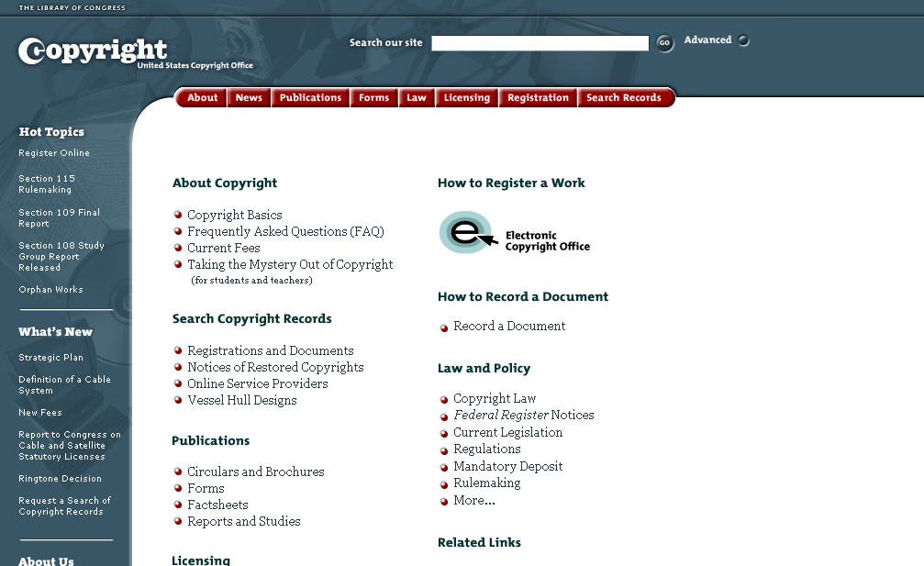
How do I find the content that’s right for me?
Notes:
http://copyright.gov/

Slide 30
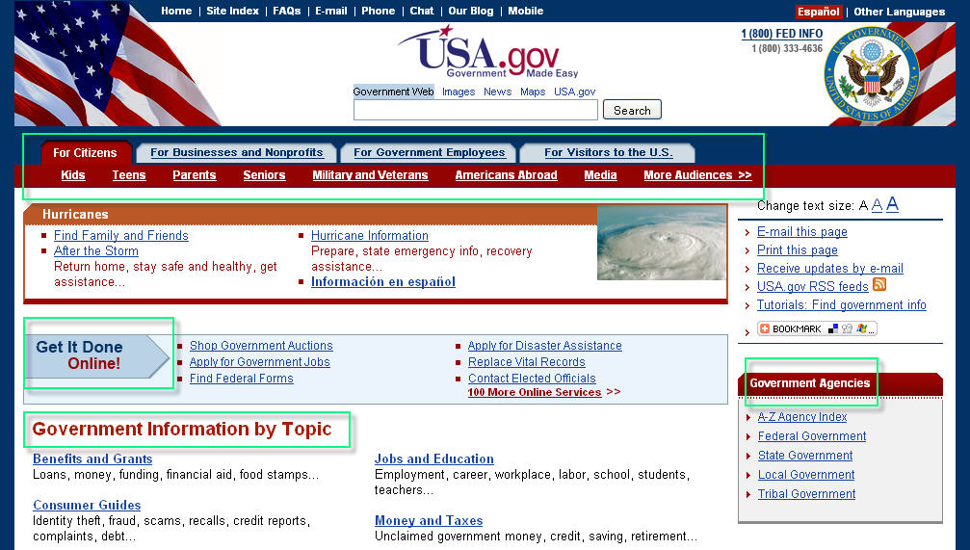
Help users navigate to the content that’s right for them
Notes:
http://www.usa.gov/

Slide 31
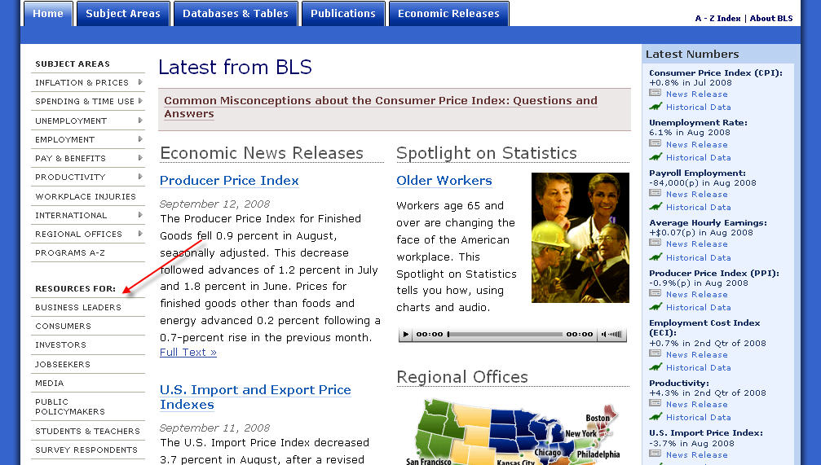
Good naming of various users
Notes:
Bureau of Labor Statistics
http://stats.bls.gov/

Slide 32
National Institute of Environmental Health Sciences (NIEHS):
An award-winning plain language web site
Contributed by Cheryl R. Thompson
NIEHS Web Manager
thompsonc2@niehs.nih.gov

Slide 33

NIEHS home page before relaunch

Slide 34
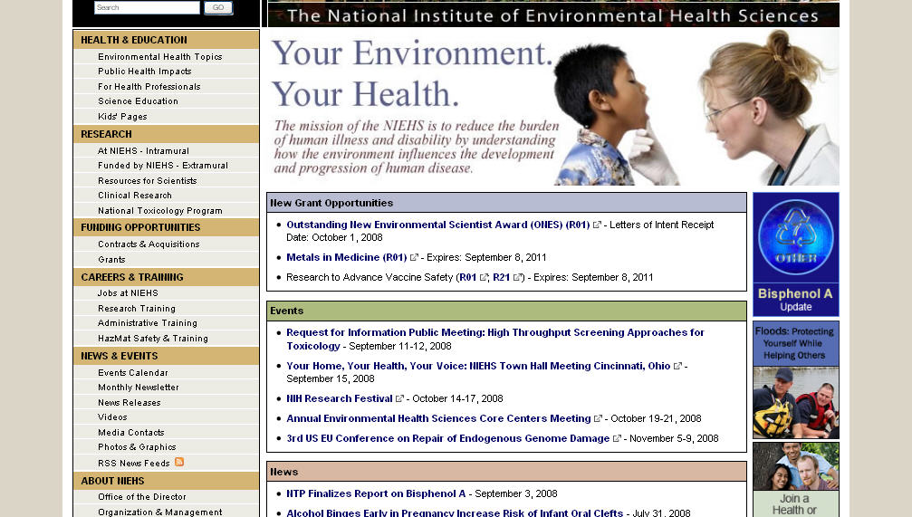
NIEHS home page after PL redo
Notes:
http://www.niehs.nih.gov/index.cfm

Slide 35
Questions?

Slide 36
Plain language web writing at every level
Part 1: Plain language in navigation
Part 2: Plain language on each page
Part 3: Plain language sentences
Part 4: Plain language word choice
Part 5: Plain language in text display

Slide 37
Part 2: Plain language on each page
Give the page a clear title
Use headings
Keep paragraphs short
Link to more information

Slide 38
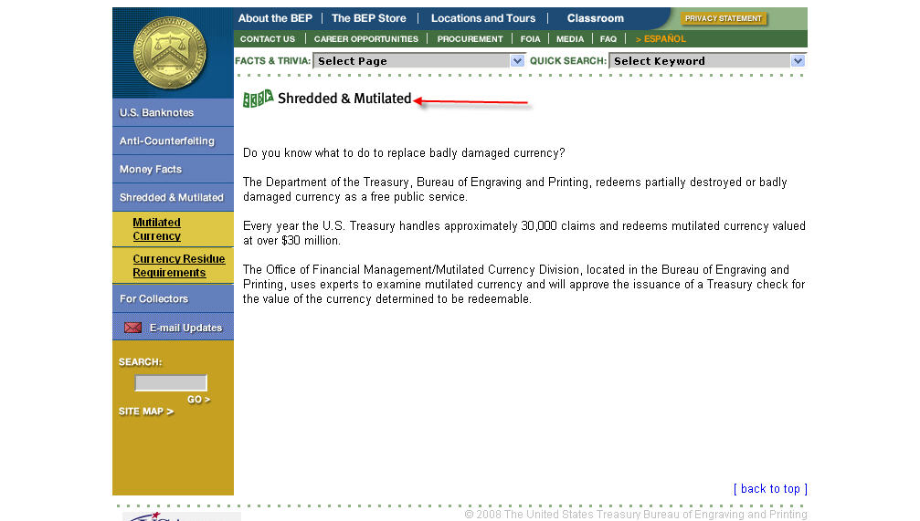
Give the page a clear title
Notes:
Bureau of Engraving and Printing
http://www.bep.treas.gov/section.cfm/8

Slide 39
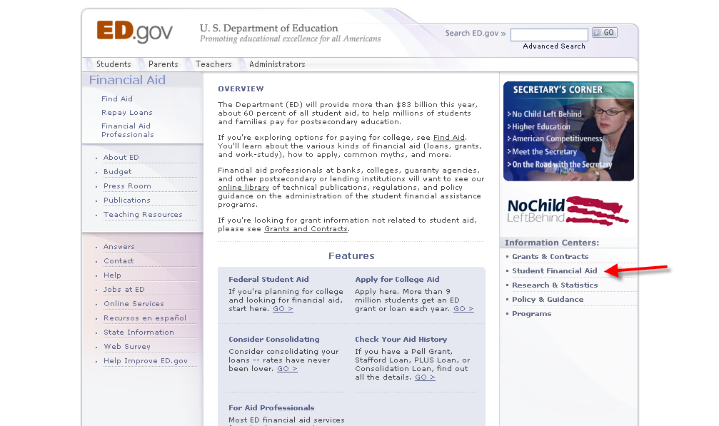
What is this page about?
Notes:
http://www.ed.gov/finaid/landing.jhtml?src=rt

Slide 40
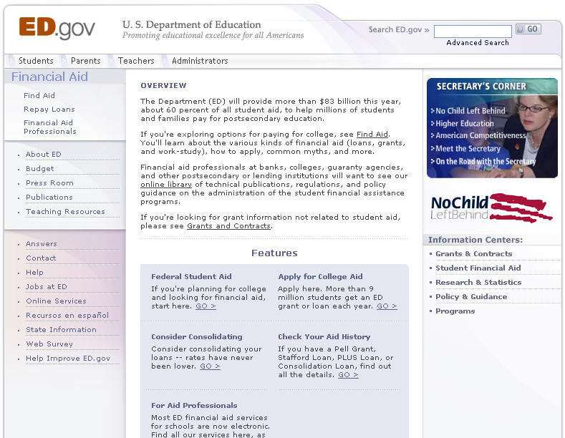
Better page titles
Student Financial Aid
Find Help with Paying for College
Helping Students and Families Pay for College
Student Financial Aid Overview

Slide 41
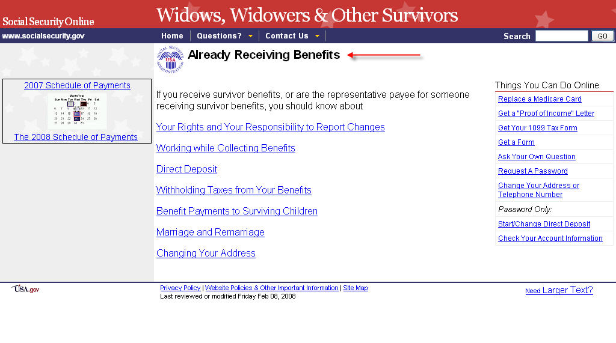
Page title – not quite there
Notes:
http://www.ssa.gov/ww&os3.htm

Slide 42
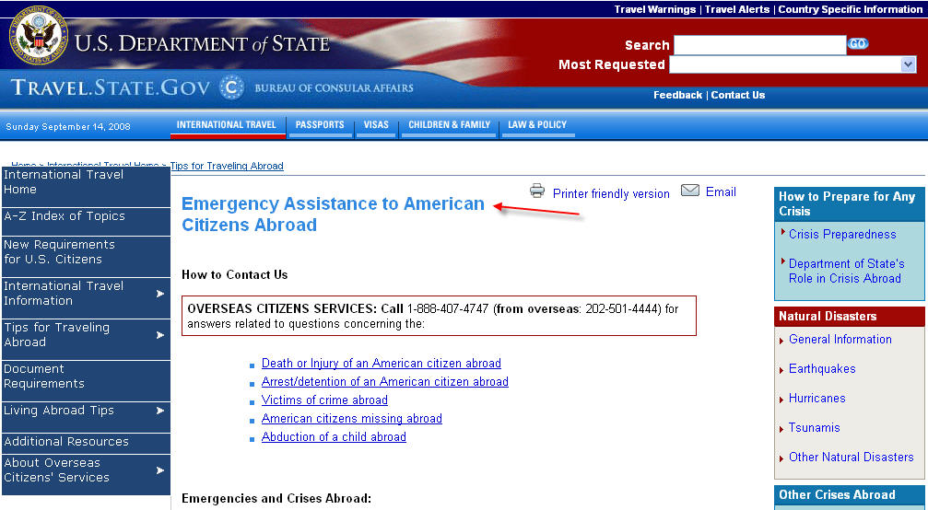
Clear page title
Notes:
http://travel.state.gov/travel/tips/emergencies/emergencies_1212.html

Slide 43
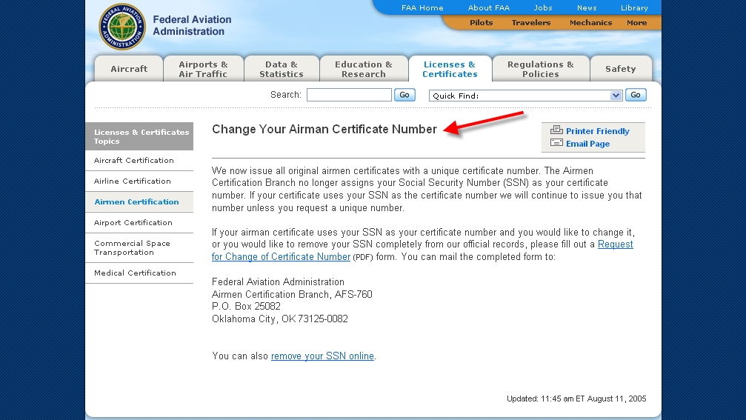
Really clear page title
Notes:
http://www.faa.gov/licenses_certificates/airmen_certification/change_certificate_number/

Slide 44
Use headings
“Your content is so good that I didn’t have to read the whole thing”
Help readers scan
Cue readers to a change in topic
Help make a page useful for different types of readers

Slide 45
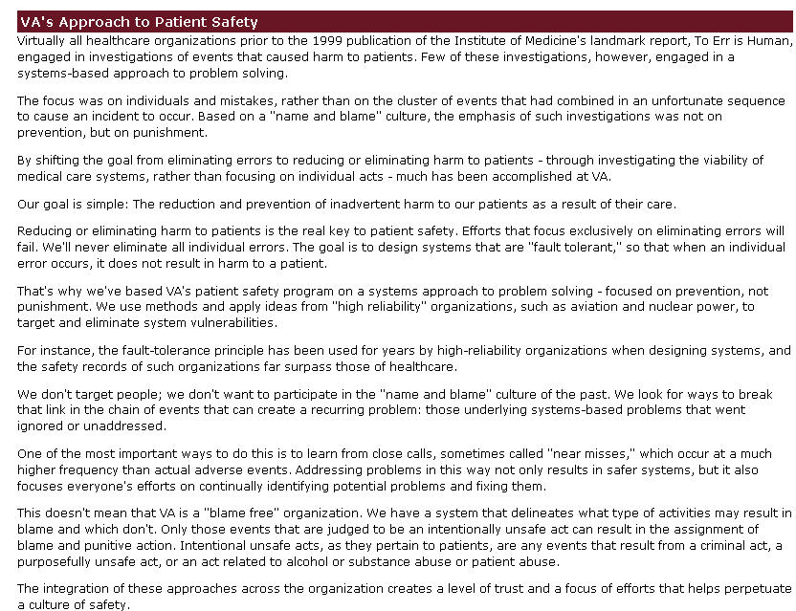
Handouts, Page 2
This content needs headings
Notes:
VA’s National Center for Patient Safety
http://www.patientsafety.gov/vision.html

Slide 46
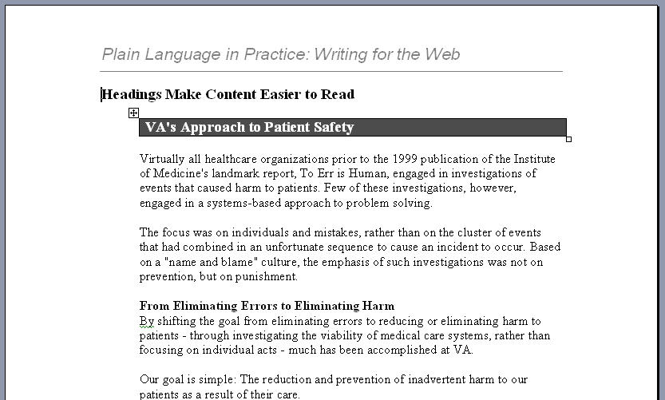
Handouts, page 7
Headings added to VA web content

Slide 47
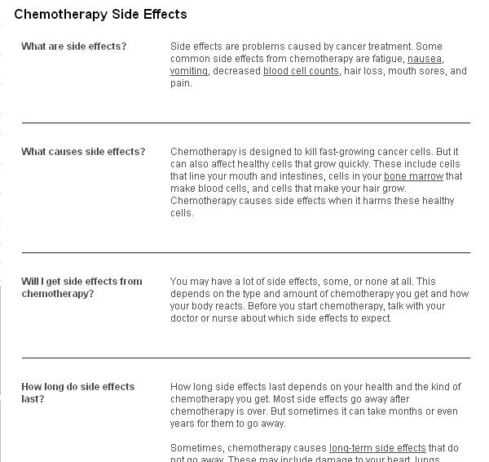
Headings make this page scannable
Notes:
http://www.cancer.gov/cancertopics/chemotherapy-and-you/page5
Published by the National Cancer Institute and National Institute of Health. Winner of a "Gold" Plain Language Award from the National Institute for Health, 2008.

Slide 48
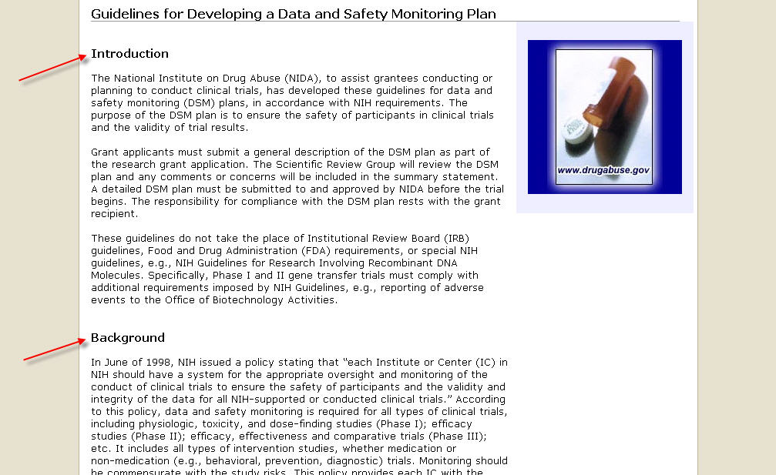
Expert readers need headings too
Notes:
National Institute on Drug Abuse
http://www.drugabuse.gov/Funding/DSMBSOP.html

Slide 49
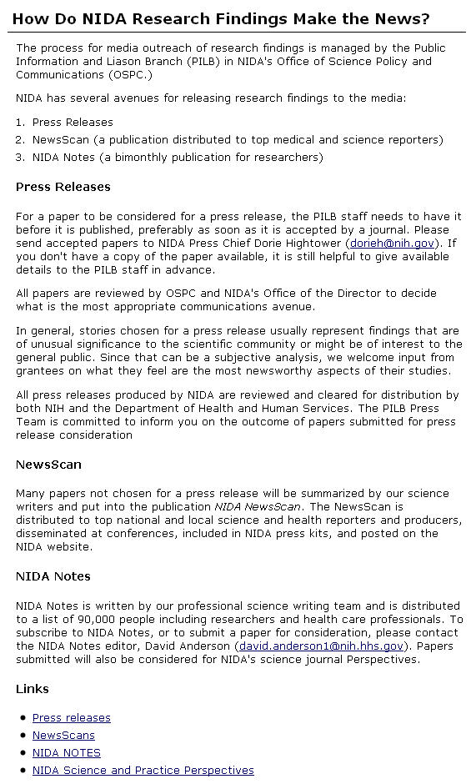
Plain language headings for expert readers
Notes:
http://www.drugabuse.gov/researchdissem.html

Slide 50
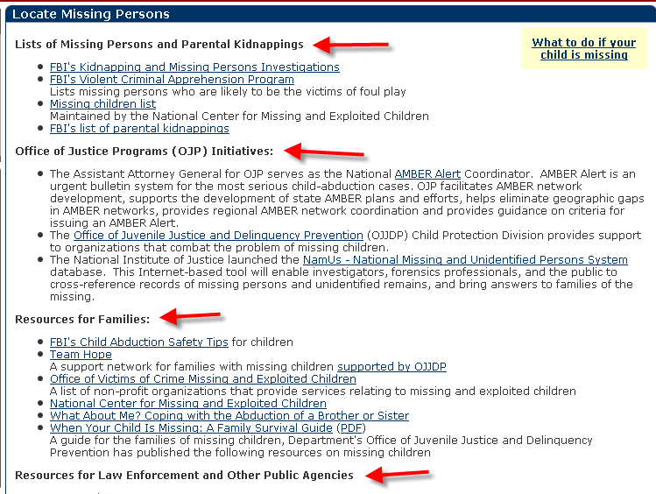
Excellent headings
Notes:
Justice Department
http://www.usdoj.gov/whatwedo/whatwedo-missing.html

Slide 51
Search engines like headings
Review search logs to discover which terms your readers use for search (jobs vs employment)
Use plain language terms in headings
Search engines give headings higher weight

Slide 52
Keep paragraphs short and focused
About five sentences or 75 words
Easily recognized as a chunk
Focused on one topic

Slide 53
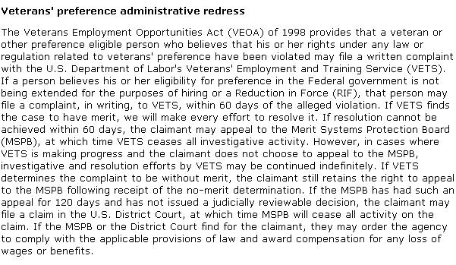
272 words, 8 sentences
Notes:
Veterans' Employment and Training Service – Dept of Labor
http://www.dol.gov/vets/programs/vetspref/veterans_preference_fs.htm

Slide 54
Shorter paragraphs make white space work
Veterans' preference administrative redress
The Veterans Employment Opportunities Act (VEOA) of 1998 provides that a veteran or other preference eligible person who believes that his or her rights under any law or regulation related to veterans' preference have been violated may file a written complaint with the U.S. Department of Labor's Veterans' Employment and Training Service (VETS). If a person believes his or her eligibility for preference in the Federal government is not being extended for the purposes of hiring or a Reduction in Force (RIF), that person may file a complaint, in writing, to VETS, within 60 days of the alleged violation. If VETS finds the case to have merit, we will make every effort to resolve it.
If resolution cannot be achieved within 60 days, the claimant may appeal to the Merit Systems Protection Board (MSPB), at which time VETS ceases all investigative activity. However, in cases where VETS is making progress and the claimant does not choose to appeal to the MSPB, investigative and resolution efforts by VETS may be continued indefinitely.
If VETS determines the complaint to be without merit, the claimant still retains the right to appeal to the MSPB following receipt of the no-merit determination. If the MSPB has had such an appeal for 120 days and has not issued a judicially reviewable decision, the claimant may file a claim in the U.S. District Court, at which time MSPB will cease all activity on the claim. If the MSPB or the District Court find for the claimant, they may order the agency to comply with the applicable provisions of law and award compensation for any loss of wages or benefits.

Slide 55
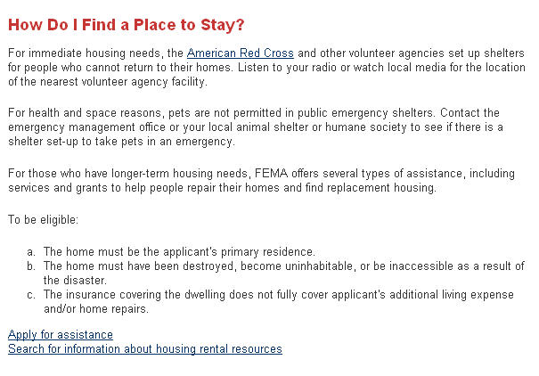
Short tidy paragraphs
Notes:
http://www.fema.gov/rebuild/recover/place.shtm

Slide 56
Write clear hypertext links
Provide access to more detailed content
“What you click is what you get”
Links are transactional words; choose verbs whenever possible
Avoid click here

Slide 57
Link to more information
Notes:
http://www.bep.treas.gov/section.cfm/8

Slide 58
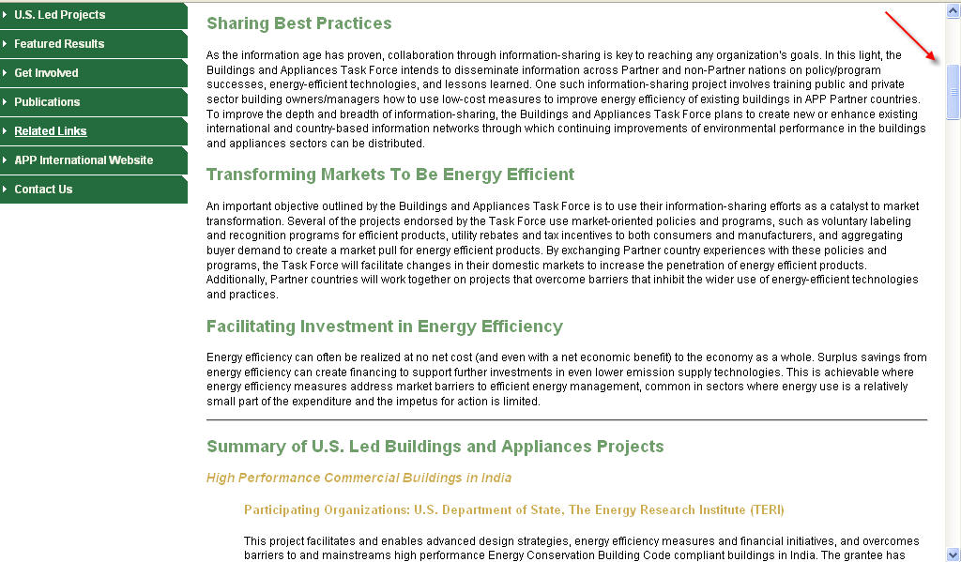
Don’t maroon your readers
Notes:
Asia-Pacific Partnership on Clean Development and Climate
http://www.app.gov/taskforces/building/

Slide 59
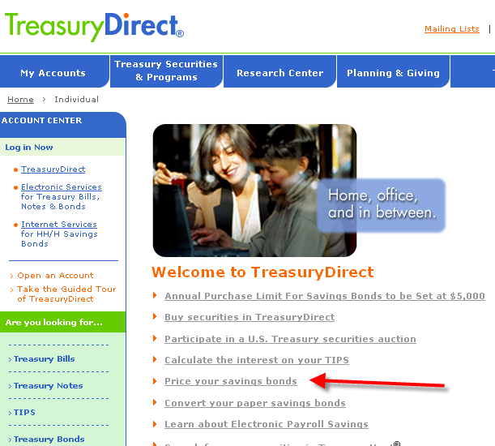
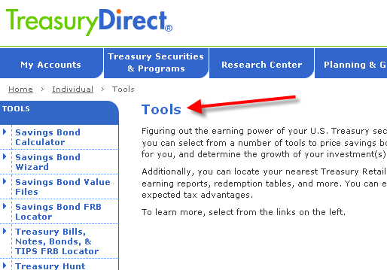
Links: what you click must be what you get
Notes:
http://www.treasurydirect.gov/indiv/indiv.htm
http://www.treasurydirect.gov/indiv/tools/tools.htm

Slide 60
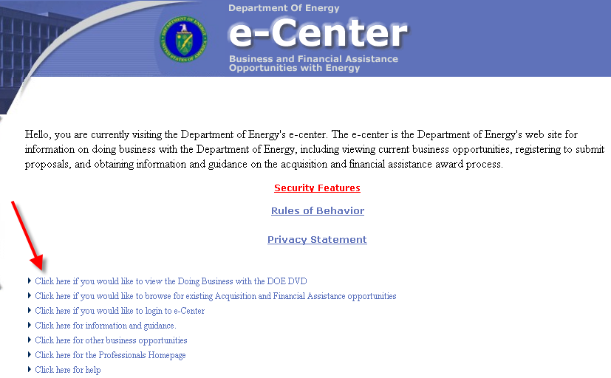
Avoid click here
Notes:
http://e-center.doe.gov/

Slide 61
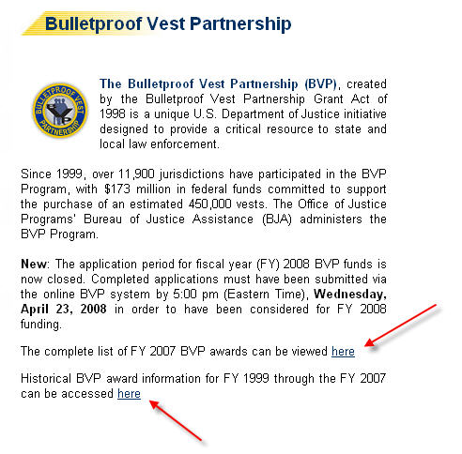
Improve the hypertext links
Review the list of FY 2007 BVP awards or past BVP awards, beginning with FY 1999.
Notes:
Office of Justice Programs
http://www.ojp.usdoj.gov/bvpbasi/

Slide 62
Plain language web writing at every level
Part 1: Plain language in navigation
Part 2: Plain language on each page
Part 3: Plain language sentences
Part 4: Plain language word choice
Part 5: Plain language in text display

Slide 63
Part 3: Plain language sentences
Make them relatively short (under 20 words)
Use active voice
Choose strong verbs

Slide 64
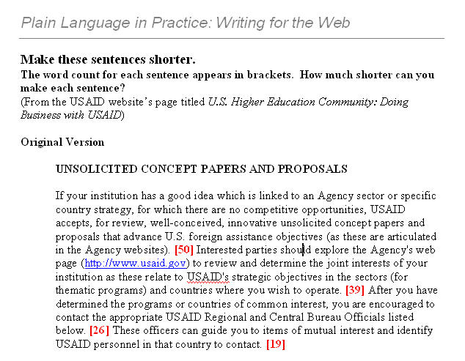
Handouts, Page 4
Make long sentences shorter

Slide 65
Make long sentences shorter
UNSOLICITED CONCEPT PAPERS AND PROPOSALS
If your institution has a good idea which is linked to an Agency sector or specific country strategy, for which there are no competitive opportunities, USAID accepts, for review, well-conceived, innovative unsolicited concept papers and proposals that advance U.S. foreign assistance objectives (as these are articulated in the Agency websites). [50] Interested parties should explore the Agency's web page (http://www.usaid.gov) to review and determine the joint interests of your institution as these relate to USAID's strategic objectives in the sectors (for thematic programs) and countries where you wish to operate. [39] After you have determined the programs or countries of common interest, you are encouraged to contact the appropriate USAID Regional and Central Bureau Officials listed below. [26] These officers can guide you to items of mutual interest and identify USAID personnel in that country to contact. [19]

Slide 66
Long sentences made shorter
If your institution has a good idea that supports an Agency sector or country strategy, but you can find no competitive opportunities, USAID may be interested. [26] USAID will review innovative unsolicited concept papers and proposals that advance US foreign assistance objectives. [15] Once you’ve determined how your institution’s interests relate to USAID's strategic objectives, contact the appropriate USAID Regional and Central Bureau officials, listed below. [23] These officials can help you identify USAID personnel to contact in each country . [14]

Slide 67
Use active voice
Avoid: A rehabilitation plan will be developed by the counselor.
Use: The counselor will develop a rehabilitation plan.
Avoid: To establish CHAMPVA eligibility, copies of marriage documents must be provided.
Use: You must provide copies of your marriage documents to establish CHAMPVA eligibility.
Avoid: It is recommended that all health care workers receive an annual influenza vaccination to prevent transmission to patients.
Use: CDC recommends that all health care workers receive an annual influenza vaccination to prevent transmission to patients.

Slide 68
Choose strong verbs
Applications that do not require a PRIA fee
A fee is required for only certain types of applications. Information on the types that do not require a fee may be found on EPA's Web site. An example of an application that does not require a fee is a request to amend or make a change to an EPA-approved label that does not require the Agency to review data (commonly called a Fast Track or Me-Too Amendment).
Applications that do not require a PRIA fee
We require a fee only for certain types of applications. You may find information on the types that do not require a fee on EPA's Web site. For example, one application that does not require a fee is a request to amend or change an EPA-approved label that does not require the Agency to review data (commonly called a Fast Track or Me-Too Amendment).
Notes:
EPA - Pesticide Registration Improvement Renewal Act
http://www.epa.gov/opp00001/fees/tool/index.htm

Slide 69
Plain language web writing at every level
Part 1: Plain language in navigation
Part 2: Plain language on each page
Part 3: Plain language sentences
Part 4: Plain language word choice
Part 5: Plain language in text display

Slide 70
Part 4: Plain language word choice
Avoid bureaucratese
Use familiar terms
Provide definitions whenever you must use technical terms

Slide 71
Use the plain language substitute for bureaucratic words
Too Fancy | Plain
Utilize | Use
At the present time | Now
On the basis of | Based on
After the completion of | After completing
Employment | Jobs
Including, but not limited to | Including

Slide 72
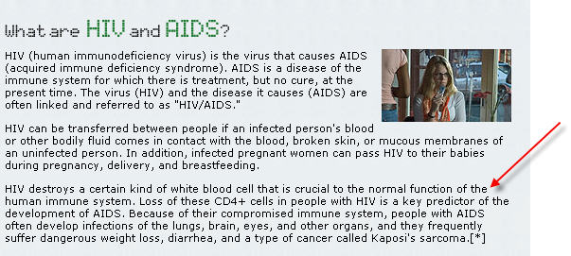
Use familiar terms
Notes:
http://hiv.drugabuse.gov/english/learn/what.html

Slide 73
Provide definitions
Link to a glossary
Insert a brief explanation into the text

Slide 74
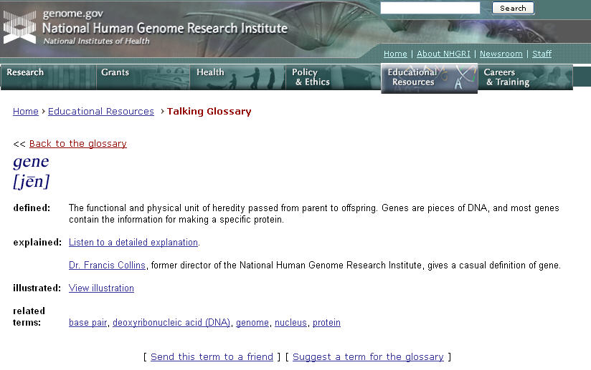
Now that’s a glossary
Notes:
http://www.genome.gov/glossary.cfm?key=gene

Slide 75
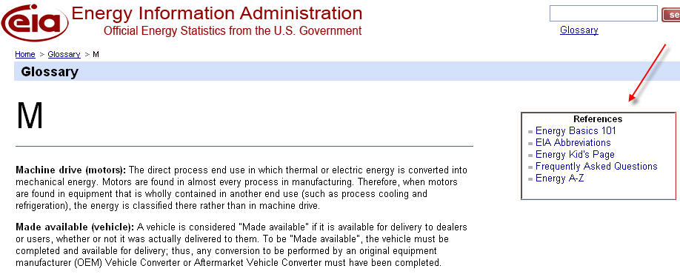
Glossary + easy access to other kinds of reference
Notes:
http://www.eia.doe.gov/glossary/glossary_m.htm

Slide 76
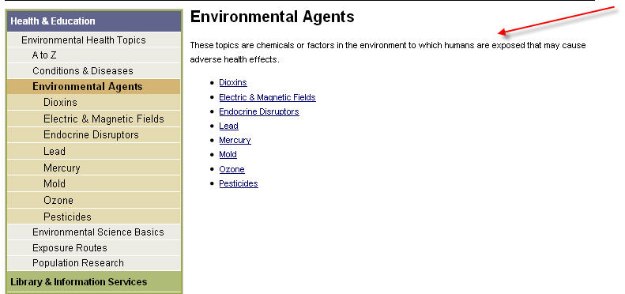
Insert a brief explanation
Notes:
http://www.niehs.nih.gov/health/topics/agents/index.cfm

Slide 77
Questions?

Slide 78
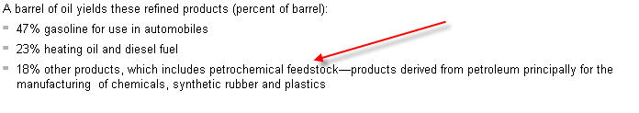
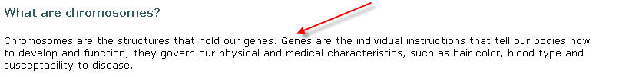
Insert a brief explanation into the text
Notes:
http://tonto.eia.doe.gov/ask/gasoline_faqs.asp#gallons_per_barrel
http://www.genome.gov/11508982

Slide 79
Plain language web writing at every level
Part 1: Plain language in navigation
Part 2: Plain language on each page
Part 3: Plain language sentences
Part 4: Plain language word choice
Part 5: Plain language in text display

Slide 80
Part 5: Plain language in text display
Use vertical lists
Use tables

Slide 81
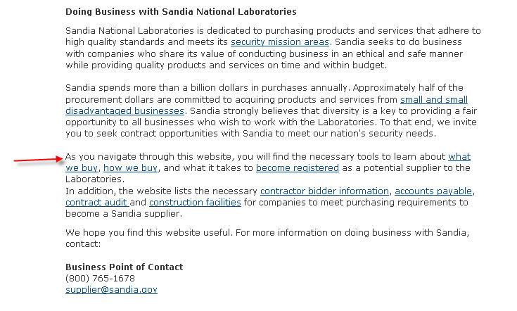
Use vertical lists to enable users to scan
Notes:
http://www.sandia.gov/bus-ops/scm/home.html

Slide 82
Bullets help!
Learn about
what we buy
how we buy
how to register as a supplier
Find
contractor bidder information
accounts payable
contract audit
construction facilities

Slide 83
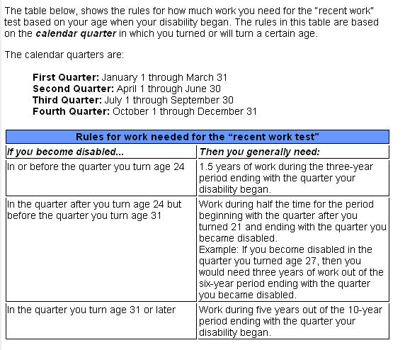
Tables enable scanning and reinforce the logic of the content
Notes:
Social Security’s Disability Benefits page
http://www.ssa.gov/pubs/10029.html

Slide 84
PL Case Study: Energy in Brief
Energy Information Administration’s online publication launched in May 2008
“Energy in Briefs explain important energy topics in plain language. Each Brief answers a question relevant to the public and recommends resources for further reading.”
EIBs are written by subject matter experts for non-experts

Slide 85
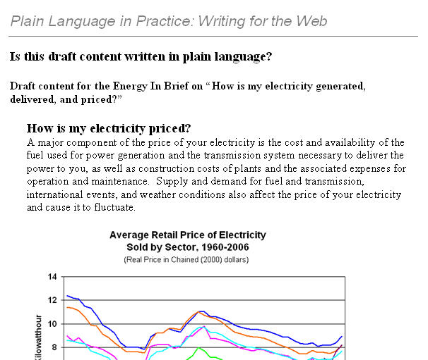
Handouts, Page 5
Draft content for Energy in Brief

Slide 86
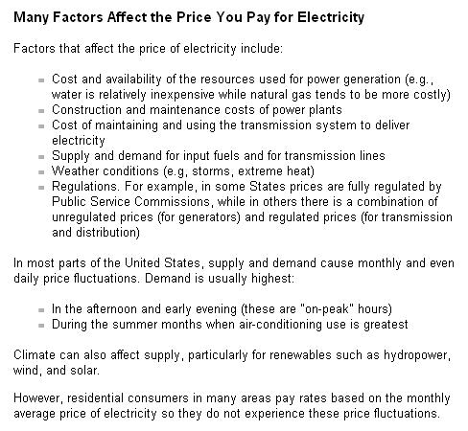
Handouts, Page 6
Plain language in the published EIB:
Notes:
http://tonto.eia.doe.gov/energy_in_brief/electricity.cfm

Slide 87
How plain language web content “happens”
Publish plain language guidelines
Provide, and require, plain language training
Prepare authors, especially experts, for plain language review of their content
Identify editorial go-betweens, people who are experts and who can edit

Slide 88
Author Guidance Sheet for EIB
What is EIB?
Who are EIBs readers?
What is the EIB publishing process?
What are the parts of an EIB?
How do you write each part of an EIB?
Where do you go for help writing an EIB?

Slide 89
Plain language resources

Slide 90
Plain language organizations
Plain Language Action and Information Network (PLAIN)
Center for Plain Language
Plain Language Association INternational
Usability.gov
Clarity - international association promoting plain legal language

Slide 91
Plain language guidelines
Federal Plain Language Guidelines
Easy-to-Read NYC
Plain Language - Making HIPAA Privacy Notices More Readable – Health Resources and Services Administration
Guidelines from NIH’s Plain Language Initiative
FAA’s videos on plain language
Governor’s Plain Language Handbook (Florida)
Making Regulations Readable (Federal Register)
Plain English Handbook (SEC)
FAA Writing Standards
Plain Language Guidelines Oklahoma Department of Human Services
Writing to Customers in Plain Talk (Washington State)

Slide 92
Plain language before-and-after examples
Florida Department of Children and Families
Home Equity Loan Contracts (Texas Office of Consumer Credit Commissioner)
Government before-and-afters at Plainlanguage.gov
Moving to Plain Language Disclosure
Letters and policies from Washington State

Slide 93
Questions?

Slide 94

Contact information
Leslie O’Flahavan
E-WRITE
Leslie@ewriteonline.com
Tel. 301-989-9853
www.ewriteonline.com
Writing Matters blog at http://writingmatters.typepad.com/

