Slide 1

NASA and Google+
National Aeronautics and Space Administration

Slide 2
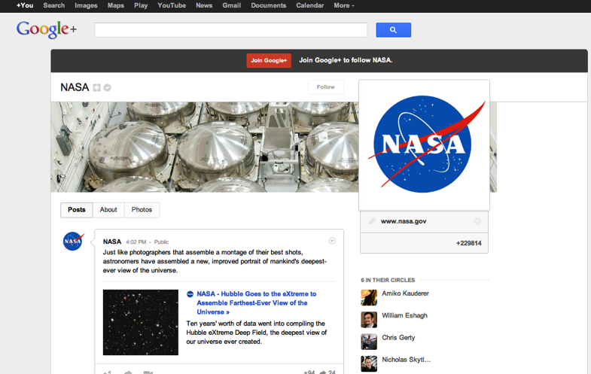
Circling +NASA
National Aeronautics and Space Administration
Joined Google+ in Nov. 2011 as the 1st federal agency
Currently we’re circled by 229,814 users
http://www.nasa.gov/connect

Slide 3
Growth for NASA on Platforms
National Aeronautics and Space Administration
Why?
People are more social now than in 2008 when we joined Twitter.
We’re a technical, scientific organization and Google+ had a lot of early technology adaptors.
http://www.nasa.gov/connect

Slide 4
How did this happen?
National Aeronautics and Space Administration
Provide GREAT content that will get people talking.
Social media is a conversation – spend as much time listening as you do speaking.
If you start a conversation, participate in it;
don’t start it and walk away.
Ask for and enable feedback – respond to questions in comments, etc.
http://www.nasa.gov/connect
Notes:
You may have heard the government is tightening its belt, which means limited resources
Create thriving social media and engagement with fans with limited resources

Slide 5
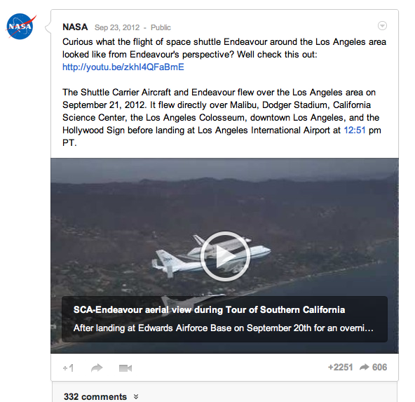
Sharing our Universe
National Aeronautics and Space Administration
Content is king: provide information, insight and clarification
Share paragraph or longer updates that have enough information, but also have a call to action for users to get more info
Add visuals & video to posts to generate more shares
Remember that most folks won’t see the update in the context of your page, but rather in a stream of updates on their feed
http://www.nasa.gov/connect

Slide 6
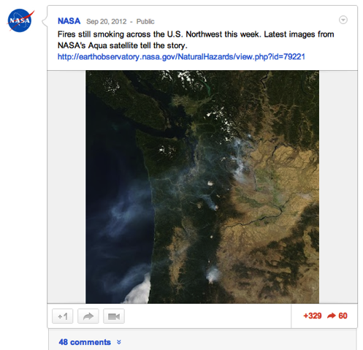
Sharing our Universe
National Aeronautics and Space Administration
While being timely is important, don’t post multiple things back to back on the same topic. Be strategic. Post it when the time is right and you have everything necessary to post.
Link to more in-depth content, such as a webpage, podcast, news release, etc.
Cover an event by providing a few comprehensive updates. Don’t ‘live post’ events on these platforms unless the event lends itself to that format based on your audience. This is viewed as spam and will cause followers to uncircle us.
http://www.nasa.gov/connect

Slide 7
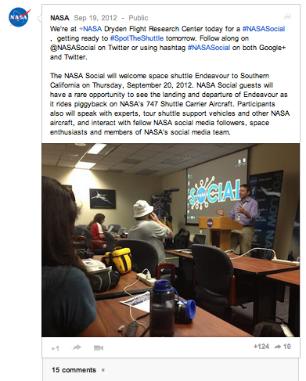
Sharing our Universe
National Aeronautics and Space Administration
Cover multiple points and provide a few links per post, if applicable. Most folks will not click on a link to find out more – provide them enough information that they have the big picture and the news nuggets.
Use #hashtags as appropriate to enable the conversation
Remember to check your spelling and check your links. Do they work before clicking publish?
http://www.nasa.gov/connect

Slide 8
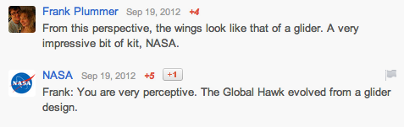
Commenting on our Universe
National Aeronautics and Space Administration
Monitor comments on your posts. Reply with more updates in the comment threads. Delete spam, links, and other profane comments.
Respond to complaints if you can help someone, but avoid arguing with people trying to bait you (referred to as "trolls" on the Internet).
http://www.nasa.gov/connect

Slide 9
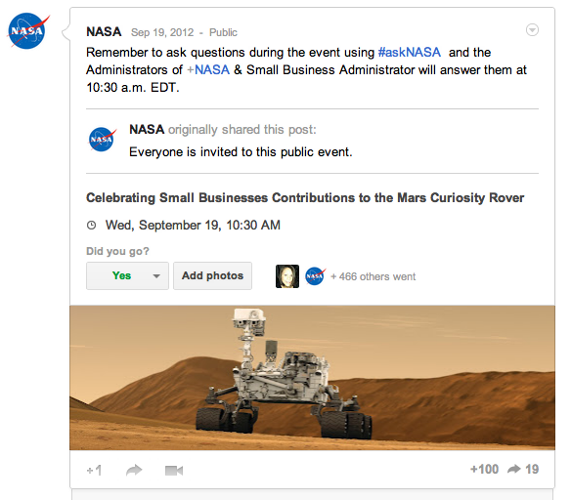
Lining Up All the Orbits
National Aeronautics and Space Administration
Create Google+ events for organizational events to allow users to place it on their calendars and participate virtually
Share the events onto your Google+ page to promote it
If doing a hangout on air, remember to add the link to your hangout prior to starting your broadcast
http://www.nasa.gov/connect

Slide 10
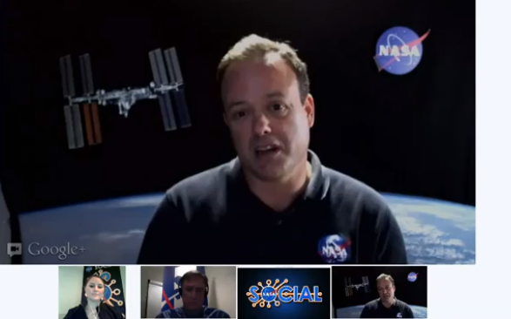
Hanging Out with +NASA
National Aeronautics and Space Administration
http://www.nasa.gov/connect

Slide 11


Benefits to Hanging Out with +NASA
National Aeronautics and Space Administration
Allows the public access to your subject matter experts
Allows you to showcase a particular topic and expertise
Can show a human side of your government organization, thus breaking previously held ideas of your organization
http://www.nasa.gov/connect

Slide 12
Hanging Out with +NASA
National Aeronautics and Space Administration
Staff:
  One on-air moderator
  One behind-the-scenes technical producer
  On-air Talent (number varies based on topic)
Resources:
  Google+ page for organization
  YouTube channel in good standing to enable “On Air” streaming
  Each participant must have a webcam and microphone, plus the Google+ Hangout Plugin installed (may need admin rights on your computer)
http://www.nasa.gov/connect

Slide 13
But why is NASA on Google+?
National Aeronautics and Space Administration
http://www.nasa.gov/connect

Slide 14
NASA’s Social Media Foundation
National Aeronautics and Space Administration
According to the National Aeronautics and Space Act (Pub. L. No. 111-314, 124 Stat. 3328 [Dec. 18, 2010]):
Sec. 20112 (a) The Administration, in order to carry out the purpose of this Act, shall—
  (3) provide for the widest practicable and appropriate dissemination of information concerning its activities and the results thereof
http://www.nasa.gov/connect

Slide 15
But Why? How does this help NASA?
National Aeronautics and Space Administration
Spreads the word as widely as possible by going directly to members of the public to tell your own story
As news organizations cut staff and trim coverage, we get more news coverage…
…in more places, especially smaller, local outlets
The diversity of followers who circle us help connect us to non-traditional audiences to further share our message
We get impactful and active participation leading to significant levels of worldwide…
ENGAGEMENT
http://www.nasa.gov/connect

Slide 16
National Aeronautics and Space Administration
“You may not have a spaceship, but your company has a fan base. They won't think of themselves as fans until they're in a room with like-minded people. They won't think of themselves as members of a community until YOU bring them together.”
David Rosen, @davidhrosen
  (group VP, Makovsky + Company)
http://www.nasa.gov/connect

Slide 17
http://www.nasa.gov/connect

