Slide 1
Innovation and Collaboration
Jeffrey R. Davis, M.D.
Director, Space Life Sciences
June 17, 2010
Exploring Space, Enhancing Life

Slide 2
Driving Innovation
Through Collaboration
Discussion topics
    Background to open collaboration/innovation
    Results to date
    Other agency/organization networking and sharing results
    NASA Human Health and Performance Center (Virtual Collaboration Center )

Slide 3
Driving Innovation
Through Collaboration
SLSD Strategic Plan 2007
  Key strategic goals:
    Manage balanced internal/external portfolio
    Drive health innovations
    Drive human system integration innovations
  Key strategies for implementation
    Alliances (began 2007, benchmark study 2009)
    Open collaboration/innovation (2008)
    Collaboration with Harvard Business School (2008)
    Proposed virtual center for collaboration (NHHPC 2010)
3
Notes:
3

Slide 4
Driving Innovation
Through Collaboration
Why open collaboration/innovation?
  Joy’s Law
    “No Matter Who You Are, Most of the Smartest People Work for Someone Else”
      Bill Joy, Cofounder Sun Microsystems
  The Causal Explanation for Joy’s Law
    Knowledge is unevenly distributed in society - Fredrich von Hayek (1945)
    Knowledge is sticky - Eric von Hippel (1994)
Karim Lakhani, PhD Harvard Business School

Slide 5
Driving Innovation
Through Collaboration
Three pilot projects
  InnoCentive- posts individual challenges/gaps to their established network of solvers (200,000)
    financial award if the solution is found viable by the posting entity
  Yet2.com- acts as an actual technology scout bringing together buyers and sellers of technologies
    Option to develop partnerships
  TopCoder - open innovation software company with a large network of solvers (200,000)
    variety of skill-based software coding competitions

Slide 6
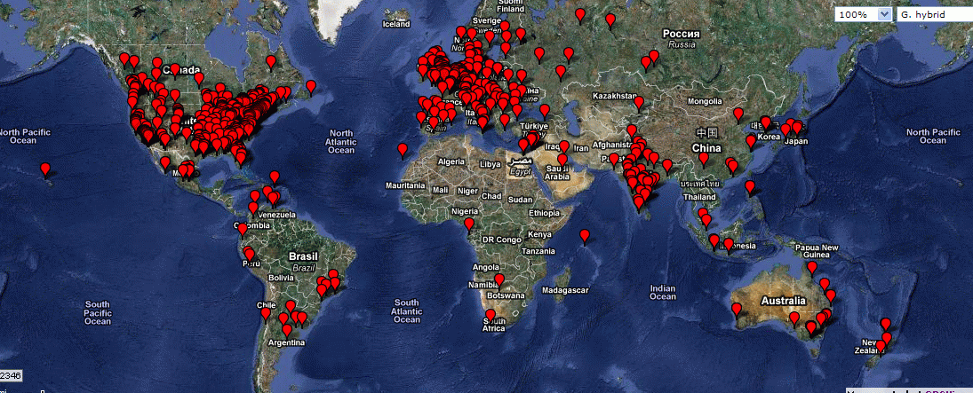
Three NASA JSC Challenges Posted at InnoCentive.com
A Total of 1,317 Solvers from 65 countries opened Project Rooms
as of April 29, 2010

Slide 7
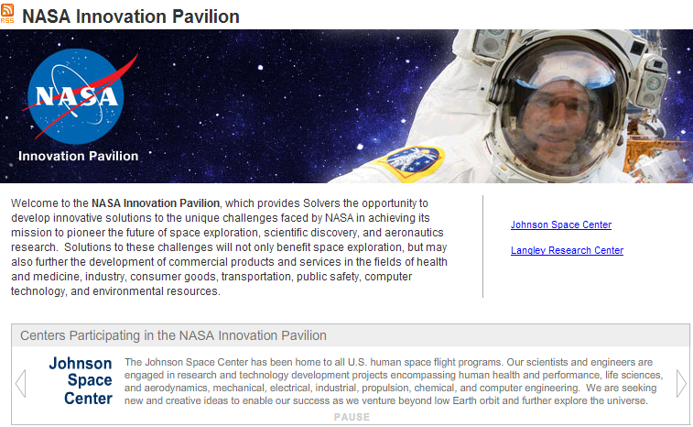
InnoCentive
Mechanical Engineer from Foxboro, MA awarded $20,000 for novel compact and resistive exercise device design. 564 “project rooms” participated
Radio Frequency Engineer from Lempster, NH awarded $30,000 for a mathematical model to be used for solar forecasting. 579 “project rooms” participated
NASA contracts with scientific network of 200,000+ experts from around the world to procure “frictionless” solutions
Source: www.innocentive.com

Slide 8
InnoCentive Challenges Summary
Challenge Title | Challenge Owner | Challenge Type / Award | Posted / Deadline | Final Numbers | Challenge Status
Improved Food Packaging | Michele Perchonok | Theoretical-IP / $15,000 | December 18, 2009 / February 28, 2010 | -174 Project Rooms from 33 Countries -22 Submissions from 10 Countries 16 for Evaluation | A partial solution was found and is still under Due Diligence for Solver Verification.
Compact, effective aerobic and resistive device | Linda Loerch | Theoretical-IP / $20,000 | December 18, 2009 / February 28, 2010 | -564 Project Rooms from 52 Countries -95 Submissions from 24 Countries 60 for Evaluation | A full award has been made to a mechanical engineer from Foxboro, MA for his pneumatic suction device. The well formed solution will be directly infused into current NASA prototype efforts.
Forecasting Solar Activity | Neal Zapp | RTP / $30,000 | December 22, 2009 / March 22, 2010 | -579 Project Rooms from 53 Countries -11 submissions from 5 Countries 4 for Evaluation | A full award has been made to a retired Ph.D from rural NH for his SPE prediction algorithm. It is felt this solution exceeds the requirements and NASA is interested in working with the solver on implementation into an operational framework.
Notes:
Is the Seeker interested in finding other cathartic activities to perform while exercising, or is a system that supports the list in the challenge template sufficient?
Has the Seeker already looked for this technology (what work has already been done), or is it possible that a solution already exists?
With this challenge type / award range I would expect Solvers to submit detailed descriptions of various technologies + providers.
I think it is unlikely Solvers will be able to provide deliverable (1), however I could imagine some Solvers throwing together some type of prototype. Perhaps framing this as an RTP - but indicating that Theoretical proposals would be accepted for a lesser award - would be ideal.
It is clear NASA has put some work into pooling ideas already - it would probably be a good idea to describe the devices they have come up with in the challenge briefly as no interest without significant modification.
I could imagine this challenge as a 5k ideation generating a ton of interesting ideas - if the Seeker would be interested in developing an idea from scratch (deliverable 4).

Slide 9
InnoCentive Challenges Summary
Challenge Title | Challenge Owner | Challenge Type / Award | Posted / Deadline | Final Numbers | Challenge Status
Coordination of Sensor Swarms for Extra - terrestrial Research | Erik Vedeler | Theoretical - Licensing / $20,000 | February 27, 2010 / April 26, 2010 | -423 Project Rooms from 49 Countries -37 Submissions from 11 Countries 22 for Evaluation | Currently under evaluation by the challenge owner and the Langley champion Melvin Ferebee. Evaluation will be completed by the team in Mid-June 2010.
Notes:
Is the Seeker interested in finding other cathartic activities to perform while exercising, or is a system that supports the list in the challenge template sufficient?
Has the Seeker already looked for this technology (what work has already been done), or is it possible that a solution already exists?
With this challenge type / award range I would expect Solvers to submit detailed descriptions of various technologies + providers.
I think it is unlikely Solvers will be able to provide deliverable (1), however I could imagine some Solvers throwing together some type of prototype. Perhaps framing this as an RTP - but indicating that Theoretical proposals would be accepted for a lesser award - would be ideal.
It is clear NASA has put some work into pooling ideas already - it would probably be a good idea to describe the devices they have come up with in the challenge briefly as no interest without significant modification.
I could imagine this challenge as a 5k ideation generating a ton of interesting ideas - if the Seeker would be interested in developing an idea from scratch (deliverable 4).

Slide 10
Yet2.com Pilot-Phase 1
6 technical needs in process
  4 have been posted, 1 closed
    Bone Imaging
      Received 37contact leads
        Investigated 15
        2 contacts chosen for further relationship with NASA
      Tech need closed
    Water Monitoring (2 components)
      Received 45 contact leads
      16 under review and 9 remain of strong interest
    Radioprotectants for humans exposed to chronic and acute radiation
      Received 26 initial contacts
      18 remain of interest

Slide 11
Yet2.com
Bone Imaging - Most Promising Leads
  New technique characterizes anatomical structures using magnetic resonance data
  High field and high resolution magnetic resonance imaging for quantitative characterization
  Imaging that advances existing techniques to image structures and tissues that are invisible to conventional MRI
  Hip Bone Mineral Density (BMD) system
  Magnetic Resonance - work demonstrated the feasibility of measuring the stiffness of trabecular bone

Slide 12
TopCoder
Opportunity presented to NASA by Harvard Business School
  Research project to compare outcomes of collaborative and competitive teams
  NASA provided the problem statement
    Competitors had to build an optimization algorithm for a medical kit
Competition began on 11/04/2009 and lasted approximately 10 days
  2800 solutions were submitted by 480 individuals
  Useful algorithm developed and incorporated into NASA model
  Team felt this process was faster and cheaper than internal development

Slide 13
Forward Work
Pilot project: NASA@Work
    Innovation at work platform
    Facilitates inter-Center and cross disciplinary communication
      Leverages breadth and depth of NASA technical expertise
    All 10 Centers participating – complete Sept 2010
      20 Challenges (2 per center)
    Assess outcomes, participation, etc.
13

Slide 14
Other Agency Collaboration
Office of Science and Technology Policy
  Requested a briefing April 8, 2010
  Multi-agency workshop April 30, 2010
  Facilitated exchanges June 9-10 with:
    General Services Administration
    Department of Education
    Federal Communications Commission
    Pending follow-ups:
      Medicare Innovation Center (to open January 2011)
      United States Agency for International Development

Slide 15
Other Collaborations
MIT Innovation Lab
  Facilitated by Harvard Business School
  Pending collaborations with:
    Nike
    Mozilla
    The World Bank
    Biomatrica (biomimicry)
Harvard Business School
  GE – “reverse innovation”, challenges similar to space flight
National Science Foundation (IdeasLab)
  Rapid, collaborative, theme-based research model

Slide 16
Other Collaborations
Rice Business Plan Competition
  NASA involvement began 2008
  NASA seeks technologies in a commercial market that can be pulled into space flight
  Student teams with technology and business plan
  4 challenges awarded
    Earth/Space Life Sciences (1)
      Prize awarded since 2008
    Engineering (2)
      Prize awarded since 2009
    Game Changer (1)
      Prize awarded since 2010

Slide 17
Human Health and Performance Center
Virtual Collaboration Center hosted by NASA
  Why? Expand previous work in open collaboration/innovation to leverage NASA expertise and resources with many external partners
    Tackle projects that no one entity can do alone
  Objectives (seek to initiate operations Sept 2010):
    Facilitate collaborative projects between members
    Exchange knowledge base including open collaboration/innovation
    Virtual – web-based and some workshops, low overhead
  JSC and Ames co-lead
    Glenn, Langley, Kennedy, Marshall core center partners

Slide 18
Human Health and Performance Center
  Other agencies interested
    NIH (ISS utilization)
    NIST (biomarkers)
    NSF (IdeasLab)
    FAA (commercial space workshop)
    Health and Human Services (multiple agencies)
    ISS Partners (collaborative human system risk forum)
  Other organizations interested
    Nike (health, exercise, nutrition)
    GE (portfolio management, technology development)
    Philips (technology development)
    Virgin Galactic, Blue Origin (human system workshop)
    Potential to invite current orbital commercial providers
    FAA Center of Excellence winner (university based)

