Slide 1
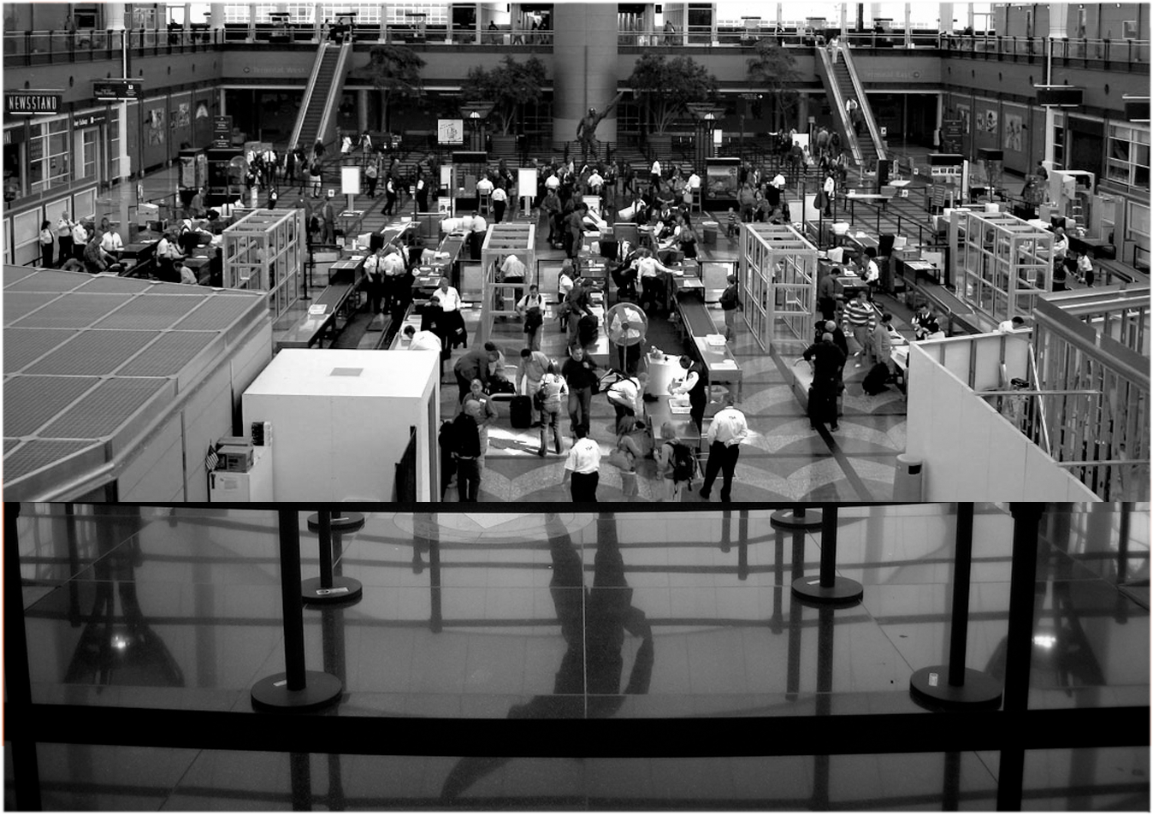
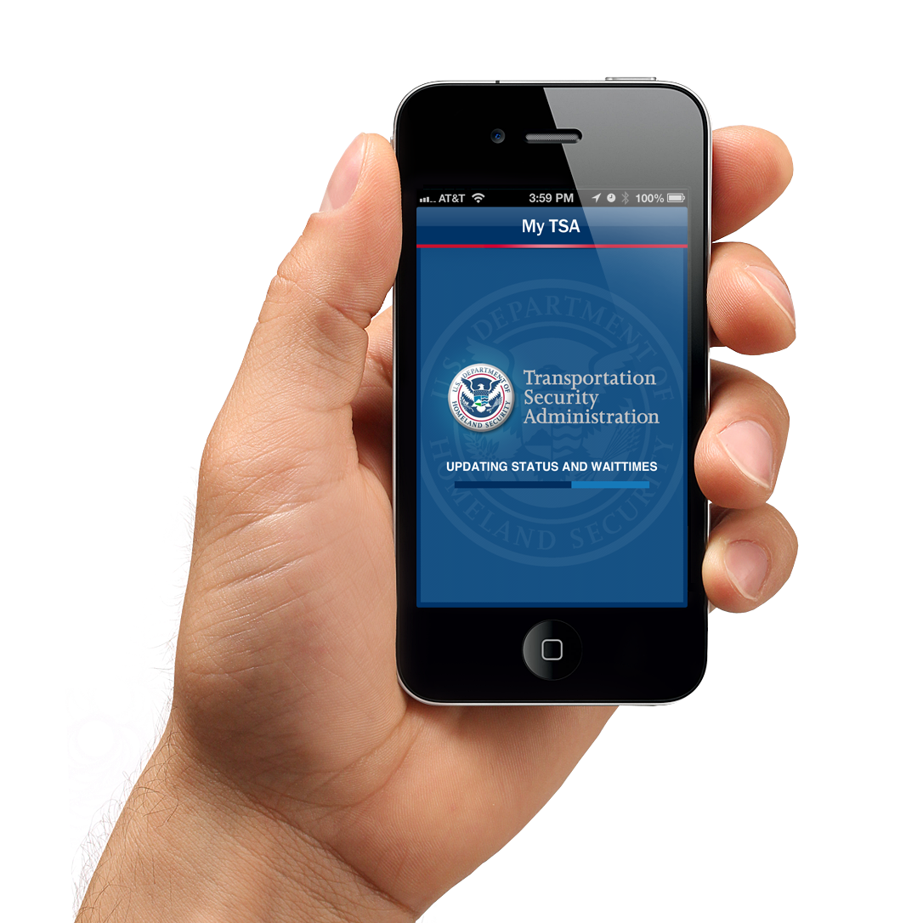
TSA’s “My TSA”
Mobile Apps Lifecycle
OIT Applications Development Division

Slide 2
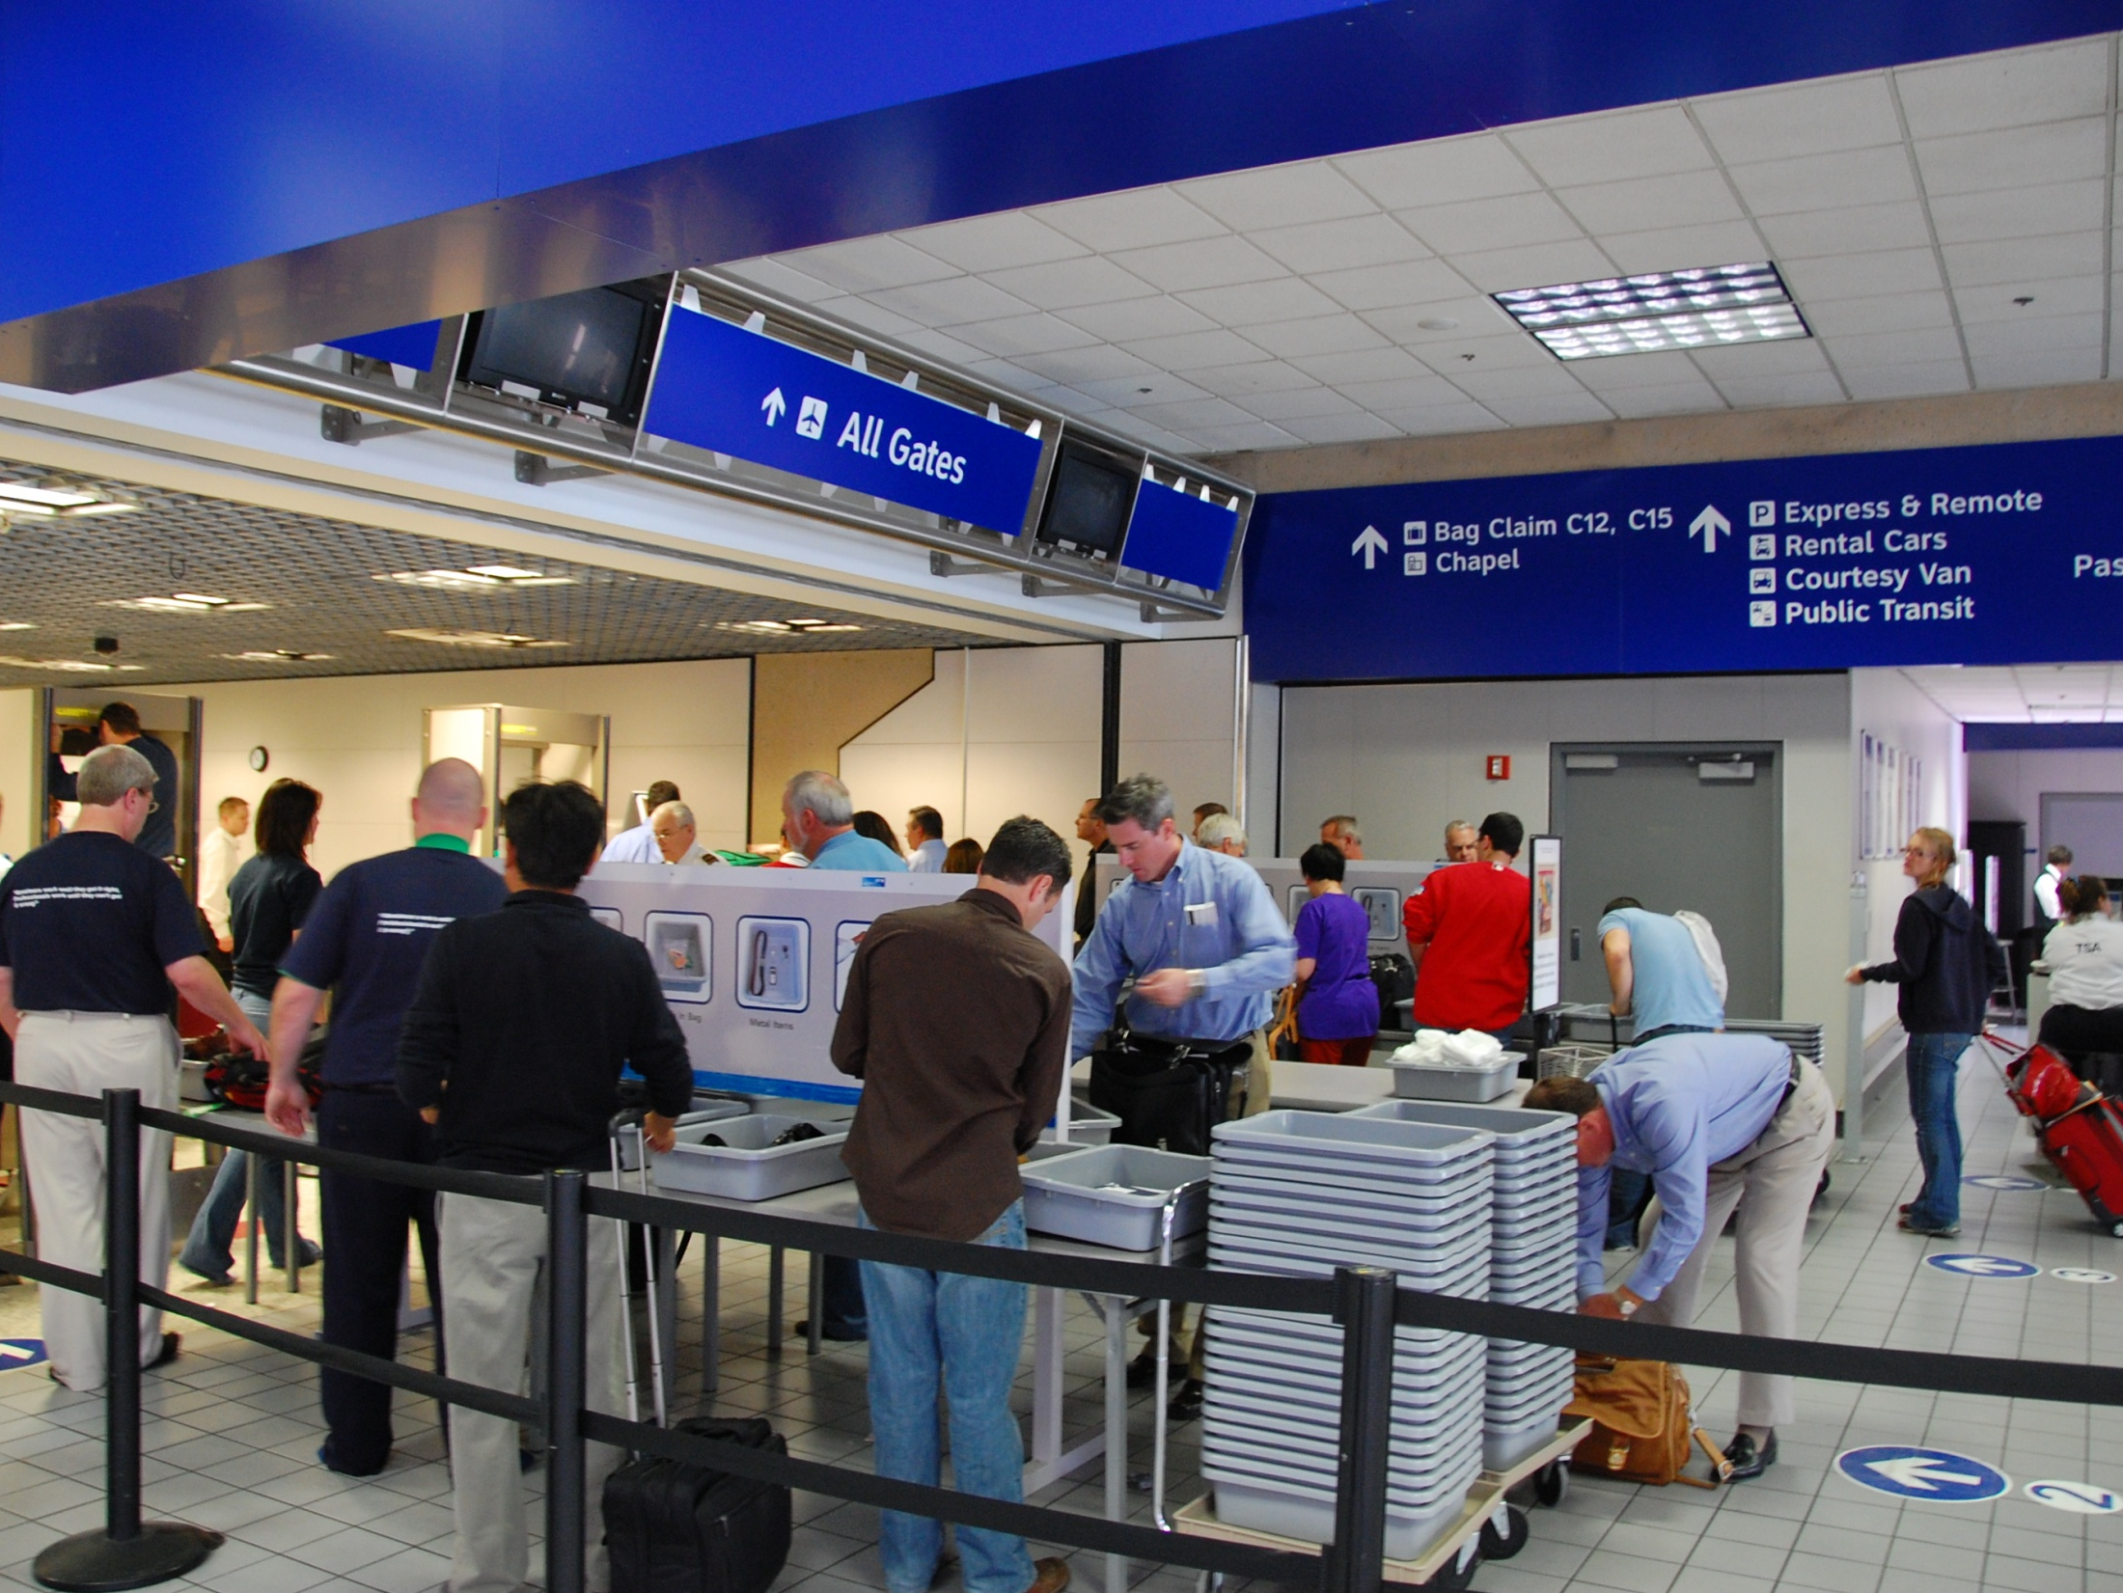
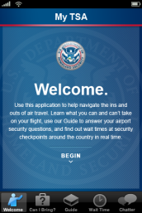
Citizen-facing mobile apps must be kept up-to-date to remain relevant.
Best federal apps are the result of a tight partnership between the IT organization and the sponsoring office.
IT provides technology & design.
Sponsoring office provides content & approves feature enhancements.
Allow each organization to be a
stakeholder & share in the credit.

Slide 3
Evolution of Changes over Time
Mobile apps should be updated with timely bug fixes and user driven enhancements. Need to have a “commercial product” approach.
July 2010 – Version 1.0: initial release (iPhone & mobile web).
May 2011 – Version 1.1: set user preferences (geo-location), CIB type-ahead, updateable Guide pages, TSA videos (YouTube), SQL Server DB for Wait Times, OAuth architecture & web services.
June 2011 – Version 1.2: NWS weather info, BTS on-time performance, “Retina” graphics support, stability enhancements.
July 2012: Android v1.0, MyTSA web services 1.3, sunrise/sunset service, mobile web v1.3 (feature complete), Civil Rights complaint form.
Version 1.3 – TBD (January 2013): TSA Pre✓™ enhancements.
Version 2.0 – TBD (Spring 2013): iPad version.

Slide 4
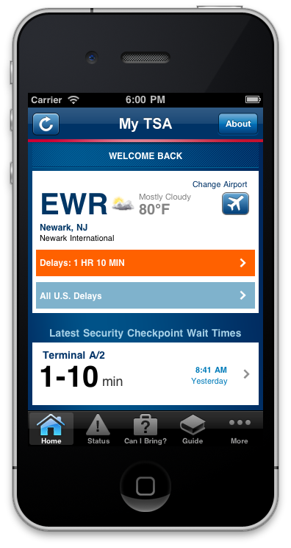
“My TSA” Principal features
24/7 access to information that passengers frequently request. Default view is a friendly dashboard.
My TSA has multiple function, including the following features:
Airport Status: Users can see what airports are experiencing general delays (not flight specific) or search for conditions at a specific airport. This information is provided by the FAA.
‘Can I Bring?’: Users can type in an item they plan to bring on a trip to find out if it is permitted or prohibited, and whether they can pack it in carry-on or checked bags.
Guide: Users can get travel tips on an array of some of the most popular topics of air travel.
Security wait times: My TSA gives passengers the ability to share their wait time and see what wait times other passengers have posted for U.S. airports.
Videos: directly from TSA’s official YouTube page.
Weather: NOAA’s National Weather Service current weather and seven day forecast.
Airport On-Time performance statistics from the Bureau of Transportation Statistics.

Slide 5
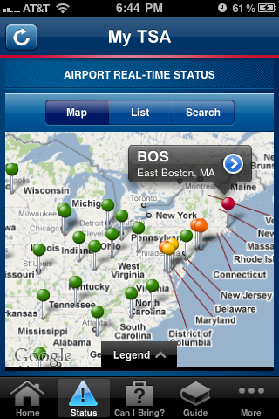
“My TSA” Principal features
24/7 access to information that passengers frequently request. Default view is a friendly dashboard.
My TSA has multiple function, including the following features:
Airport Status: Users can see what airports are experiencing general delays (not flight specific) or search for conditions at a specific airport. This information is provided by the FAA.
‘Can I Bring?’: Users can type in an item they plan to bring on a trip to find out if it is permitted or prohibited, and whether they can pack it in carry-on or checked bags.
Guide: Users can get travel tips on an array of some of the most popular topics of air travel.
Security wait times: My TSA gives passengers the ability to share their wait time and see what wait times other passengers have posted for U.S. airports.
Videos: directly from TSA’s official YouTube page.
Weather: NOAA’s National Weather Service current weather and seven day forecast.
Airport On-Time performance statistics from the Bureau of Transportation Statistics.

Slide 6
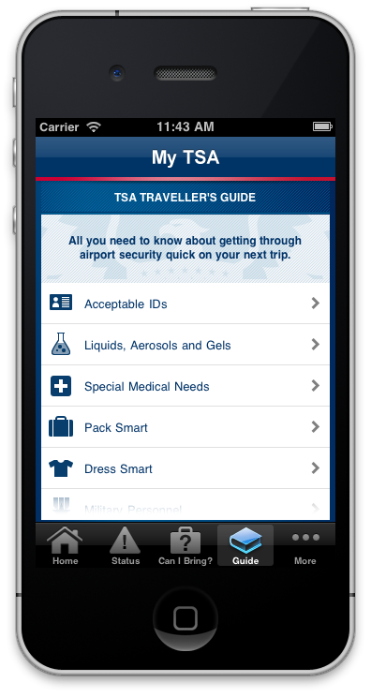
“My TSA” Principal features
24/7 access to information that passengers frequently request. Default view is a friendly dashboard.
My TSA has multiple function, including the following features:
Airport Status: Users can see what airports are experiencing general delays (not flight specific) or search for conditions at a specific airport. This information is provided by the FAA.
‘Can I Bring?’: Users can type in an item they plan to bring on a trip to find out if it is permitted or prohibited, and whether they can pack it in carry-on or checked bags.
Guide: Users can get travel tips on an array of some of the most popular topics of air travel.
Security wait times: My TSA gives passengers the ability to share their wait time and see what wait times other passengers have posted for U.S. airports.
Videos: directly from TSA’s official YouTube page.
Weather: NOAA’s National Weather Service current weather and seven day forecast.
Airport On-Time performance statistics from the Bureau of Transportation Statistics.

Slide 7
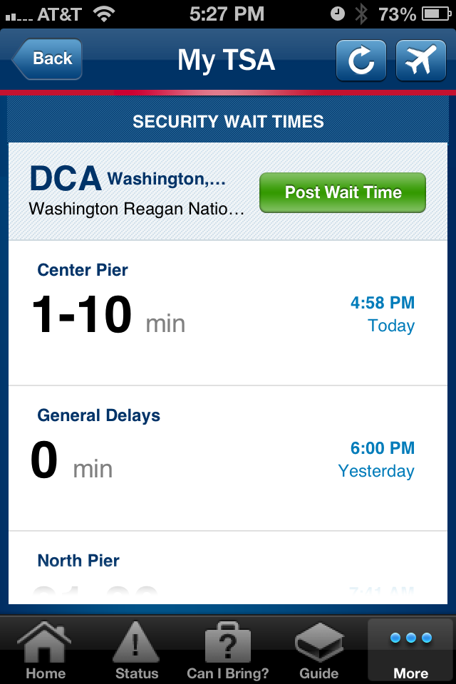
“My TSA” Principal features
24/7 access to information that passengers frequently request. Default view is a friendly dashboard.
My TSA has multiple function, including the following features:
Airport Status: Users can see what airports are experiencing general delays (not flight specific) or search for conditions at a specific airport. This information is provided by the FAA.
‘Can I Bring?’: Users can type in an item they plan to bring on a trip to find out if it is permitted or prohibited, and whether they can pack it in carry-on or checked bags.
Guide: Users can get travel tips on an array of some of the most popular topics of air travel.
Security wait times: My TSA gives passengers the ability to share their wait time and see what wait times other passengers have posted for U.S. airports.
Videos: directly from TSA’s official YouTube page.
Weather: NOAA’s National Weather Service current weather and seven day forecast.
Airport On-Time performance statistics from the Bureau of Transportation Statistics.

Slide 8
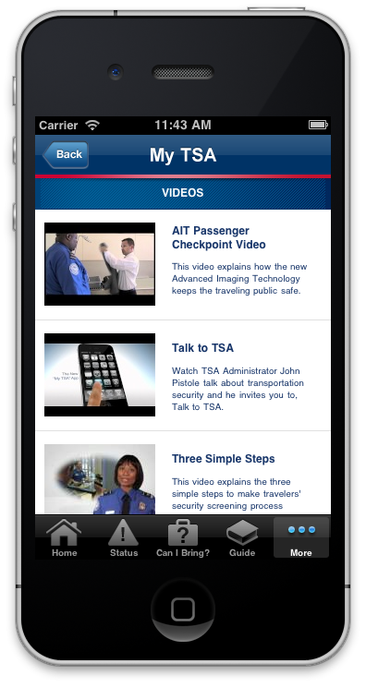
“My TSA” Principal features
24/7 access to information that passengers frequently request. Default view is a friendly dashboard.
My TSA has multiple function, including the following features:
Airport Status: Users can see what airports are experiencing general delays (not flight specific) or search for conditions at a specific airport. This information is provided by the FAA.
‘Can I Bring?’: Users can type in an item they plan to bring on a trip to find out if it is permitted or prohibited, and whether they can pack it in carry-on or checked bags.
Guide: Users can get travel tips on an array of some of the most popular topics of air travel.
Security wait times: My TSA gives passengers the ability to share their wait time and see what wait times other passengers have posted for U.S. airports.
Videos: directly from TSA’s official YouTube page.
Weather: NOAA’s National Weather Service current weather and seven day forecast.
Airport On-Time performance statistics from the Bureau of Transportation Statistics.

Slide 9
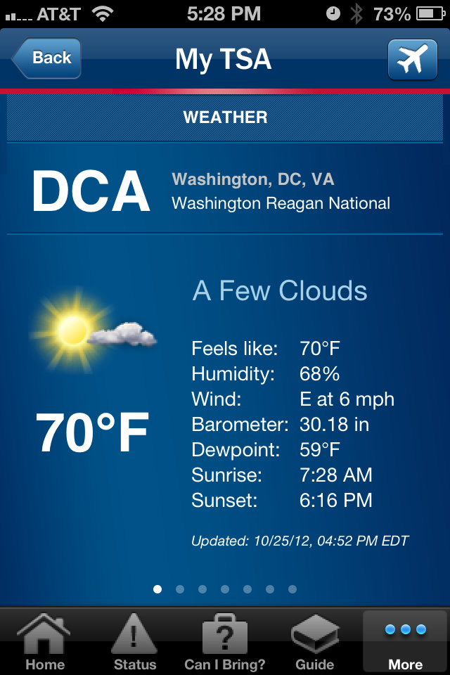
“My TSA” Principal features
24/7 access to information that passengers frequently request. Default view is a friendly dashboard.
My TSA has multiple function, including the following features:
Airport Status: Users can see what airports are experiencing general delays (not flight specific) or search for conditions at a specific airport. This information is provided by the FAA.
‘Can I Bring?’: Users can type in an item they plan to bring on a trip to find out if it is permitted or prohibited, and whether they can pack it in carry-on or checked bags.
Guide: Users can get travel tips on an array of some of the most popular topics of air travel.
Security wait times: My TSA gives passengers the ability to share their wait time and see what wait times other passengers have posted for U.S. airports.
Videos: directly from TSA’s official YouTube page.
Weather: NOAA’s National Weather Service current weather and seven day forecast.
Airport On-Time performance statistics from the Bureau of Transportation Statistics.

Slide 10
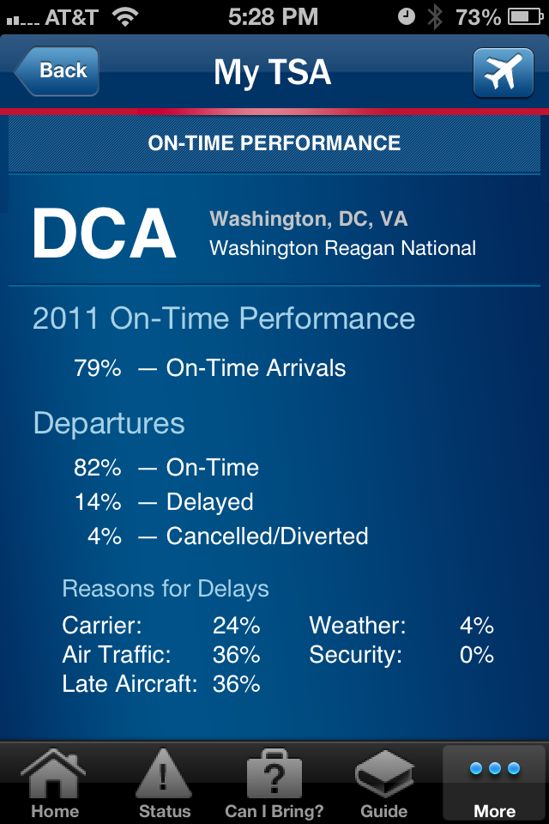
“My TSA” Principal features
24/7 access to information that passengers frequently request. Default view is a friendly dashboard.
My TSA has multiple function, including the following features:
Airport Status: Users can see what airports are experiencing general delays (not flight specific) or search for conditions at a specific airport. This information is provided by the FAA.
‘Can I Bring?’: Users can type in an item they plan to bring on a trip to find out if it is permitted or prohibited, and whether they can pack it in carry-on or checked bags.
Guide: Users can get travel tips on an array of some of the most popular topics of air travel.
Security wait times: My TSA gives passengers the ability to share their wait time and see what wait times other passengers have posted for U.S. airports.
Videos: directly from TSA’s official YouTube page.
Weather: NOAA’s National Weather Service current weather and seven day forecast.
Airport On-Time performance statistics from the Bureau of Transportation Statistics.

Slide 11
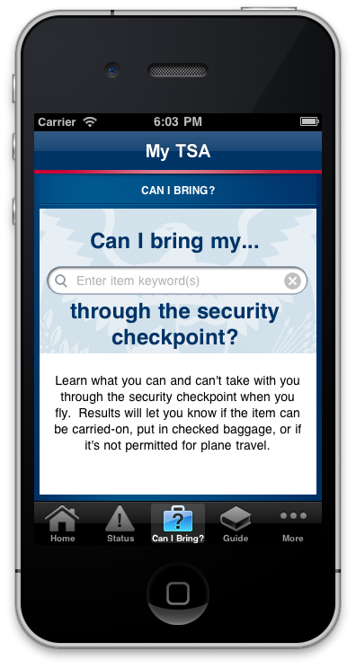
MyTSA “Can I Bring?” Feature on iPhone.
The “Can I Bring?” feature of the MyTSA app (iPhone, Android, and mobile web) is a useful travelers tool that can help answer the question, “Can I bring this item on the airplane when I travel?”.
When the tool was launch in June 2010 there were approximately 900 items in the database. As of August 2012 because of traveler’s suggestions there are nearly 4,000 items included.
Because of frequent misspellings (we only include the correct spelling for each item) we enhanced the tool with a “type ahead” feature that has predictive typing and auto-complete. If the traveler enters an item that is not in our database they have an opportunity to submit the suggestion anonymously to TSA.
Depending on the item entered, there is a predefined set of “status” categories which are returned as the definitive answer.

Slide 12
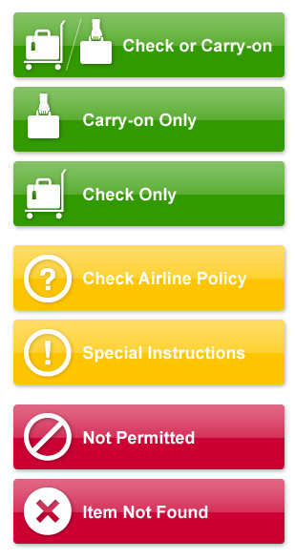
There are a total of seven “status” results based on the item entered.
The status and the particular “category” of item determine if an item can be carried-on, put in checked baggage or if it’s not permitted for plane travel.

Slide 13
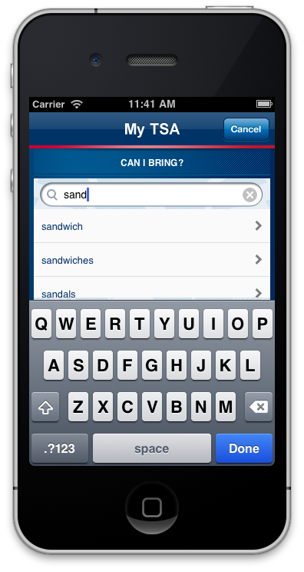
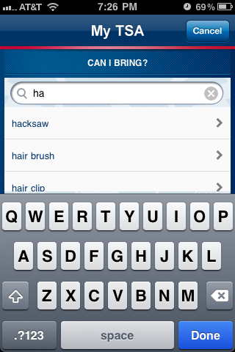
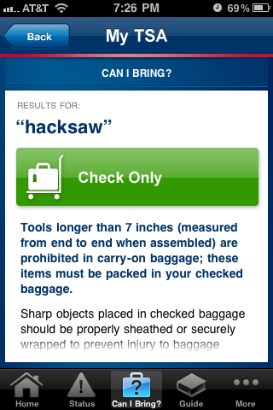
MyTSA “Can I Bring?” Feature on iPhone.

Slide 14
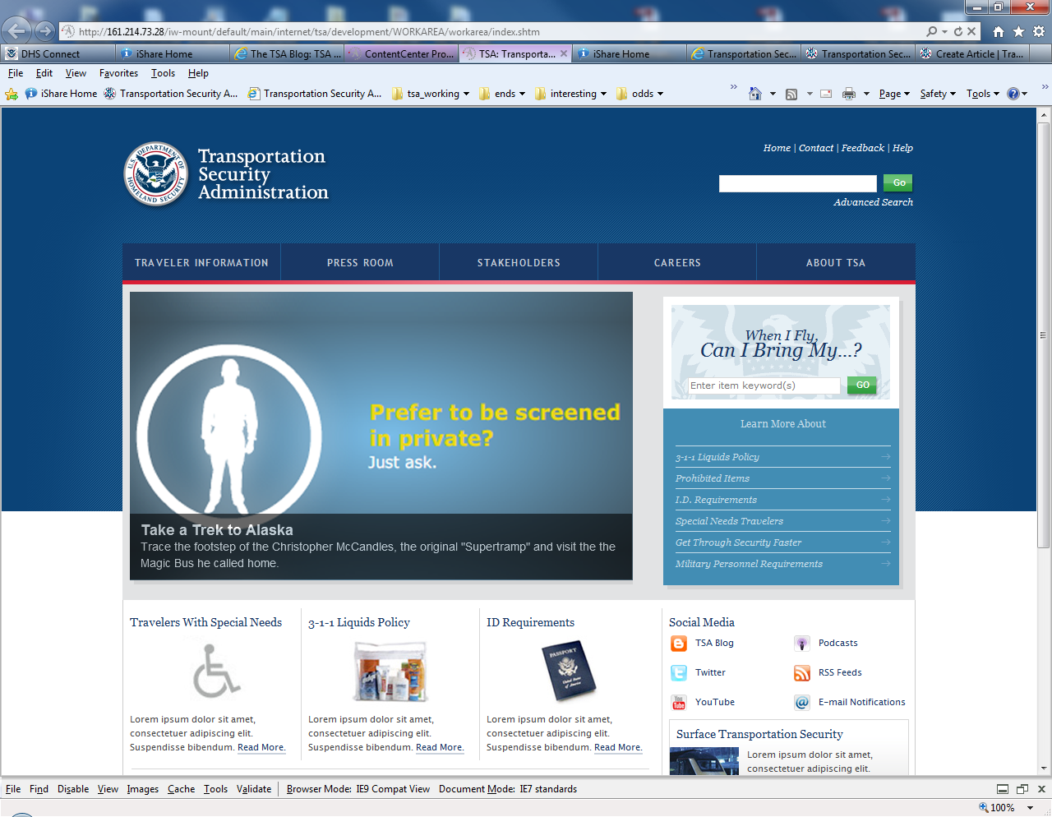
Can I Bring My…? feature on new TSA.gov. “Widget” can be placed on any website.

Slide 15
Thank You!

