Slide 1
Federal Risk and Authorization Management Program (FedRAMP)
FedRAMP Security Testing and Completing the Package
January 8, 2013

Slide 2
Today’s Webinar
FedRAMP is a government-wide program that provides a standardized approach to security assessment, authorization, and continuous monitoring for cloud products and services.
This webinar will cover the completion of the FedRAMP process from prepping for testing, completing testing, and documenting the results to submitting a complete package to the FedRAMP secure repository.
Notes:
Thank you <Introducer>. Good afternoon everyone. Thank you for taking the time to join us for FedRAMP’s webinar on completing the FedRAMP process and submitting your finalized package. [Katie] I am Katie Lewin, Director of the Federal Cloud Computing Program and [Matt] my name is Matt Goodrich and I’m the Project Manager for the FedRAMP Program Management Office. This webinar is the fourth in our series and will cover the completion of the FedRAMP process from security testing and documenting the results to submitting a complete package to the FedRAMP secure repository. During this webinar we will explain the importance of conformity assessment in the FedRAMP process and the role of Third Party Assessment Organizations (3PAO) in completing the security assessment and testing. We will also provide a high level look at planning for testing, documenting the results, and the process for remediating vulnerabilities found during testing. Additionally, were going to talk about how to finalize your security authorization package for submission to the FedRAMP secure repository and how to provide an overview of the lifecycle for that package. Before we begin the webinar, please submit questions as they arise – using the chat function. Members of the PMO will be taking a look at the incoming questions and answering them during the course of the webinar. We will respond to as many as possible while the webinar is in progress. If there are any questions that we are not able to get to, we will answer them later in the FAQ section on fedramp.gov.
[Click to next slide]

Slide 3
PAST EVENTS – Check Out Webinars 1 - 3
Notes:
Last webinar - reviewed the System Security Plan (SSP) and provide the information and guidelines that you need to accurately document the FedRAMP controls and assemble a strong SSP that will meet FedRAMP review requirements.
If this is your first FedRAMP webinar or if you missed any of the previous ones, I’d highly encourage you to go to FedRAMP.gov and view our past webinars which covered:
-Developing your System Security Plan.
-FedRAMP Security Authorization Process.
-Four Ways to Get Listed in the FedRAMP Repository.
Links to each of these webinars are available on FedRAMP.gov by clicking on News and Events in the left hand navigation and selecting “Materials from Past Events”
[Click to next slide]

Slide 4
Overview: Perform Security Testing
1.0
Security Assessment
1.1
Initiate Request
1.3.1
Develop Testing Plan
Leverage ATO
1.2
Document Security Controls
2.0
Ongoing A&A
1.3
Perform Security Testing
Audit Control Implementations
3.0
1.3.2
1.4
Finalize Security Assessment
1.3.3
Perform Vulnerability / Penetration Testing
Test SSP – Begin work with 3PAO
Assess against the SSP with NIST SP 800-53a test cases
3PAO audits assessment and results
3PAO generates security assessment report
1.3.4
Develop Plan of Action & Milestones (POAM)
Notes:
Before we move into the details, I would like to provide a high level look at the closing steps in the FedRAMP process, which include testing and submitting your package to the FedRAMP secure repository. The Perform Security Testing step requires the CSP to select a 3PAO to perform the assessment. The 3PAO is responsible for developing the Security Assessment Plan performing the testing, and documenting the results in the Security Assessment Report.
Vulnerabilities found during the assessment, and the plan to fix these vulnerabilities are documented in the Plan of Action and Milestones by the CSP. FedRAMP provides templates for the Security Assessment Plan, the Security Assessment Report, and the POA&M – they are available on FedRAMP.gov.
[Click to next slide]

Slide 5
Overview: Finalize Security Assessment
Initiate Request
Compile all Updated and Final Documentation
1.0
Security Assessment
1.1
1.4.1
Leverage ATO
1.2
Document Security Controls
2.0
Ongoing A&A
1.3
Perform Security Testing
Answer Questions Risk Assessment**
3.0
1.4.2
1.4
Finalize Security Assessment
Accept Findings & Make Updates to POA&M**
1.4.3
Compile Completed Authorization Package
Review all documentation
Review risk posture of CSP system
Grant / deny Provisional Authorization**
Upload to the Secure Repository
Accept Provisional Authorization**/ Upload to Secure Repository
1.4.4
** Steps only apply to packages submitted for JAB Provisional Authorization
Notes:
Following the conclusion of testing, any documents that need to be updated as a result of the testing are updated. The security package documents are then consolidated into a single package for submission to the secure repository. Unless the package is a CSP Self-Supplied package, all packages in the repository with have either an agency ATO or a FedRAMP Provisional Authorization. The FedRAMP PMO provides the CSP with access to the secure repository and provides a secure, access controlled section of the website for posting the security assessment package. Finally, the listing of packages available in the secure repository is updated to include the newly submitted package. The list is provided to allow agencies to view the packages available for leveraging. Access to the actual security assessment package is limited to Federal Agencies and requires permission from the FedRAMP PMO. CSPs with packages in the repository are required to implement a continuous monitoring program and submit periodic updates.
[Click to next slide]

Slide 6
Authorization Level and Testing
Category | Description | Authorization
1 | CSP Supplied, not yet reviewed | Candidate for Authorization
2 | Reviewed by agency | Agency ATO
3 | Reviewed by FedRAMP ISSO & JAB | FedRAMP PA & Agency ATO
Notes:
As you head toward testing, who performs the assessment depends on the category of your package. Package submitted by a CSP without an ATO and packages submitted for FedRAMP JAB Provisional Authorization require an accredited 3PAO. Federal Agencies have flexibility in whether or not the 3PAO they use is accredited when issuing an ATO. If an agency ATO was issued without the use of an accredited 3PAO, the Federal Agency must submit an attestation describing the independence and technical qualifications of the non-accredited 3PAO utilized to assess that CSP package. This diagram also illustrates that there is a higher level of government review at the JAB Provisional Authorization level. CSP’s that want to submit a package to the FedRAMP repository must use an accredited 3PAO whether they intend to obtain a JAB review and a Provisional Authorization, or simply want to list their not yet reviewed package in the repository. If the CSP intends to apply for a Provisional Authorization, as part of this process the CSP meets with a FedRAMP (Information System Security Officer) ISSO to discuss the testing process and must have their testing plans approved by the JAB and receive approvals to move forward with testing. At levels below Provisional Authorization, the FedRAMP PMO is not involved with providing approvals for testing.
[Click to next slide]

Slide 7
Overview of Independent Assessors
Develops Security Assessment Plan (SAP)
Performs Initial and Periodic Assessments of CSP Security Controls
Conducts Security Testing
Use Test Case Workbooks
Manual Tests
Automated Tests
Develops Security Assessment Report (SAR)
Assessor must be independent
Cannot test and help CSP prepare documents
Cannot test and assist CSP in implementing controls
Notes:
3PAOs have a very distinct role in the FedRAMP process. The 3PAO carries most of the responsibilities for the assessment, by developing the assessment plan (SAP) based on the FedRAMP Test Cases and the types of servers, applications and databases that make up the system. The 3PAO should develop the test plan to ensure that results represent in the Security Assessment Report represent an unbiased and accurate picture of the security implementation within the system. 3PAOs are required to demonstrate independence; this means that the same 3PAO cannot develop a system or prepare the security documentation for a system and also assess the same system. It is possible for a CSP to hire a 3PAO to assist in preparing the security documentation; however that 3PAO’s role cannot extend to planning, performing or documenting the results of an assessment. The CSP would need to hire a second, separate 3PAO to do the assessment work. Something to keep in mind is that if a CSP wants to hire an outside consultant to assist in the preparation of the security package, this outside consultant does not have to be a 3PAO.
[Click to next slide]

Slide 8
FedRAMP Third Party Assessment Organization (3PAO) Conformity Assessment Process
FedRAMP requires CSPs to use Third Party Assessment Organizations (3PAOs) to independently validate and verify that they meet FedRAMP security requirements.
FedRAMP worked with NIST to develop a conformity assessment process to qualify 3PAOs.
This conformity assessment process will qualify 3PAOs according to two requirements:
Independence and quality management in accordance with ISO standards; and
Technical competence through FISMA knowledge testing.
Benefits of leveraging a formal 3PAO approval process:
Establishes an approved list of 3PAOs for CSPs and agencies to choose from to satisfy FedRAMP requirements.
Creates consistency in performing security assessments among 3PAOs in accordance with FISMA and NIST standards
Ensures 3PAO independence from Cloud Service Providers in accordance with international standards
Notes:
In the previous slide you will notice that the most of the testing related activity is handled by the 3PAO. FedRAMP implements a conformity assessment process and requires the use of a 3PAO to ensure the assessors are independent and possess the technical knowledge to assess cloud systems. Conformity assessment also ensures that the process and level of rigor present are consistent across all assessments. FedRAMP worked closely with National Institute of Standards and Technology (NIST) to select the requirements for accredited 3PAOs. 3PAOs undergoing accreditation must meet the ISO/IEC 17020:1998 standard for bodies performing inspections in terms of independence and a quality management system. We also worked with NIST to develop requirements that demonstrate that the 3PAO has the technical knowledge to assess cloud systems based on FISMA requirements.
[Click to next slide]

Slide 9
Accredited Third Party Assessment Organizations
Notes:
A listing of all accredited 3PAOs is available on FedRAMP.gov. There are currently 16 accredited 3PAOs available. The list is updated as new 3PAOs are accredited.
[Click to next slide]

Slide 10
Relationship of 3PAOs and CSPs
CSPs must manage their own relationship with 3PAOs
FedRAMP does not make introductions
CSPs may interview multiple 3PAOs
Information on past performance
The number of FTEs required
Ensure the 3PAO has the right scanner licenses
Ask for a estimate for the time required to complete the assessment
Find out what services are included in the pricing
CSPs applying for Provisional ATO must:
Formally notify FedRAMP of their 3PAO selection
Receive permission before starting to test
Notes:
FedRAMP does not manage the relationship between 3PAOs and CSPs and cannot make a recommendation regarding which 3PAO a CSP should use. CSPs are responsible for choosing their own assessor. CSPs may consider interviewing multiple 3PAOs to find the assessor that’s the right fit. In selecting a third-party assessor, CSPs may want to ask the assessor for information on past performance, the anticipated number of FTEs required to assess the system, whether or not the CSP has the right scanner licenses, and how long the assessor believes it will take to complete the testing. CSPs should make sure that they understand what services are included in the pricing. CSPs applying for FedRAMP Provisional Authorization are required to formally notify FedRAMP after selecting a 3PAO in order to receive permission to proceed with testing. CSPs that plan to submit packages at other review levels do not need permission to test from FedRAMP.
[Click to next slide]

Slide 11
Developing the SAP
3PAO develops the SAP
Defines scope of assessment
Hardware
Software
Databases
Applications
Facilities
Testing Schedule
Rules of Engagement (ROE)
Components included and excluded in assessment
Rules for transmission of results
ROE signed by CSP and 3PAO
Notes:
We’ve talked about who can do the assessments and how to choose your assessor, now let’s put that to actions. How do you begin the testing phase to demonstrate your compliance with the FedRAMP security controls?
The 3PAO you select will develop the Security Assessment Plan which we refer to as the SAP. The SAP defines the scope of the assessment and identifies the components that will be included in the assessment, such as hardware, software, databases, applications and physical facilities. It also identifies the testing methodology and provides the test cases used for the assessment. The SAP contains a schedule outlining the timeline for testing and defines the Rules of Engagement for the tests.
The Rules of Engagement (ROE) describes the notifications and disclosures between the CSP and 3PAO. It includes a listing of components to be included and excluded from testing and provides instructions on how the results of the assessment are to be encrypted and transmitted to the CSP. The ROE is signed by both the CSP and 3PAO to signify agreement on the terms.
[Click to next slide]

Slide 12
Getting Ready for Testing – What to Expect
Prep to make sure testing goes smoothly
Provide three testing contacts to 3PAO
At least one contact available 24x7
Set up a meeting to discuss testing schedule
Obtain list of originating IP addresses for scans
Prepare list of facilities with addresses and directions
Have legal counsel review Rules of Engagement
Notes:
Even though 3PAOs manage and complete the testing, CSPs should prepare ahead of time to ensure that testing goes as smoothly as possible.
CSPs should give their 3PAO distinct points of contacts – actual people, not a general office number or support number. The CSP should provide at least three contacts and at least one of those contacts should be at an operations center such as a SOC or a NOC that is staffed 24x7.
The schedule for performing scans or penetration testing shouldn’t be a surprise to the CSP. 3PAO’s and CSPs should discuss the testing schedule so the CSP can ensure their 3PAO will have appropriate access to a CSPs environment and personnel as needed to complete the testing.
As a part of this, 3PAOs should provide the CSP with a list of the IP addresses where the scans will originate from so testing isn’t mistaken as a malicious attack.
Additionally, 3PAOs will need to access facilities to assess physical and environmental controls. CSPs should provide a list of facilities along with their addresses to the 3PAO. CSPs should ensure the staff at these facilities when they can expect the 3PAO to be on site to perform testing. Additionally, if there is information needed to grant 3PAO personnel with access to the facilities, the CSP should inform the 3PAO of these requirements ahead of time.
Finally, CSPs and 3PAOs need to review and sign off on a Rules of Engagement. These rules govern how the test will be conducted, and by completing this before beginning testing, both parties can prevent any interruption of a CSPs services. The ROE is negotiable and should be reviewed by the general counsel of both the CSP and 3PAO.

Slide 13
Developing the SAR
3PAO develops the SAR
Documents Findings
Analysis of Test Results
Highlights ways for CSPs to Mitigate Security Weaknesses
Primary Document for Making Risk Based Decisions
Notes:
After the 3PAO has followed the SAP and tested a CSP’s system, the 3PAO must develops a Security Assessment Report, referred to as the SAR. The SAR documents the test findings. In these findings, the 3PAO will provide an analysis of the test results to determine the risk exposure of the system.
The SAR also highlights ways for a CSP to mitigate the security weaknesses found during testing.
Since the SAR is a report on the overall risk the CSPs system poses, the SAR serves as the primary document that the JAB or leveraging Federal Agencies will review to make their decision in granting an authorization.
While the 3PAO has the sole responsibility for writing the SAR, we do recommend that the CSP and 3PAO schedule time to review the initial draft to ensure its accuracy before the SAR is finalized.
[Click to next slide]

Slide 14
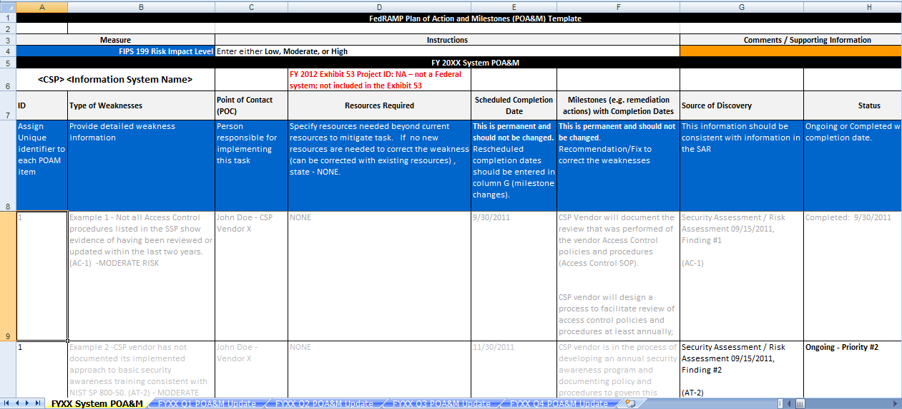
Developing the POA&M
SAR findings map to POA&M items IDs
False positives are not identified in the POA&M
CSPs applying for Provisional ATO:
Remediate high severity findings before Provisional ATO is granted
Remediate moderate findings within 90 days
CSP develops the POA&M
Detailed Schedule of Actions to Address and Fix Vulnerabilities
POA&M Template Contains Excel Spreadsheet for Tracking POA&M Items
Notes:
After finalizing the SAR, the CSP uses the vulnerabilities and recommendations in the SAR to create a Plan of Action and Milestones, simply referred to as POAMs. The POA&M provides a detailed plan with a schedule of how the CSP plans to address and fix and vulnerabilities found during testing.
[Click]
The POA&M template on FedRAMP.gov contains an embedded Excel spreadsheet that CSPs should use to track and manage their POA&M items.
In this spreadsheet, a CSP will have unique IDs for each POAM, a description of weakness found during testing, and details about when and how the POAM will be closed. POAMs will be updated on a continual basis during the course of a security authorization, and at no less frequency than every quarter, but may be updated at any time to reflect the addition of a new vulnerabilities or the closing of a POA&M item.
Subsequent workbooks in the POA&M are used to track overdue items during POA&M updates.
[Click]
A few things to remember when developing your POA&Ms are:
-All SAR findings must map to a POA&M item. This is accomplished by giving each POA&M item with a unique identifier which pairs with the respective SAR finding.
-False positives should be clearly marked in the SAR, but do not need to be identified in the POA&M – as there is no remediation needed to correct these false positives.
-CSPs that apply for FedRAMP Provisional Authorization are required to remediate all high severity risk findings before the JAB will grant a Provisional ATO. CSPs must also remediate moderate findings within 90 days after receiving a Provisional Authorization.
[Click to next slide]

Slide 15
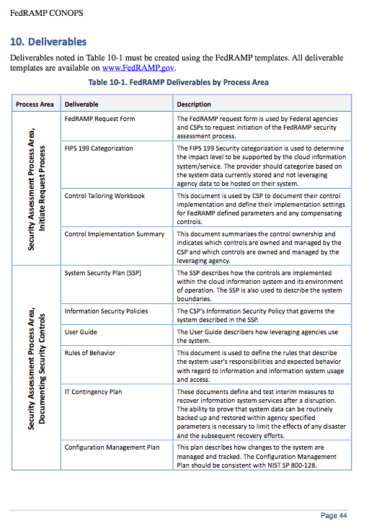
Preparing Package for Submission
A complete security authorization package includes deliverables in section 10 of the FedRAMP CONOPS
Mandatory Templates:
System Security Plan
Security Assessment Plan
Security Assessment Report
Other Templates located on fedramp.gov:
Control Tailoring Workbook
Control Implementation Summary
IT Contingency Plan
Plan Of Action & Milestones
Supplier’s Declaration of Conformity
Notes:
After finalizing the SAR and POA&M, it’s time to compile and submit your complete security authorization package. Your final Package should include:
Control Tailoring Workbook – identifies controls that have been adapted by the cloud service provider
Control Implementation Summary – identifies who is responsible for each security control
These two documents are extremely helpful for agencies leveraging an authorization because they detail in a summary fashion what a customer’s responsibility is in securely using a CSPs services as well as what a CSP does differently in meeting the FedRAMP security controls.
System Security Plan – this is the “rosetta stone” and foundational document for your security authorization - describes the system and the security controls used to protect the system.
There are also supporting documents to the SSP, and they include:
IT Contingency Plan - details how the recovery of the system occurs in the case of a disruption of service.
Configuration Management Plan – identifies how the CSP makes routine changes to their operating environment.
Incident Response Plan – explains provider actions in response to a security incident.
And the focus of this webinar has been on the final documents needed to complete your security authorization package:
Security Assessment Plan - describes the assessment methodology followed by the 3PAO to test the controls
Security Assessment Report - contains the 3PAO’s completed test case results, collected evidence, analysis and report on the implementation of controls.
Plan Of Action & Milestones - documents planned actions by the provider to change or implement security controls based on their independent assessment.
Self-Attestation Declaration of Conformity states that the package represents a true and accurate depiction of the system.
[Click to next slide]

Slide 16
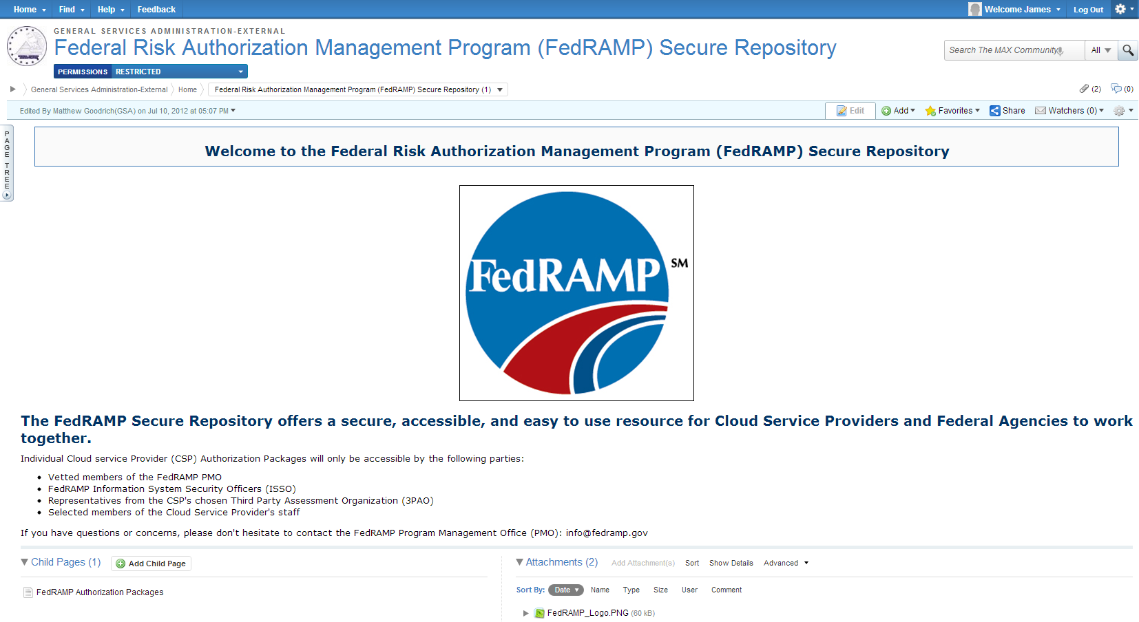
Preparing Package for Submission (Continued)
Review and update documents
FedRAMP will provide instructions on uploading documents to the secure repository (Max.gov)
Add sensitivity markings to package documents
Change to match company designation
Place markings in other sections as needed
Notes:
Before submitting all documentation, CSPs should review their documents, with a special focus on the System Security Plan, and ensure that they are up to date and reflect any changes made in either remediating vulnerabilities or in response to findings.
Updates to all documents should include adding sensitivity markings on the cover page and the footer of each document. You may change the existing sensitivity marking on any template to match your official company sensitivity nomenclature if it is different than what is on the template. Sensitivity markings may also be placed in the headers of any documents and on any other places in the documents that you feel requires sensitivity labeling.
Depending on the assessment level of your package, either the PMO or a FedRAMP ISSO will work with the CSP and provide instructions on accessing and uploading the package into the FedRAMP secure repository. CSPs should be aware that Federal Agencies interested in acquiring their services will be able to request access to the secure repository to view the CSP’s package.
[Click to next slide]

Slide 17
Declaration of Conformity
CSP attests and verifies that the system conforms to FedRAMP requirements.
Certifies that all controls are working properly
Both JAB and leveraging agencies use the Self-Attestation Declaration of Conformity when considering issuing an ATO
Notes:
Once a CSP has finalized all documents and double checked for accuracy, the last step in submitting a final package is for the CSP to include a self-attestation declaration of conformity letter.
This letter attests and verifies that the system conforms to the FedRAMP requirements based on the assessment results and also certifies that all implemented controls are working.
FedRAMP provides a declaration of conformity letter template on page 6 and 7 of the self attestation template on FedRAMP.gov. CSPs should edit the declaration by putting in their company name and address, fill in the system name and then have an authorized company official sign and date it.
The declaration of conformity is the document that the CSP system owner signs off saying that all of the information being presented to FedRAMP is complete and accurate.
[Click to next slide]

Slide 18
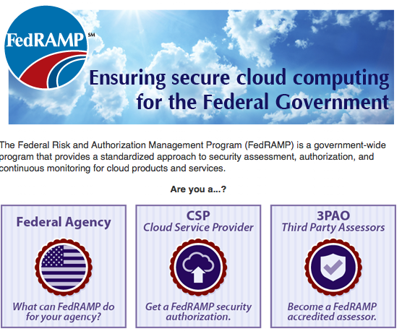
How does an agency use a package in the repository?
Complete and Submit a FedRAMP Package Access Request Form
Supervisor Must Sign Off on Form
FedRAMP will Provide Notification of Acceptance or Rejection of Request
Must Demonstrate a Need to View the Package
Agency Authority to Operate (ATO)
Agencies must implement customer responsibility controls and grant an Agency ATO for the information system residing on the cloud service
Leveraging Agencies search the repository and find:
Provider
Date Listed
Category
Agency ATO (if applicable)
Agency can Request Access to Any Package
Vendors Limited to Area for Storing Their Documentation
Notes:
Agencies interested in leveraging a package will be able to search the repository for services that meet their requirements. Only Federal Agencies will be able to request access to a security package in the repository. A vendor’s access to the secure repository is limited to the areas for storing their own respective documentation.
[Click]
To access a package listed in the repository, the user at the agency must complete a FedRAMP Package Access Request form, have their CISO sign the form, and submit the form to the FedRAMP PMO. After FedRAMP receives the form, the PMO will perform a review and provide notification of accepting or rejecting the request.
[Click]
To leverage the package, agencies must implement customer responsibility controls and grant an Agency ATO. CSPs with packages in the secure repository are required to maintain a continuous monitoring program which provides for periodic reporting on control implementations, POAM resolution, and annual re-testing. Further details about Continuous Monitoring are available on FedRAMP.gov in the FedRAMP Continuous Monitoring Strategy & Guide.
[Click to next slide]

Slide 19
Webinar Summary
Use a 3PAO to develop the test plan (SAP), perform testing, and document results (SAR)
FedRAMP requires the use of 3PAOs to provide an independent assessment of the system
CSP leverages SAR to develop POA&M
CSP updates documents then submits to secure repository
CSPs must implement a continuous monitoring program and keep package current
Notes:
In summary, the perform testing step of the FedRAMP process introduces the independent assessor to the process. CSPs must use a 3PAO to plan the test and develop the SAP, perform the assessment, and document the findings in the SAR. This is a requirement for FedRAMP rooted in the FedRAMP security controls baseline. CSPs must use a 3PAO to provide an independent assessment of the CSP’s system.
While agencies have flexibility in selecting a 3PAO, FedRAMP recommends the use of FedRAMP accredited 3PAOs because the FedRAMP accreditation program ensures accredited 3PAOs are independent, have the knowledge to assess cloud systems, and that the assessment is consistent in terms of the process and level of rigor. The CSP will work closely with a 3PAO to assess their system and then uses the findings in the SAR to develop a plan of action for remediating any vulnerabilities in a CSP environment.
After completion of the testing process, the CSP updates all the security documentation and submits it as a single package ready for authorization.
FedRAMP will post the packages to the FedRAMP secure repository based on the level of review and authorization granted.
Only federal Federal Agencies will have access to CSP security authorization packages in the secure repository.
To remain in the repository, CSPs must implement a continuous monitoring program and update security documents in accordance with the FedRAMP Continuous Monitoring Strategy & Guide.
[Click to next slide]

Slide 20
Question and Answer Session
For more information, please contact us or visit us at any of the following websites:
http://FedRAMP.gov
http://gsa.gov/FedRAMP
Email: info@fedramp.gov
@ FederalCloud
Notes:
This completes our fourth webinar, covering the basics of testing and finalizing security package.
We would now like to open the session up for questions.
To ask a question, please use the chat dialog box within the GoTo Meeting. We will do our best to answer all questions asked, but if we do not get to your question, we will review all of the questions and ensure they are answered on FedRAMP.gov. Please restrict your questions to the topics addressed in this webinar. At the conclusion of the webinar we will go over the list of upcoming webinars that will address other common questions regarding FedRAMP.
As always, you can also submit questions to info@FedRAMP.gov. Your questions will be anonymous, so please ask away.

Slide 21
For more information, please contact us or visit us at any of the following websites:
http://FedRAMP.gov
http://gsa.gov/FedRAMP
Email: info@fedramp.gov
@ FederalCloud

